Slide 1



Local Area Energy Planning:
Overview & Impact
North East & Yorkshire Net Zero Hub
Darlington
12th October 2023

Slide 2











Accelerating Net Zero energy innovation
Our unique energy system expertise and capabilities spanning consumer research, design, engineering, modelling and innovation
Homes
Sites
Place
Whole Systems
& Networks
Energy Launchpad & International

Slide 3

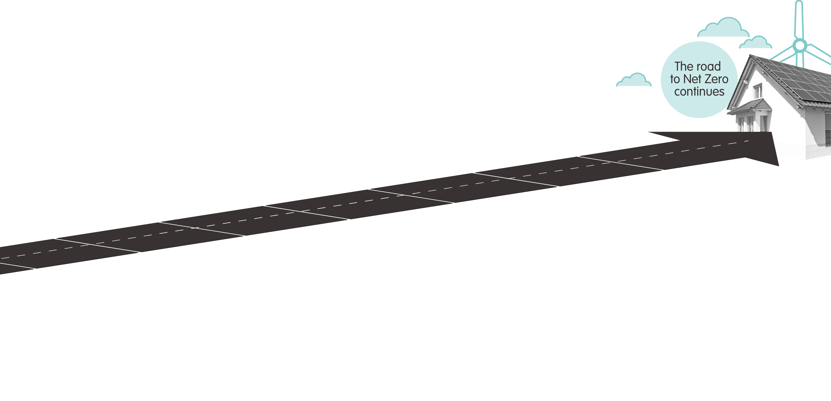








What is a Local Area Energy Plan (LAEP)?
“
A whole energy system approach led by local government, with key stakeholders.
It identifies the most cost-effective integrated plan for the local area to contribute to timebound national and local net zero targets.
7
6
5
Create the plan
Identify
Actions, priorities,
projects & decisions
4
Choose
Pick your future pathway
3
2
Model
Get your options for
the future
Map
Understand your
current local area
1
Engage
Identify key stakeholders
and start conversations
Prepare
Outline area hopes,
ambitions, and get
ready to mobilise

Slide 4

Local Authorities are seeing the impact...
“We are defining a project pipeline for the pilot scheme with UK Infrastructure Bank (UKIB) and building programmes of work based around the LAEP outputs.”
“The plan has been identified as a key piece of evidence in the preparation of the Council’s forthcoming strategic Local Plan, alongside a Green Infrastructure Strategy.”
“The LAEP supports timely delivery of new housing and commercial development required for our area which has significant infrastructure challenges”.
“We used the LAEP outputs to identify and accelerate feasibility studies for EV infrastructure and solar project development…and found that 80% were commercially viable opportunities.”

Slide 5






LAEP can drive significant benefits for stakeholders
Drive coordination of policies and an evidence base
Align and de-risk investment at scale
Provide confidence for big decisions
Drive stakeholder coordination, learning from pioneers

Slide 6
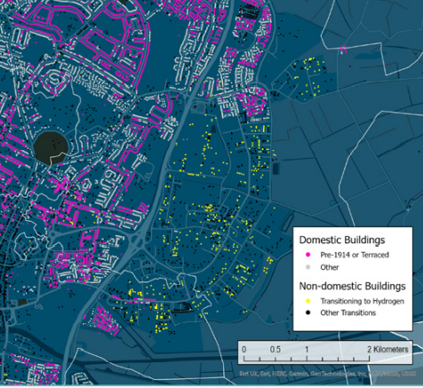
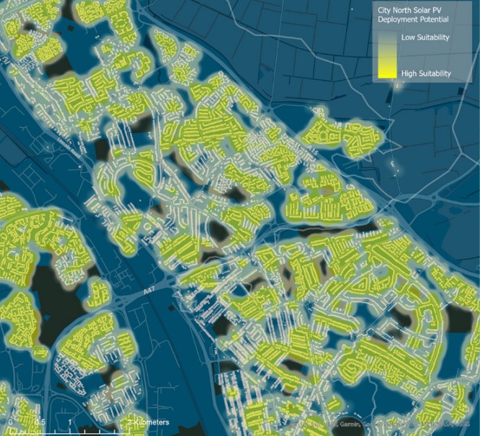
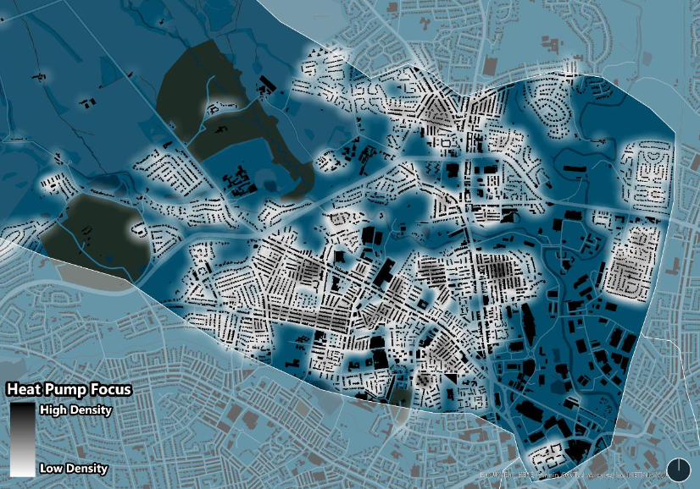
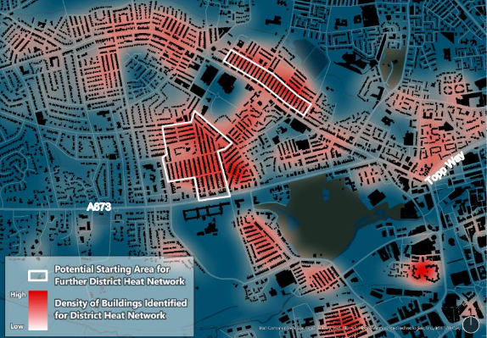
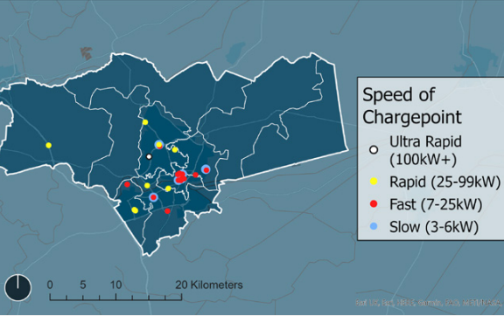
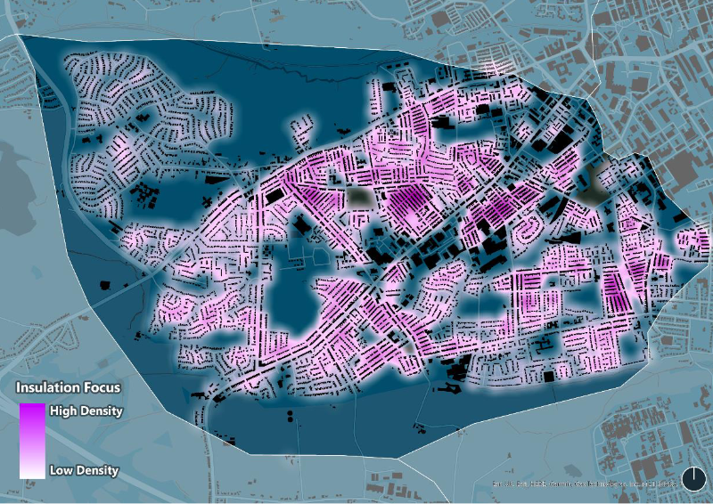
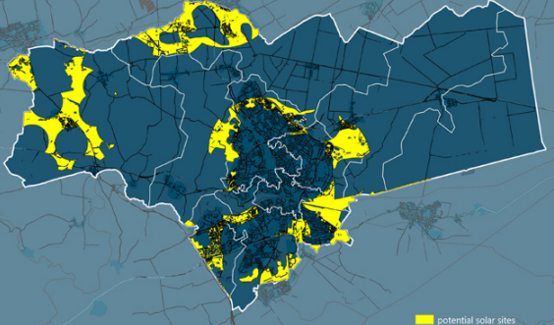
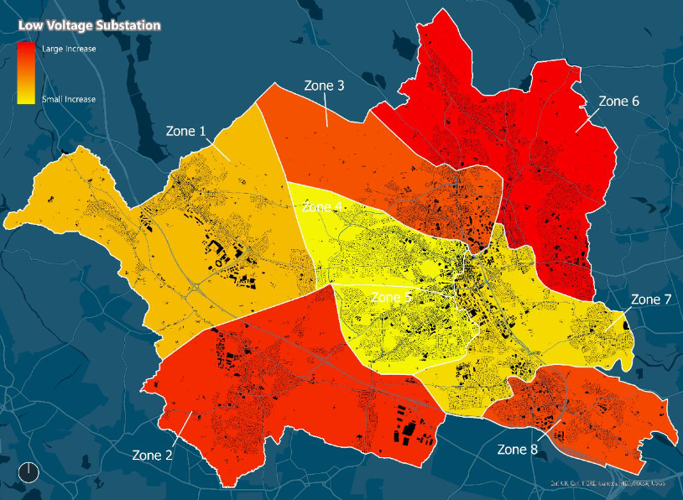
LAEP Output Examples:
Hydrogen opportunity area
Domestic rooftop PV focus zone
Domestic heat pump focus zone
Heat network focus zone
Energy network impact
Public EV charging hubs
Fabric retrofit focus zone
Large scale renewables opportunity areas

Slide 7
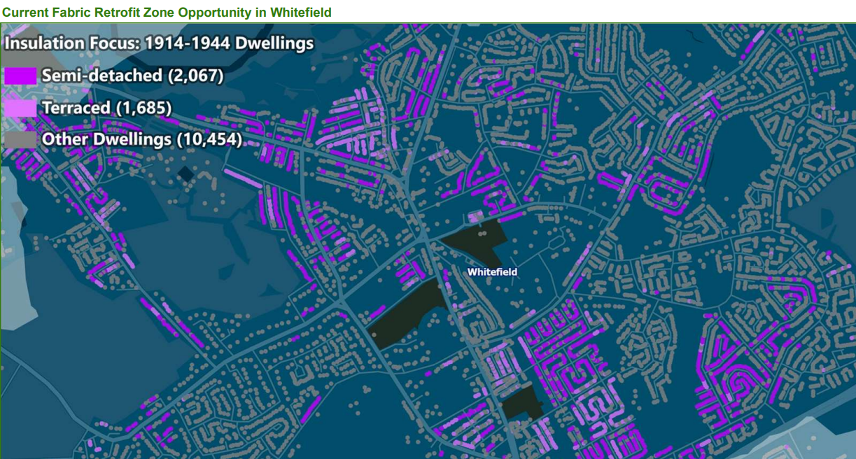

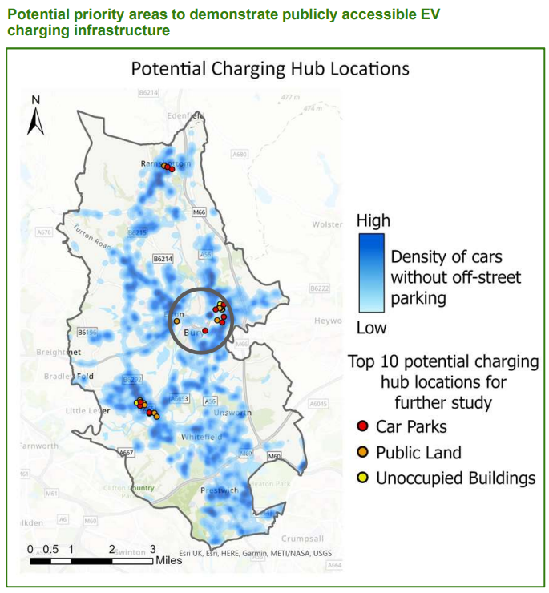
Providing Greater Manchester with a plan to deliver Net Zero
A plan for each of the 10 districts for 2038 carbon neutrality
Near term opportunities; 140,000 domestic retrofits; 4.5GW solar, EV charging, heat networks…
Visibility of total investment, e.g. £5.1bn in Bolton across all technologies and the network by 2038
Catalysing private sector funder and developer interest, and political traction
Informing the trailblazer devolution deal and creation of in-house capacity
“The LAEP work undertaken is powerful because it identifies not just the type of technologies that will be needed for this transition, but their scale, indicative locations, and costs.”
Mark Atherton, Director of Environment, GMCA

Slide 8


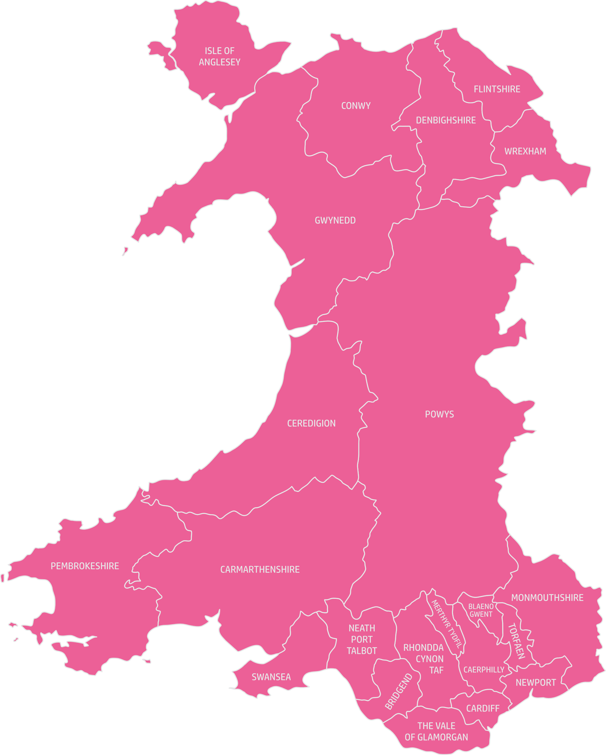

Helping shape a Welsh national Net Zero energy plan
The Catapult is advisor to Welsh Government on the rollout of all LAEPs in Wales, advising on procurement, management, and quality in delivery
LAEPs across 22 local councils
The Catapult is directly delivering two mid-Wales LAEPs
Helping Wales produce a National Energy plan informed by the 22 LAEPs
“It has been very helpful to draw on the breadth of whole energy system expertise at the Catapult to develop energy scenarios for Wales. With the support of the Catapult as our Technical Advisor we aim to be the first nation to have complete coverage of Local area energy plans.”
Huw Lewis Welsh Government
Lead for LAEP

Slide 9



















The Catapult’s Local Area Energy Plan timeline.
2013/14
2020
2022
2018
2021
2023
Key
Concept / guidance development
Technical advisory
LAEP delivery

Slide 10
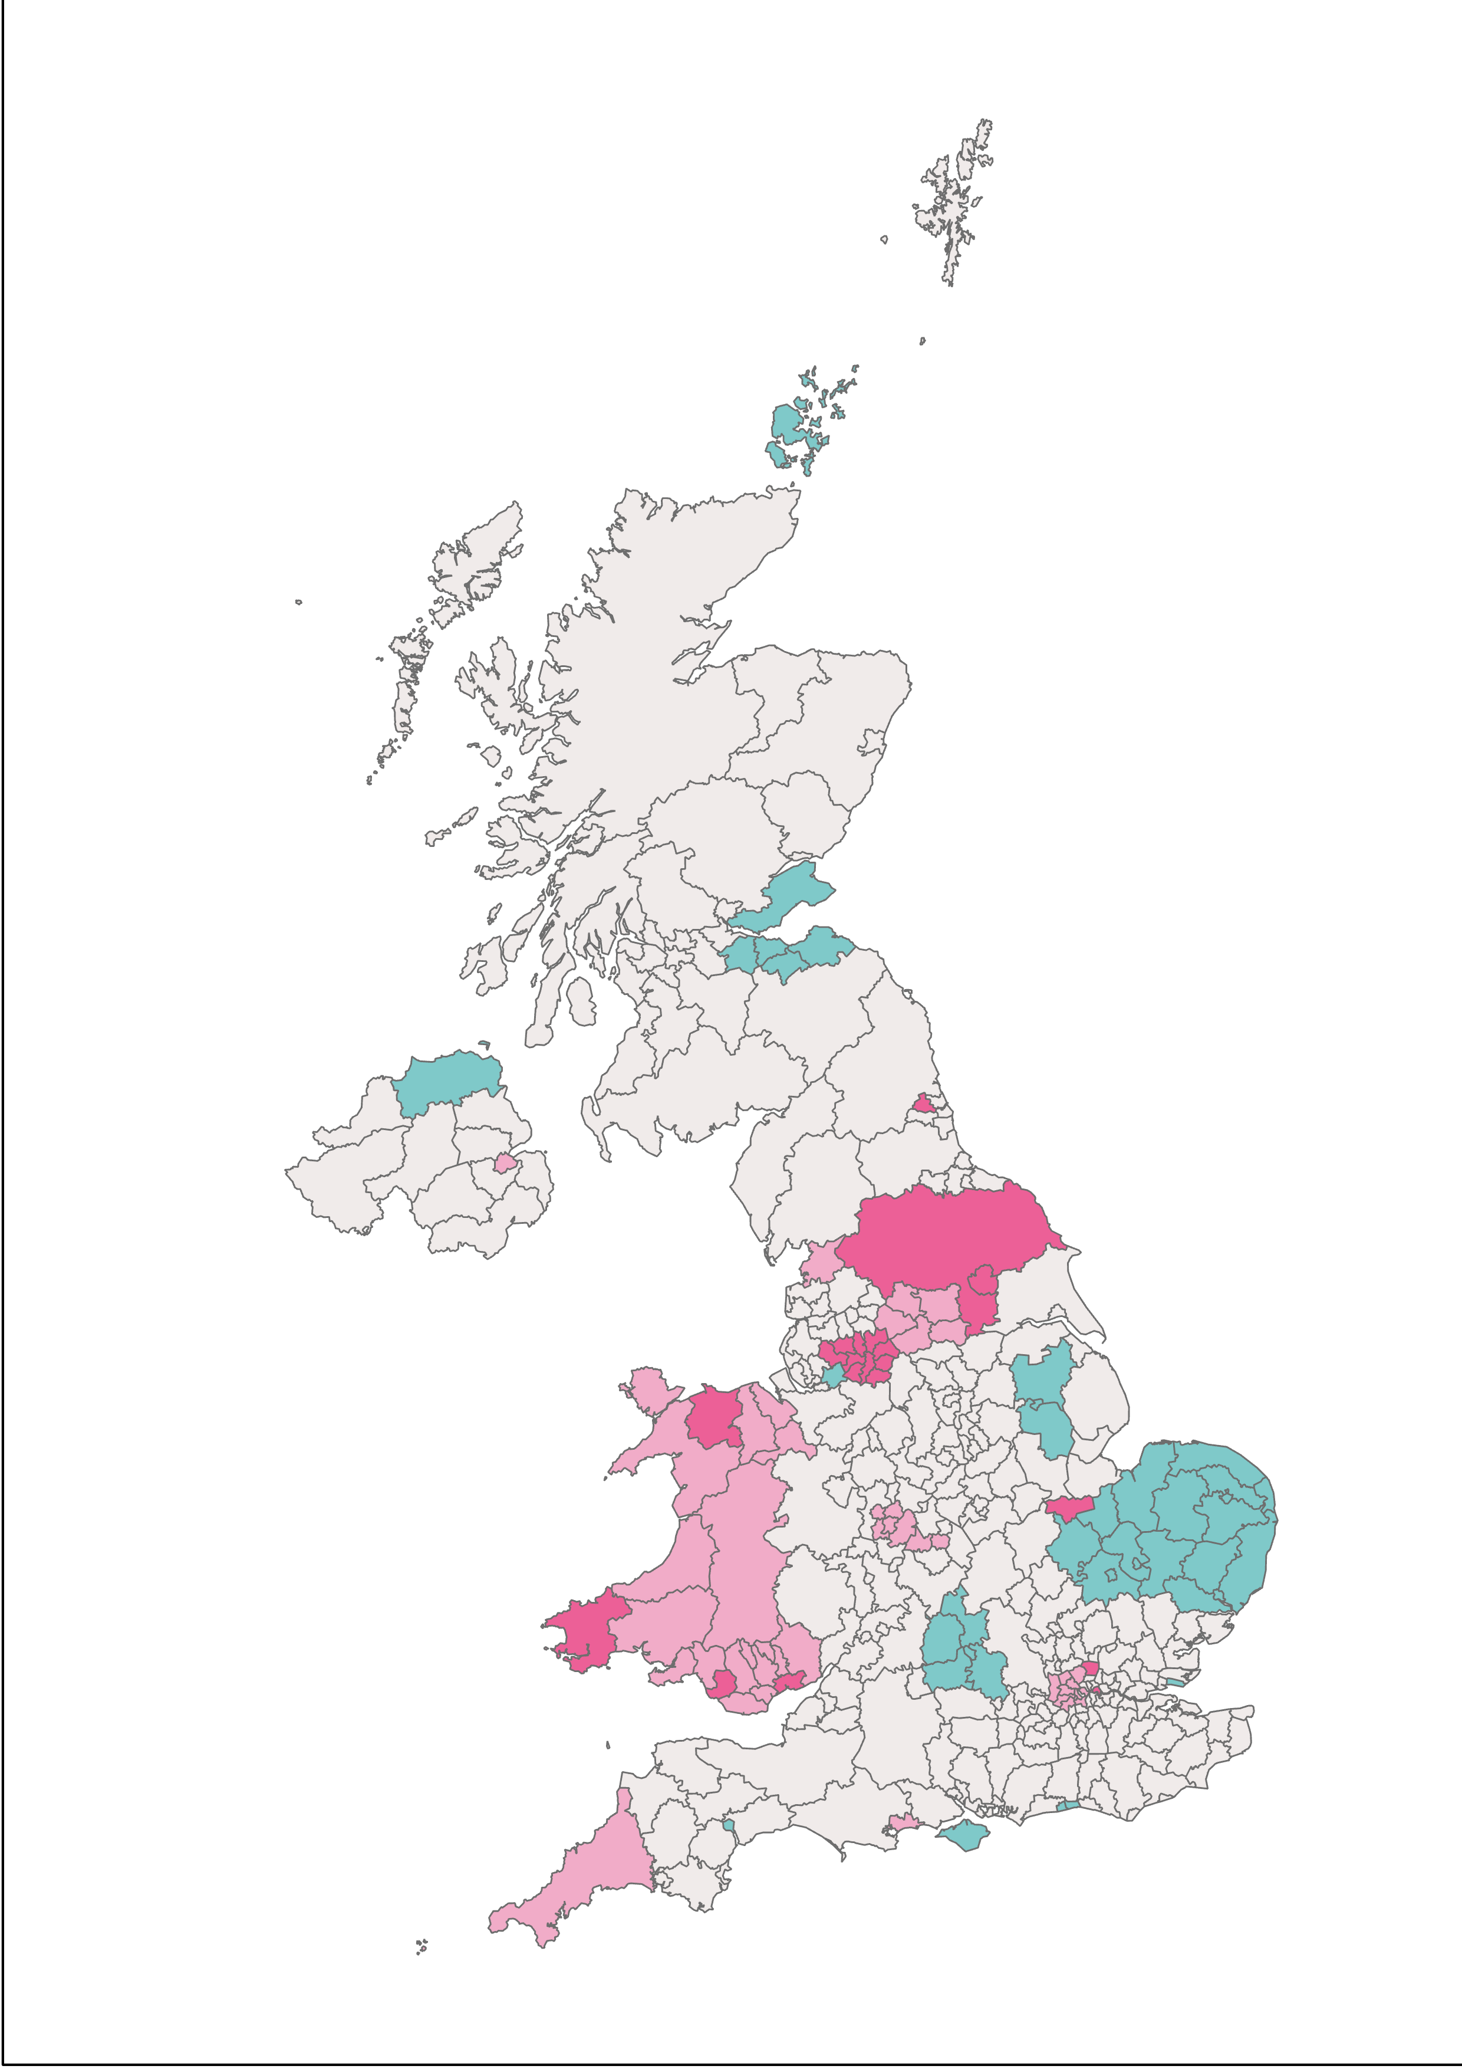



85% of local authorities in England & Wales have declared a climate emergency.
Nearly 17% of local authorities in the UK have, or are developing, a Local Area Energy Plan*.
Local Area Energy Plan - Completed
Local Area Energy Plan - In progress
Local Energy Asset Representation (a LAEP building block) - Completed
*Sept 2023

Slide 11

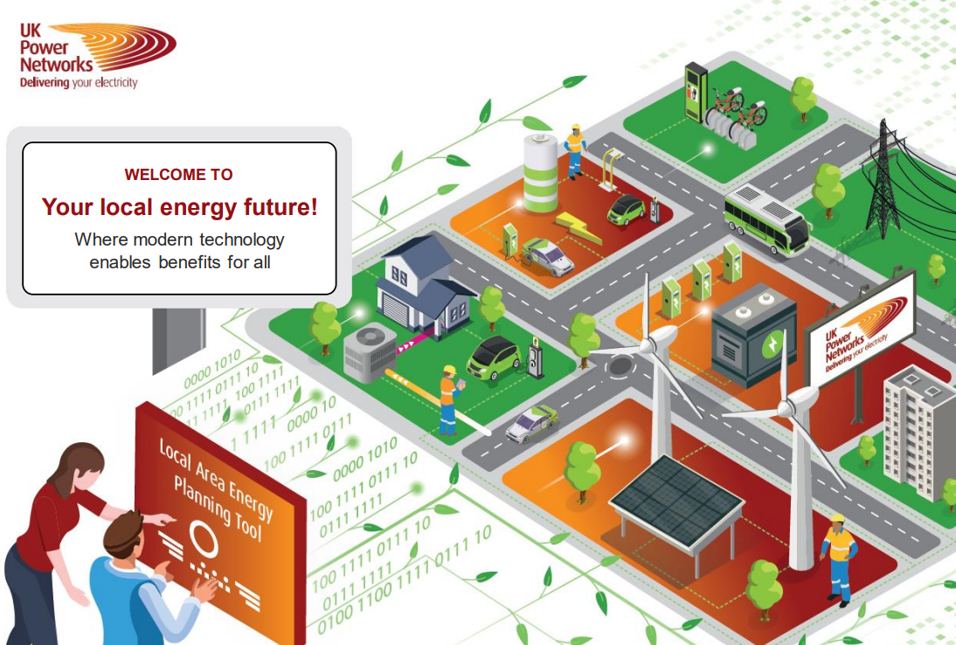
Data led self service tool to support LAEP
A digital tool prototype has been launched: Your Local Net Zero Hub which supports modelling and visualisation of local net zero plans.
It enables local authorities to layer local inputs such as decarbonisation strategies, local action plans, local market trends, social inclusion policies and transport plans overlaid with the DNO’s Distributed Energy Future Energy Scenario(s) and plans.

Slide 12


Download the report:

