Slide 1
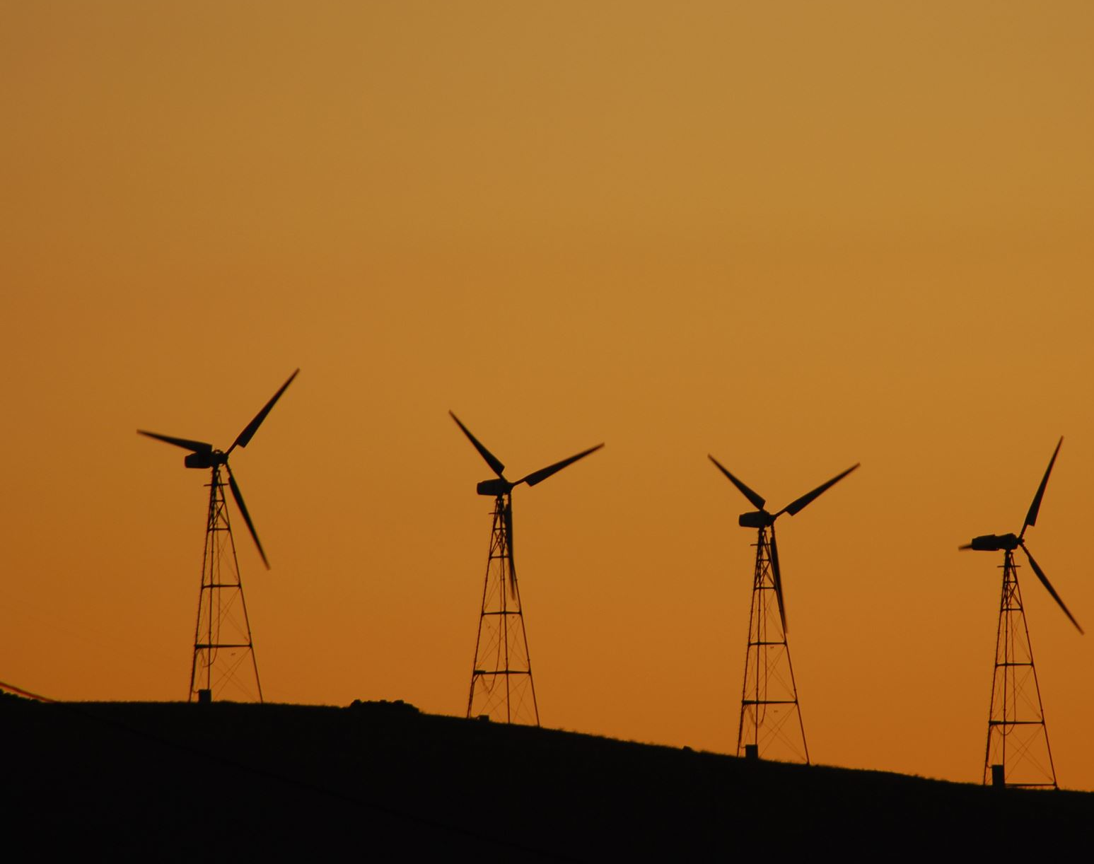

What part does Community Energy play in Local Area Energy Planning?
Abbie Raynes – Net Zero Hub Project Manager

Slide 2
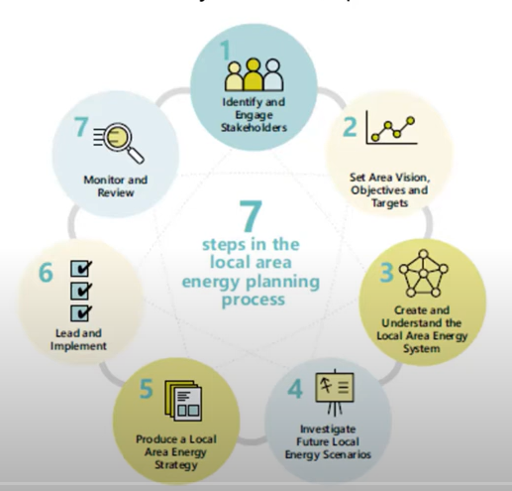
Where does Community Energy fit into Local Area Energy Planning?
Community Energy groups are key local stakeholders.
Groups/project sponsors know the area/landscape better than most.
Community Energy projects are a crucial element of future energy scenarios.
Community Energy groups already leading on innovative and impressive projects.
Feedback from groups can help to identify what needs to change/what is working well.
Energy Systems Catapult – 7 steps in the LAEP process
Notes:
CE groups are key local stakeholders who cannot be ignored, they hold valuable insight, experience, and ideas.
Groups/project sponsors know the area/landscape better than most which can help influence future land-use and planning.
CE projects are a crucial element of future energy scenarios, they are already working hard to increase capacity.
CE groups already leading on innovative and impressive projects – what good looks like, lessons learned, scalable projects, replicable projects.
Feedback from groups can help to identify what needs to change/what is working well.

Slide 3
What are the benefits of involving Community Energy in Local Area Energy Panning?
Community Energy groups have ‘on-the-ground’ experience.
Keeping communities involved and up-to-date can make planning processes more streamlined
Wealth of pre-existing knowledge and expertise (project knowledge, tech, landscape)
Avoiding the duplication of key research already being carried out by Community Energy groups
Opportunity to scale-up or duplicate pre-existing successful Community Energy projects
Passionate people keen to make a difference locally.
Overall reduction of demand as some communities already using energy produced from Community Energy projects
Education and awareness raising, driving of local interest

Slide 4
What are the barriers to Community Energy Groups being involved with Local Area Energy Planning?
Resource for groups.
Local Authority engagement with groups and capacity constraints.
DNO grid connection constraints.
Often a lack of collaboration within an area, so work can be duplicated/missed.
Big corporations undercutting local operators.
Burn out of local energy groups due to ongoing barriers.
Liaising with larger stakeholders.
Policy sets the tone for Community Energy.
Notes:
Resource for groups – time, funding, technical expertise, etc.
Local Authority engagement with groups – officers are stretched as it is, and there’s not often one designated officer for CE.
DNO grid connection constraints – groups struggle to get projects off the ground due to unknown connection times, prices/landscape can change by the time the connection is approved.
Often a lack of collaboration within an area, so work can be duplicated/missed.
Big corporations undercutting local operators.
Burn out of local energy groups due to ongoing barriers.
Liaising with larger stakeholders.

Slide 5
What can be done to overcome these barriers?
Local Area Energy pilots with Community Energy at the heart of delivery.
Wider stakeholder roundtables.
Lobbying.
Best practice and lessons learned shared between groups delivering similar projects, and between Local Authorities.
A designated Local Authority officer to catalyse and champion for Community Energy.
Upskilling within Local Authorities and Community Groups.
Stronger communication from DNOs and large stakeholders.

Slide 6
How is the Hub supporting Community Energy?
Rural Community Energy Fund
Energy Project Enabling Fund
Community Energy Workstream 23-25
Community Energy Fund

Slide 7
Rural Community Energy Fund
The Rural Community Energy Fund (RCEF) was a £10 million programme which supported rural communities in England to develop renewable energy projects which provided economic and social benefits to the community. The RCEF programme closed in March 2023.
This programme was a national fund delivered by all 5 local Net Zero Hubs.
RCEF provided support in 2 stages:
Stage 1: grants up to £40,000 for a feasibility study
Stage 2: Grants of us to £100,000 for business development and planning or feasibility schemes.
The NEY Hub received:
41 applications for stage 1 funding, with 31 being successful, with an overall grant offer of £1,013,165
13 applications for stage 2 funding, with 10 being successful, with an overall grant offer of £699,380.

Slide 8
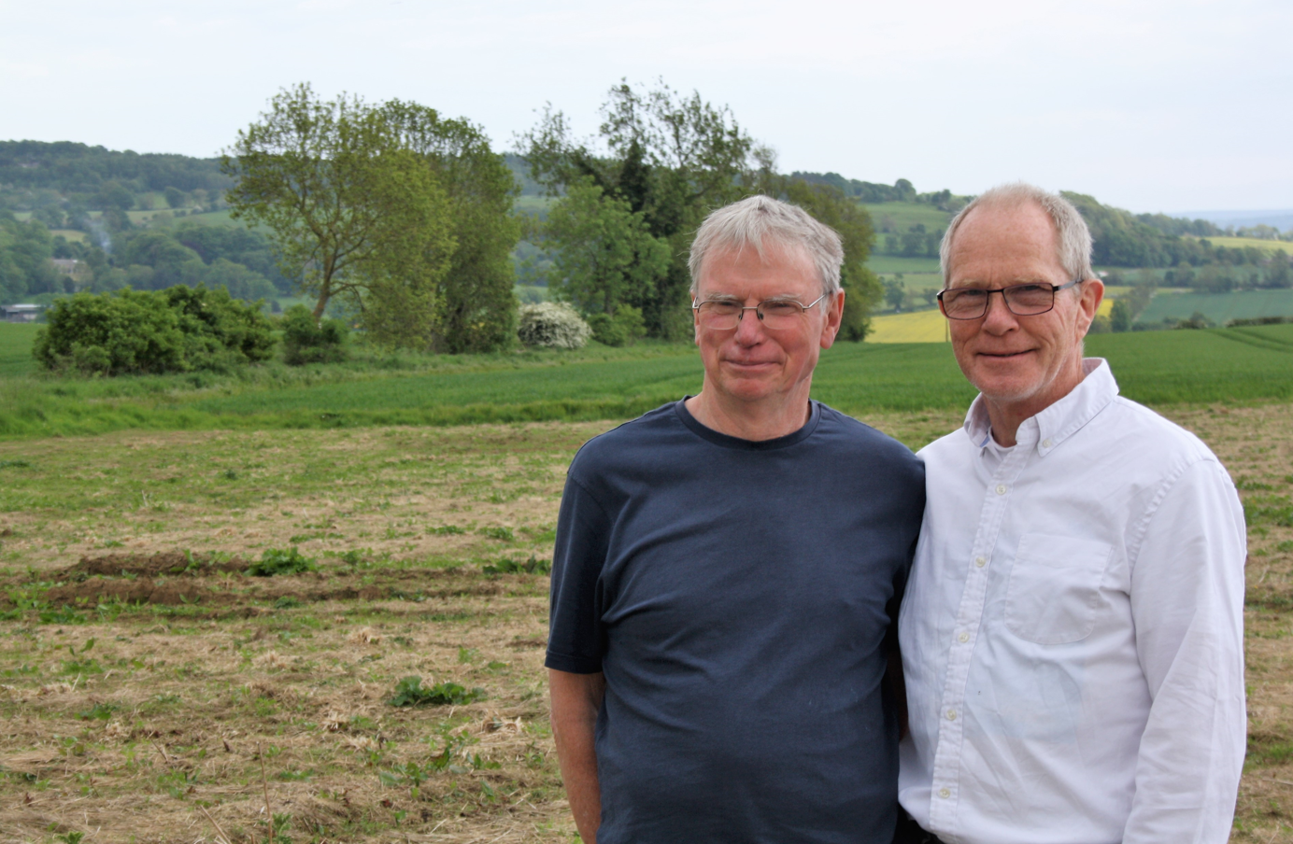
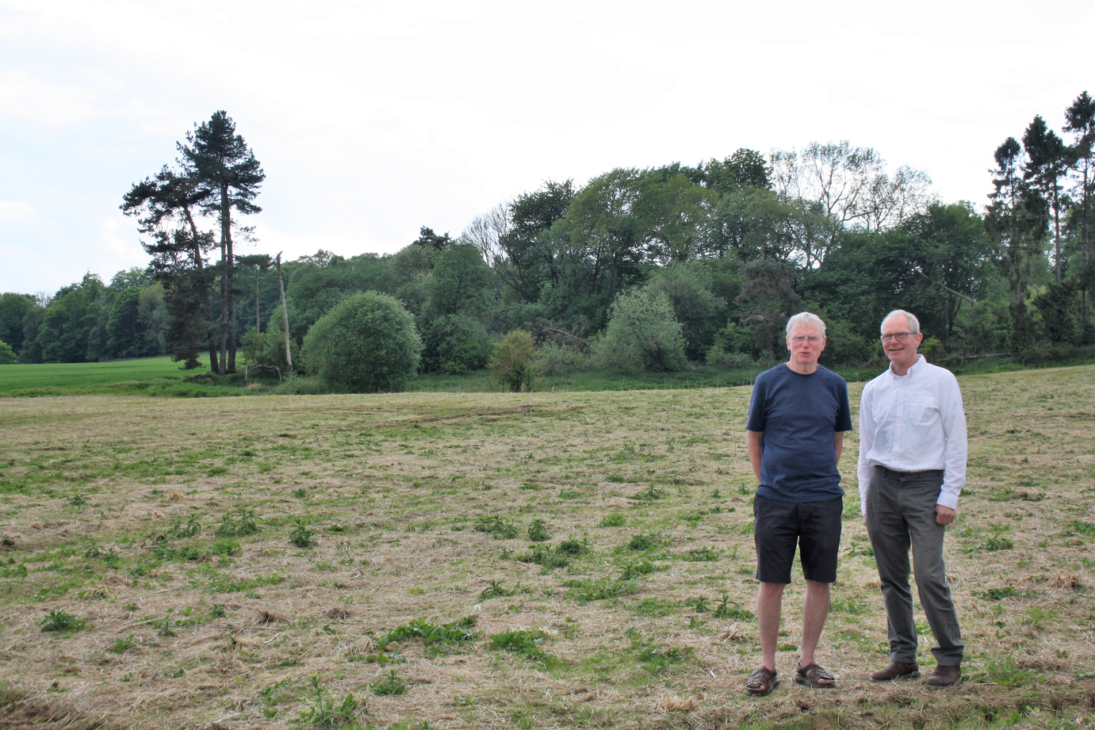
RCEF Case Studies
Humshaugh Net Zero CIC
Humshaugh were successful for both stage 1 and stage 2 funding, with an overall grant award of £104,000 to develop their community solar project.
Humshaugh Net Zero CIC was formed to foster activities that would achieve Net Zero carbon emissions by 2030 in line with Northumberland County Council targets.
With over 50 members, in a parish with about 350 households and a population of 600, their RCEF project identified an opportunity to develop a PV project on low grade agricultural land within Humshaugh parish.
The project will supply the equivalent amount of electricity used by 150 households.

Slide 9
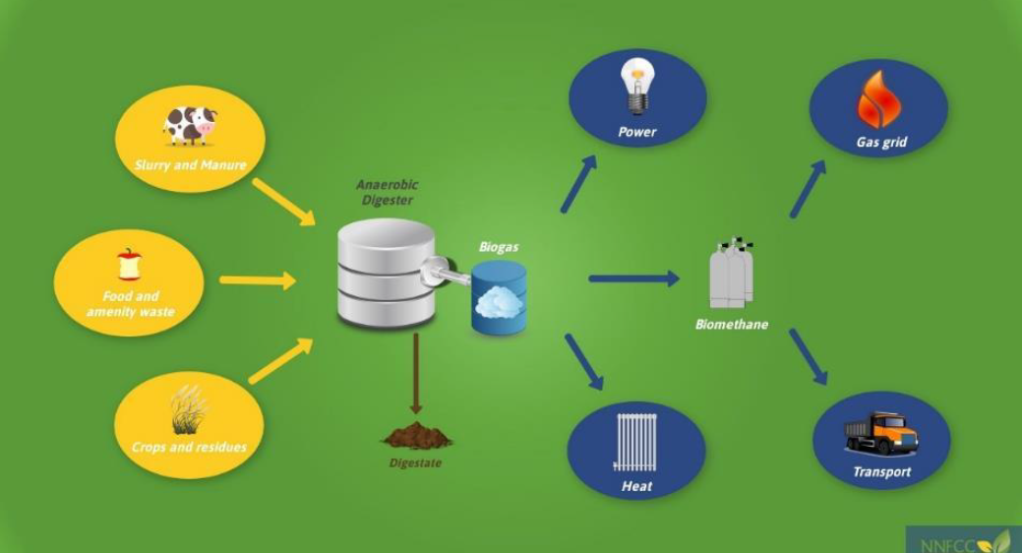

RCEF Case Studies
Circular Malton and Norton CIC
Circular Malton were successful for both stage 1 and stage 2 funding, with an overall grant award of £140,000 to develop their Mixed Feedstock Anaerobic Digestor.
Circular Malton’s development project has focused on developing an anaerobic digester in two towns to help break down biodegradable material to create renewable energy.
It is envisaged the project will create local jobs, local businesses will improve their carbon footprint and any surplus generated from this project will be reinvested into future energy excellence projects in the area.
The community has rallied behind the project, with 78% of local people coming out in favour of the ideas. Projections also show it is likely to create a minimum of 14 new local jobs. Those behind the project hope it will be a beacon for educating visitors on the circular economy, championing ‘Zero food waste from Yorkshire’s food capital’.

Slide 10
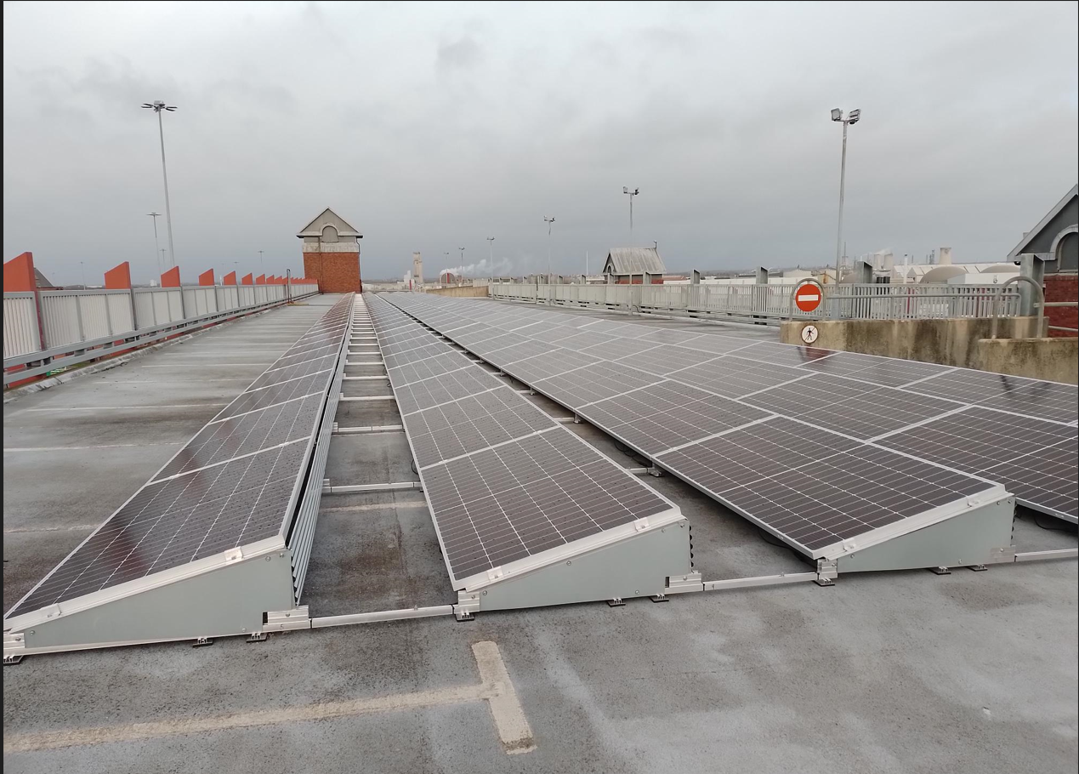
Energy Project Enabling Fund Round 1
The first round of the Energy Project Enabling Fund (EPEF) was a £400,000 investment scheme providing capital grants to a range of organisations across the North East and Yorkshire Net Zero Hub’s geography to support the delivery of energy projects.
Grants of between £10,000 and £50,000 were available to eligible public sector organisations, community groups, charities and businesses, wanting to deliver local energy projects for communal or public benefit.
Round one attracted a lot of interest, especially from local authorities and community energy groups with 57 applications received, with a total grant request of £1,756,913.48.
19 successful applications with a grant allocation of £476,449.90.
Zetland Carpark - Middlesbrough

Slide 11
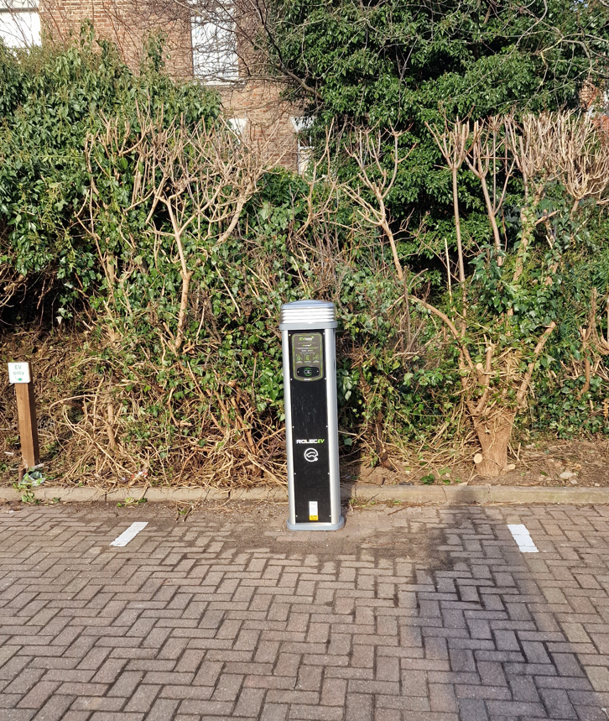
Energy Project Enabling Fund Round 2
£575,000 investment scheme providing both a development and delivery stream of grants to a range of organisations to support the development and delivery of energy projects.
Through the development trench of the programme, grants of between £10,000 and £50,000 are available to eligible organisations wanting to complete development works on their local energy projects to prepare it for delivery.
Through the delivery trench of the programme, grants of between £50,000 and £100,000 are available to eligible organisations wanting to complete deliver local energy projects.
22 applications were received, with 11 applications received for each tranche. The overall grant ask for development funding was £336,606, while the grant ask for delivery funding was £781,043.
11 successful applications with a grant allocation of £535,423, with a match value of £676,923.52.
Project EV Whitby

Slide 12
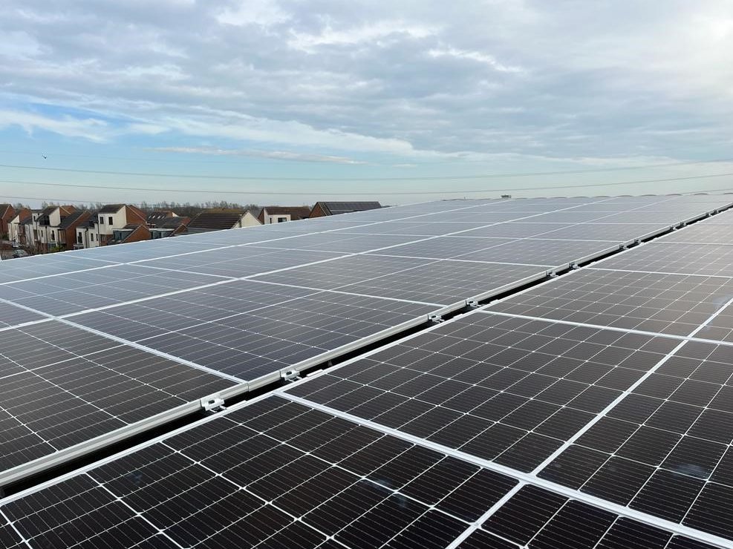
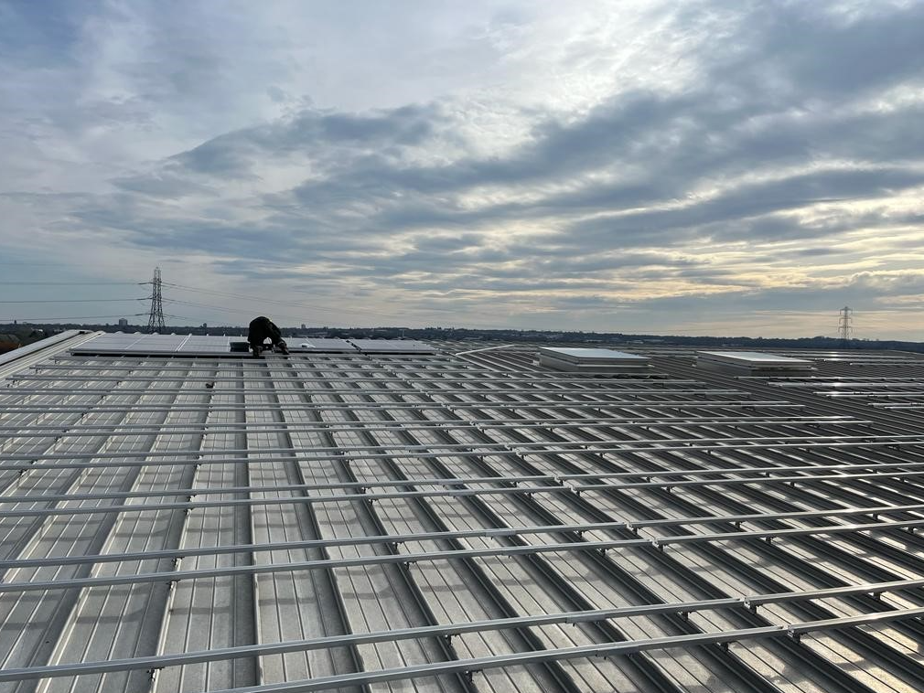
EPEF Case Studies
Newcastle Great Park Community Centre
Successful in the first round of EPEF and awarded £22,000.
Supported to install a Solar PV array comprised of 134 panels, reducing the community centre’s carbon footprint by nearly 10,000 tonnes of C02 a year.

Slide 13
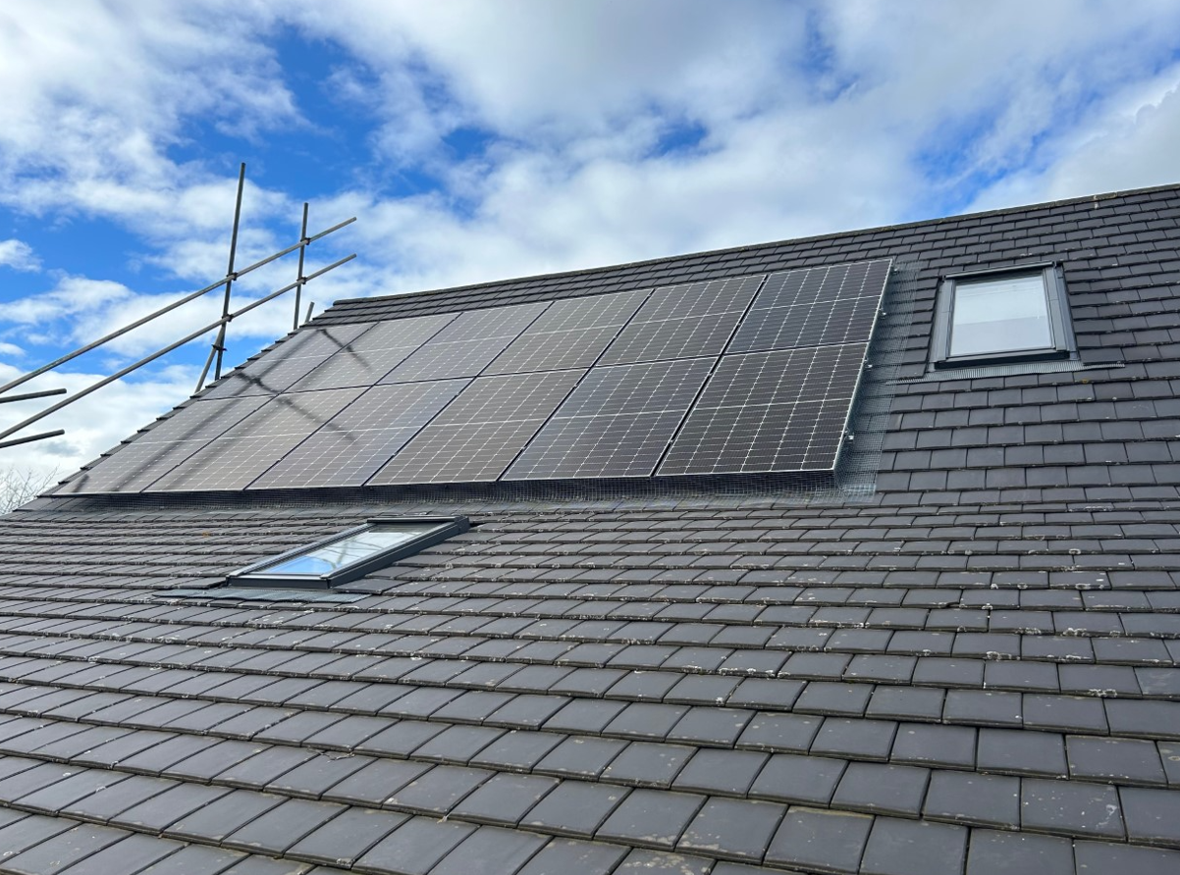
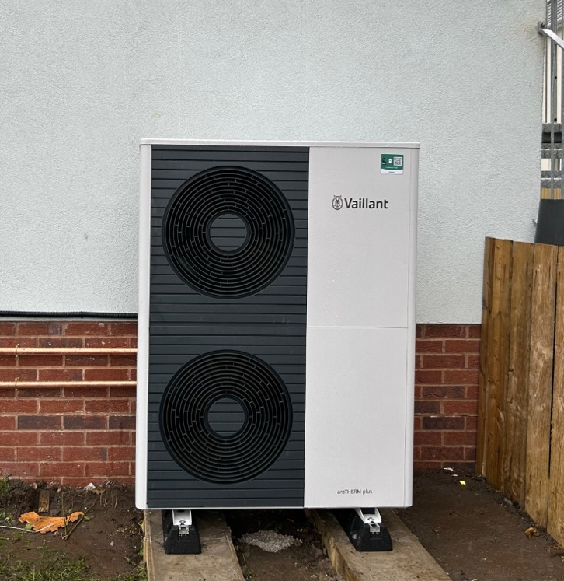
EPEF Case Studies
Fenham Association of Residents Community Centre
Successful in the first round of EPEF and awarded £24,080.
Faced with what they called “spiralling” energy costs, the charity secured funding through the Hub to install 24 solar panels and an air source heat pump to their building – saving 24 tonnes of carbon, the same as over 60,000km of car journeys and the equivalent of planting almost 400 trees.
Quote from the charity:
‘We have seen recently a number of charities close because of the increased energy costs, so we are delighted to receive this grant which will enable us to reduce our costs and additionally avoid carbon. We feel this project is a win-win for our charity and the environment.’

Slide 14

Community Energy Workstream 23-25
The NEY Hub has been awarded funding from DESNZ to deliver a Community Energy Workstream that builds capacity for the sector and strengthens the links between community groups and Local Authorities.
NEY approach:
Pan-northern Roundtable
NEY Steering Group
Energy Audit Programme
Support of the ‘Growing Yorkshire’ project

Slide 15
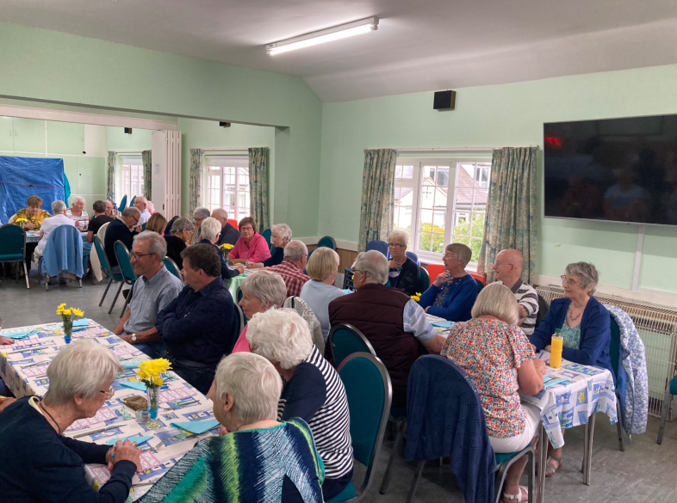
Community Energy Fund
Follows on from successful RCEF programme but allows urban groups to apply.
£10 million programme to be delivered over 2 years by all 5 local Net Zero Hubs.
CEF will provide support in 2 stages:
Stage 1: grants up to £40,000 for a feasibility study
Stage 2: Grants of us to £100,000 for business development and planning or feasibility schemes.
This funding will help to kickstart projects including small-scale wind farms and rooftop solar partnerships, as well as battery storage, rural heat networks, electric vehicle charging points, and fuel poverty alleviation schemes - all proposed, designed and owned by local people.
This programme is currently being mobilised, with the aim of being open to applications from October.
Sewerby Methodist Church

Slide 16
Any Questions?
enquiries@neynetzerohub.com

