Slide 1
North East & Yorkshire Energy Hub
Net Zero and LAEP
Darlington
Thursday 12th October
David Lynch – Strategy Manager (Future Energy Transition)

Slide 2
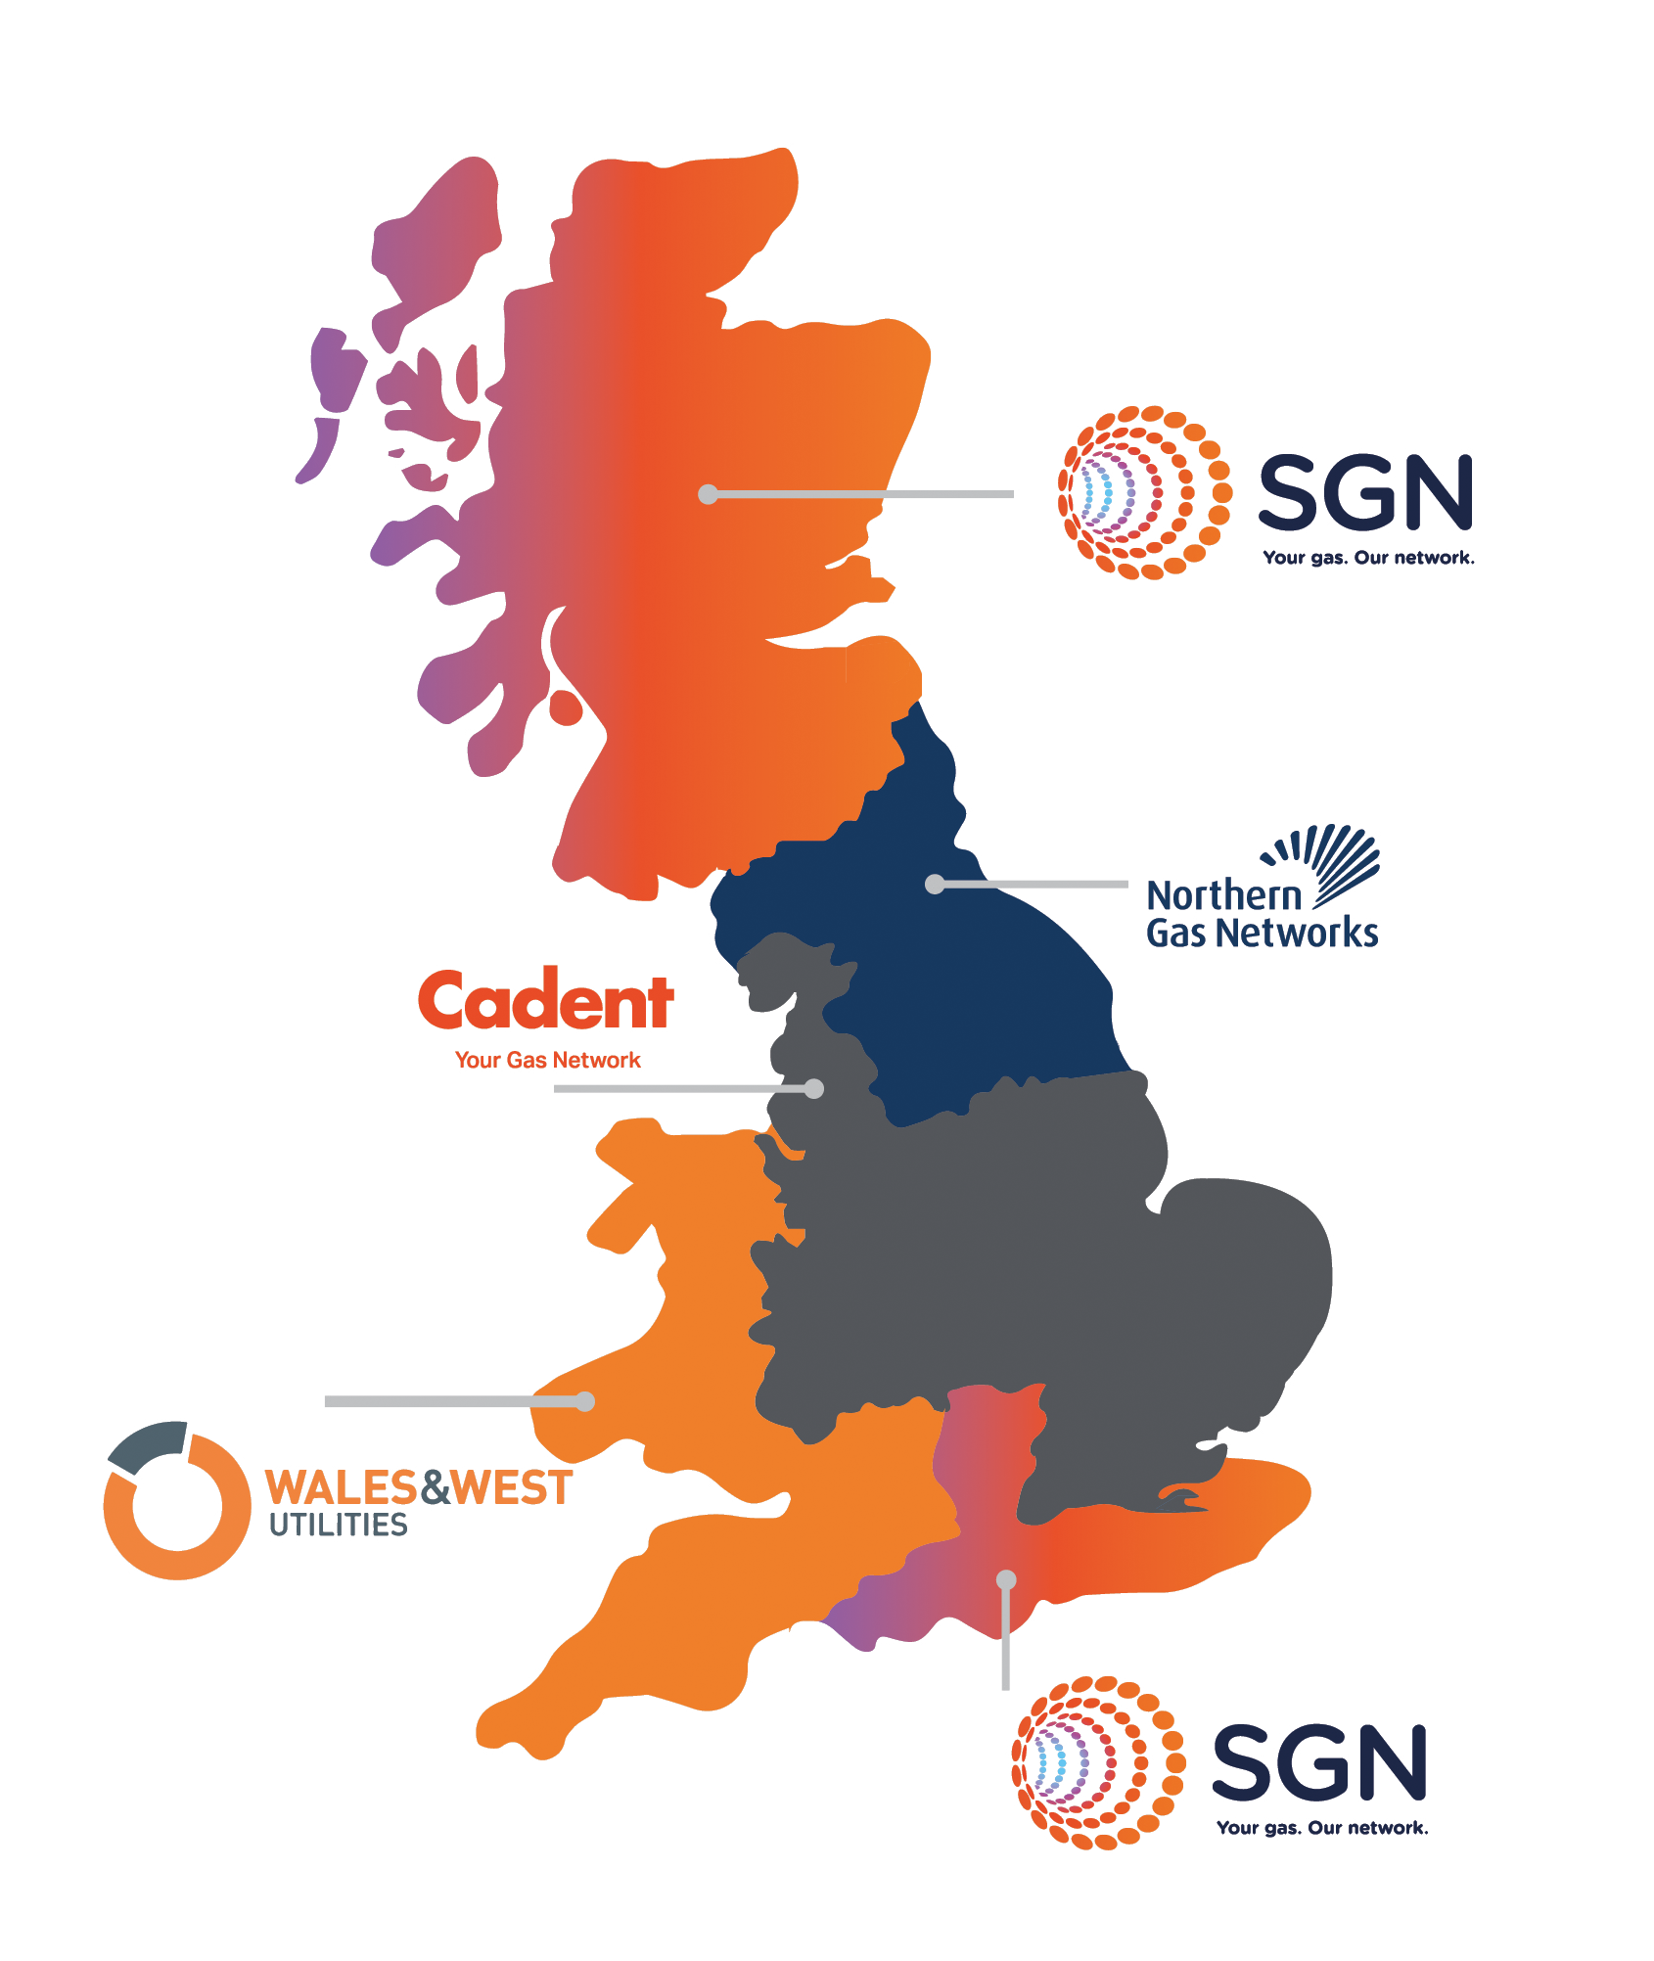
Who we are
We are the gas distribution network across the North of England, including Yorkshire, Northern Cumbria and the North-East.
We own and look after 37,000km of gas pipe, just in the North of England.
We provide energy for cooking, hot water and heating to 2.7 million people throughout our network.
Notes:
Northern Gas Networks are the Gas Distribution Network (GDN) for the North of England.
We own and look after around 37,000km of gas pipe located within our network, and transport gas to approximately 2,7million people.
At NGN we are committed to helping the UK reach it’s Net Zero target by 2050, and have been part of the research into what we can do to help stop climate change. We are led our own projects, as well as projects in collaboration with our partners to help understand how we can help. One of the main focuses in our industry at the moment is the potential to move to Hydrogen as a fuel of the future to replace Natural Gas (Methane).
There are 1,300 people who work directly for NGN and then 800 people who work indirectly for us through dedicated service providers or companies in each region in our area.

Slide 3
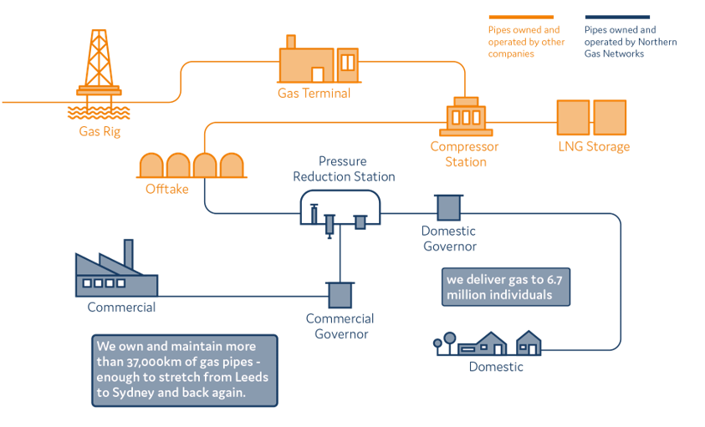
From ‘Beach’ to… Meter
Notes:
Talk through ‘Beach to Meter’

Slide 4
Regulation around Digitalisation
This does get more interesting, honest…
A new Special Licence Condition for Digitalisation was introduced at the start of RIIO2.
It covers all network companies – Gas & Electricity; Distribution & Transmission
Non-compliance can have serious consequences
2 | NGN Digitalisation Action Plan – June 2023

Slide 5
Supporting LAEPs
May 2023- dedicated LAEP email set up
laep@northerngas.co.uk
Supporting LAEPs as and when requests come in
Feeding into LAEP Frameworks & Tools
ENA LAEP Best Practice Guide
Taking part in working groups / workshops upon request
August 2023 - Launch of NGNs ‘Open Data Portal’
https://northerngasopendataportal.co.uk/
Next steps is to create dedicated area on the portal to inform LAEPs
ASK – Help us shape this!

Slide 6
Open Data Portal
Empowering change through data
Project Milestones:
Phase One: Stakeholder engagement and requirements gathering. (Sept ‘22 – Jan ‘23)
Phase Two: Identifying data assets, classifying and applying metadata. (Feb ‘23 – Jun ‘23)
Phase Three: Design and build Open Data Portal. (May ‘23 – Aug ‘23)
Stakeholders
Tags
What is it?
“Opening our data for everyone to explore and use…”
A Digital Data Hub
Our open data portal provides end users with a fully interactive, self-serve web application, where they can access our open data assets, submit a request for data that is not already available, feedback on data quality issues, and publicise their data initiatives.
Full Transparency
The portal will provide access to geospatial data on our physical assets and operational performance data. In addition, end users will find
data on the portal itself, how it is
used, what requests have been
made, and what policies we are
following.
Data Users
To Start
In Progress
Complete
Local Authorities
To Start
In Progress
Complete
To Start
In Progress
Complete
Why are we doing it?
Open Data
In order to comply with Data Best Practice Guidelines, we must treat all our data assets as ‘Presumed Open’ and make those assets classified as open available to all data users. Even more important than that, our data can be a vital part of the drive towards Net Zero and energy security.
What’s happening in the next 6 months:
The portal is now live. We will spend the next 6 months promoting use of the portal, gathering feedback, triaging any new requests and increasing the number of data assets available.
Data Quality
Data Best Practice
Net Zero
“Helping all users access the data they need…”
7 | NGN Digitalisation Action Plan – June 2023

Slide 8
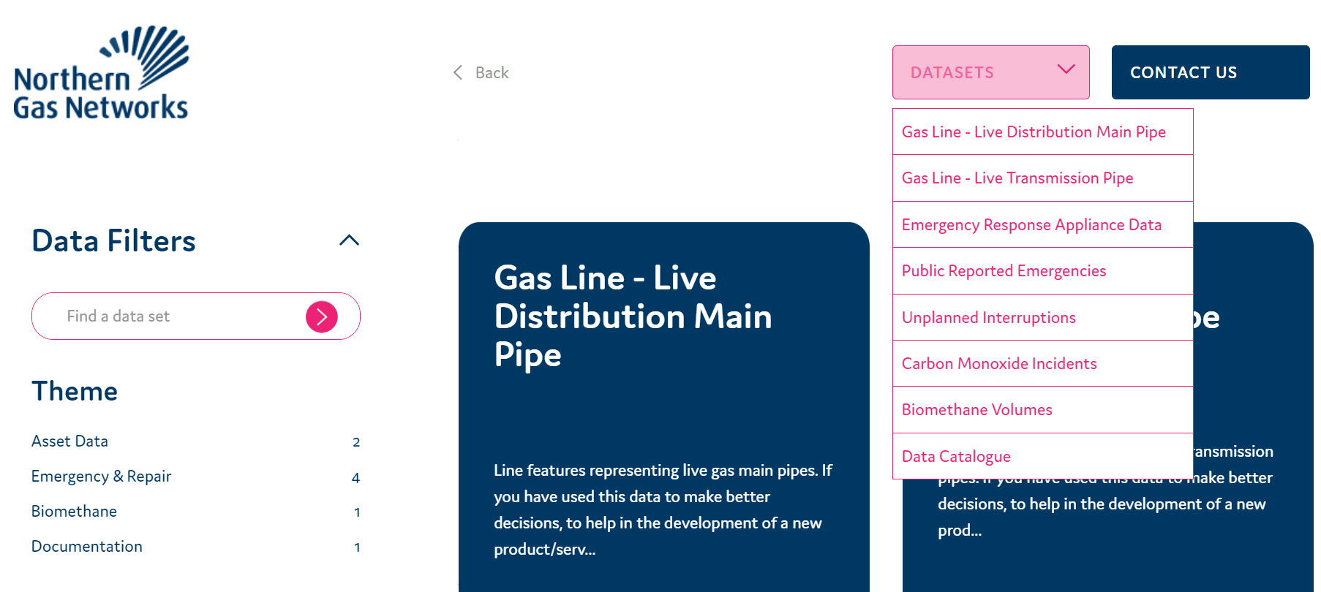

Slide 9
Futures Close
David Lynch (Strategy Manager) – Energy Systems Transition

Slide 10
A reality check…
We need to decarbonise circa 25 million homes in England to hit Net-Zero by 2050.
There are major challenges with domestic decarbonisation:
The U.K. has the most diverse housing stock - 35% built before the end of WWII.
A ‘whole house’ approach is required - consideration must be given to building fabric and heating system.
Fuel Poverty is at its highest level – how do we secure equity for all in low carbon transition.
Intricacies of deployment and installation of retrofit measures are complex

Slide 11
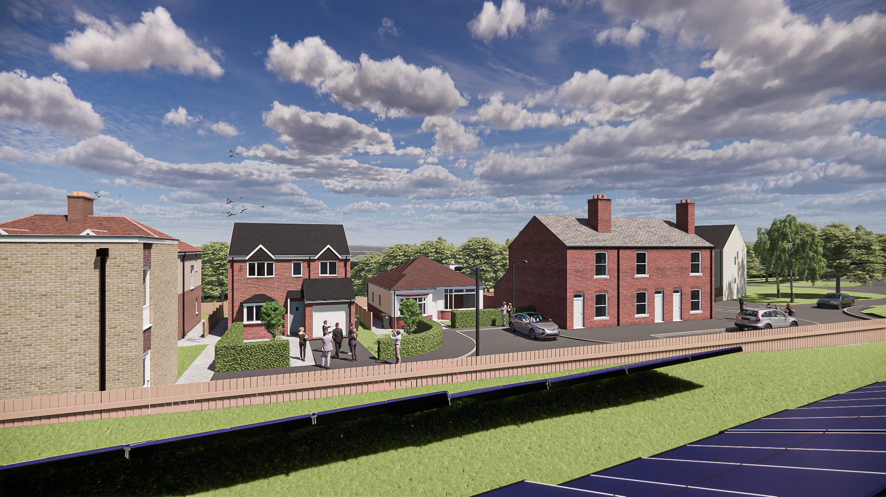
Futures Close - Opportunity
A representation of the 20+ million existing homes that require good decarbonisation solutions.
Research
Innovation
Training
Stakeholder
1910s terrace (3 homes)
1930s semi-detached
(2 homes)
1950s bungalow
(1 home)
1970s
flats
(2 homes)
1990s detached
(1 home)
A research facility for a whole system approach and for decarbonisation solutions in the home
Notes:
The CEV is a development of four to five homes [much depends of the cost and available funding], to create housing infrastructure reflective of existing housing stock across the north. If funding permits we also intend the fifth home to reflect a future home design so we capture the full spectrum of challenge facing communities needing to reduce their energy demand and their carbon output.
The CEV will demonstrate
Low carbon heating technologies
home based solutions,
Digital technologies
with a focus [from NGN] on vulnerable customers and the role digital technology can play to support such.
Timecales:
Design of CEV funded via NELEP LGF and vendor proposals in for review by CEV design board [consisting all partners inclusive of Gateshead team]
All Design work to be complete no later than March 2021 but costs and baseline architect to be established to support Nov Getting building fund submission
Primary risk around planning permissions so earlier engagement initiated
Targeting an April 2021 commencement with completion required no later than March 2021.

Slide 12
Vision

Slide 13
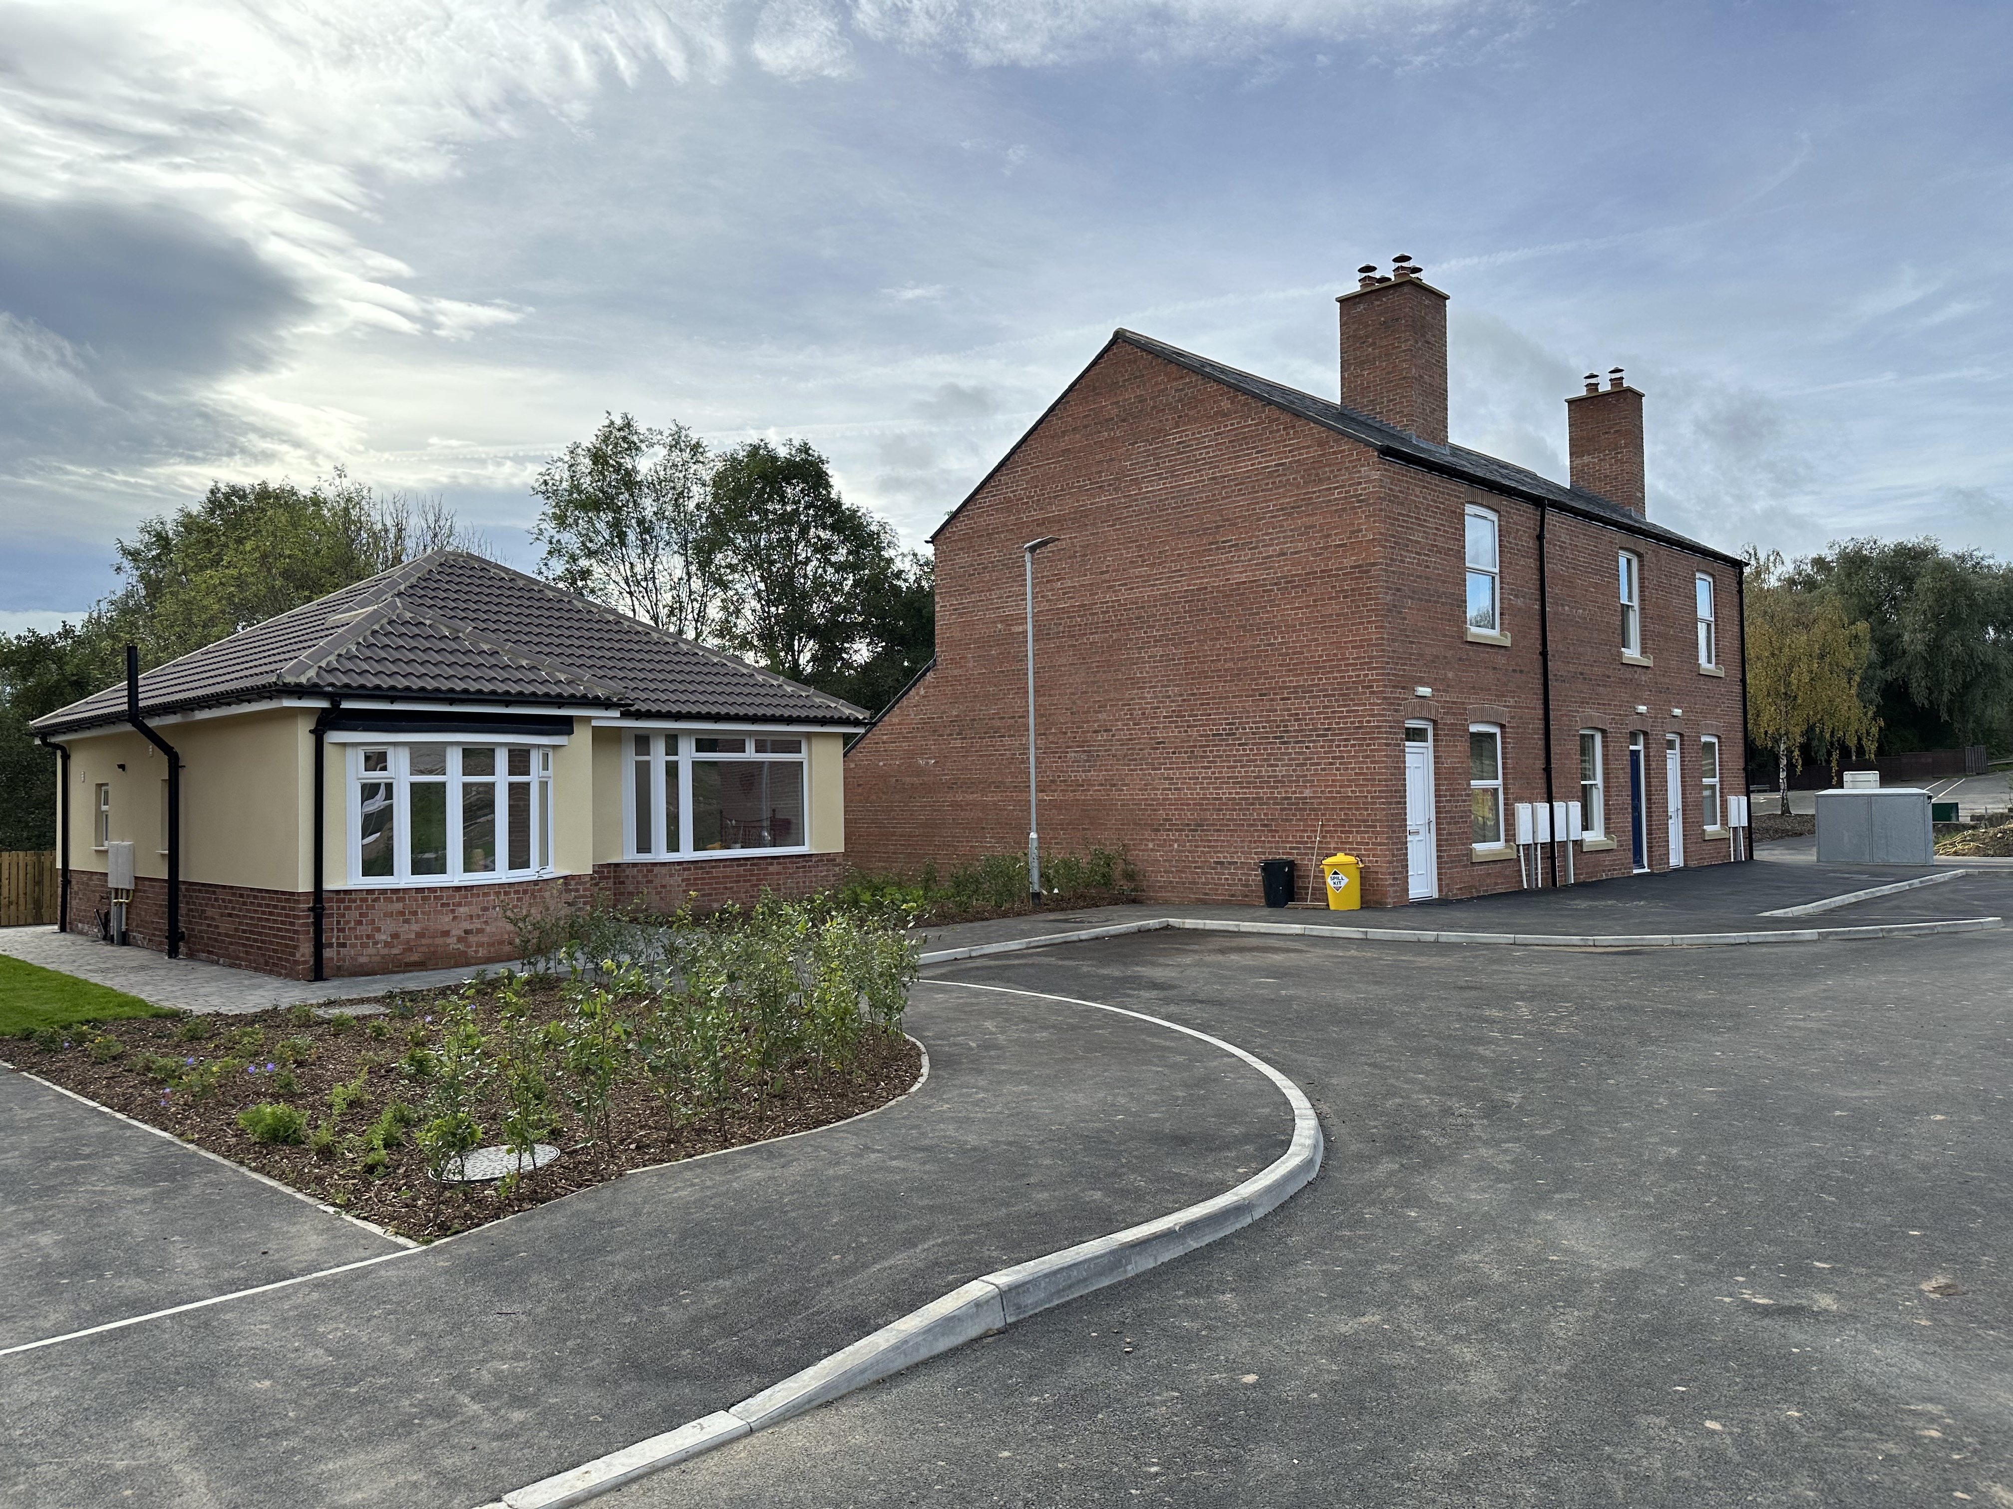
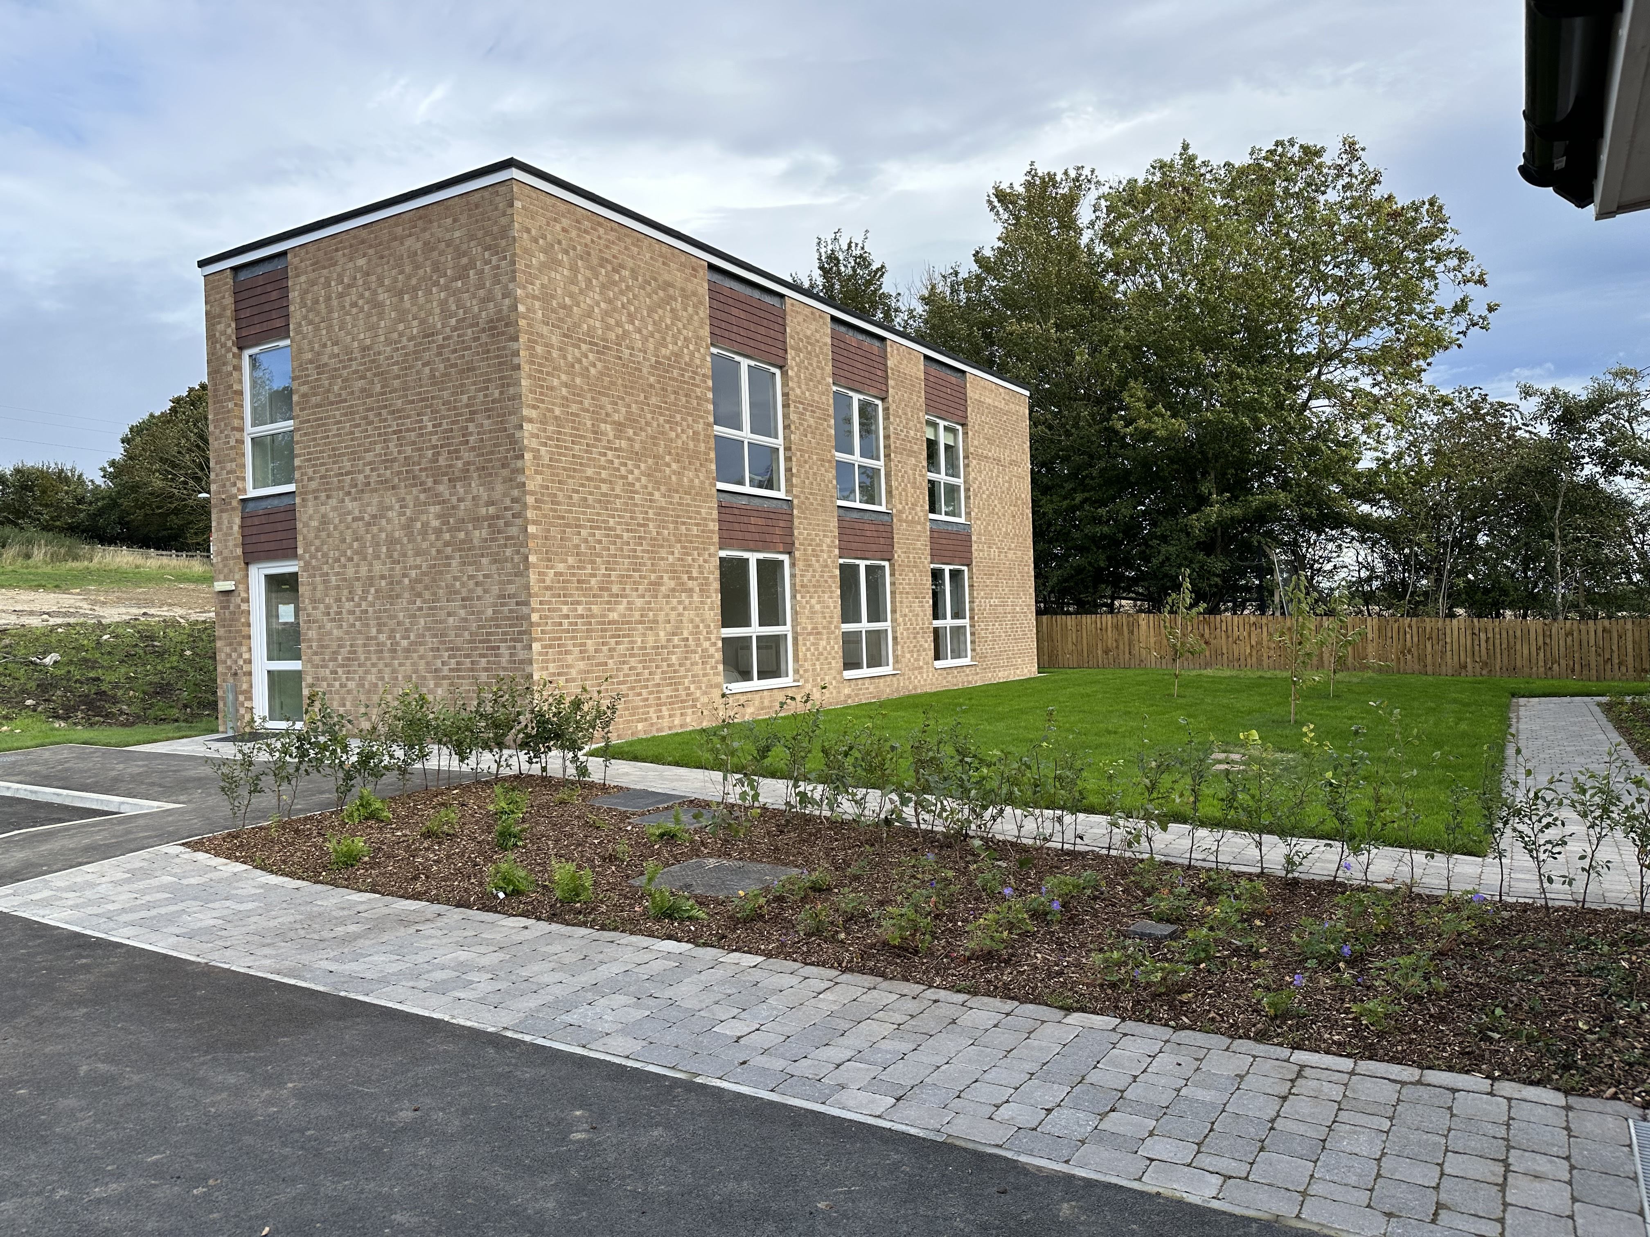
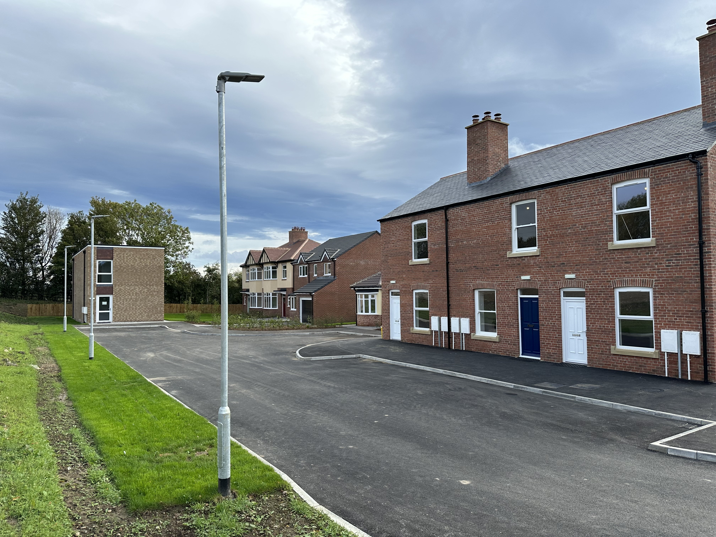
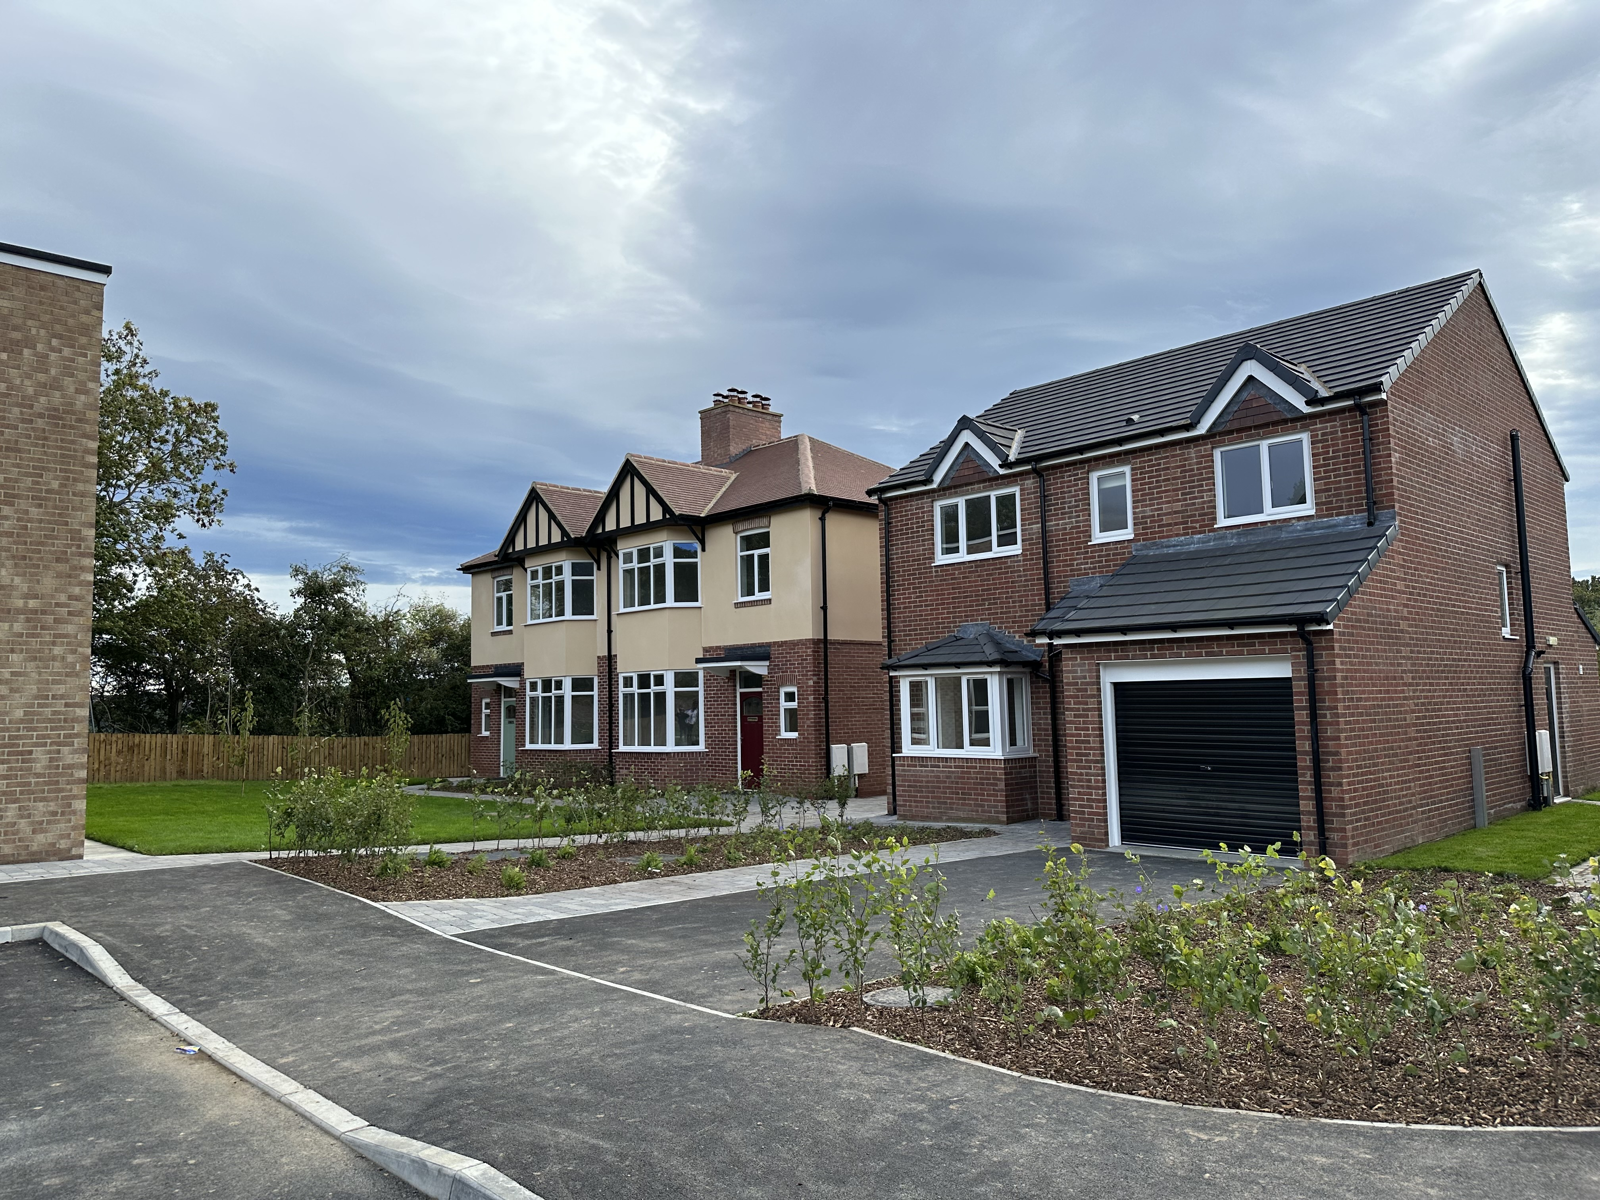
Futures Close - Today

Slide 14
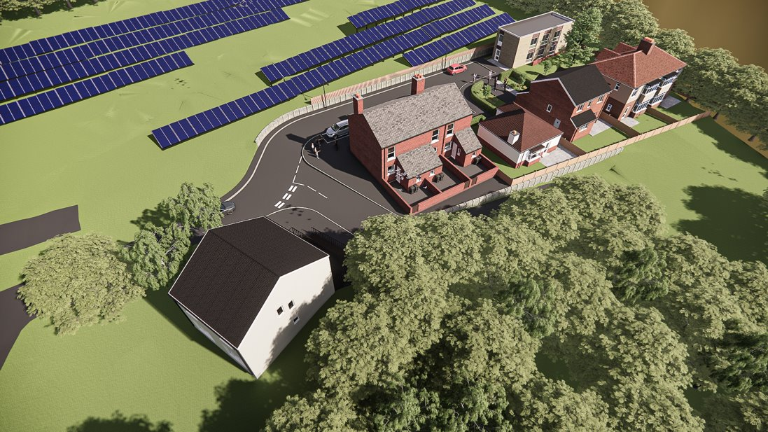

Slide 15
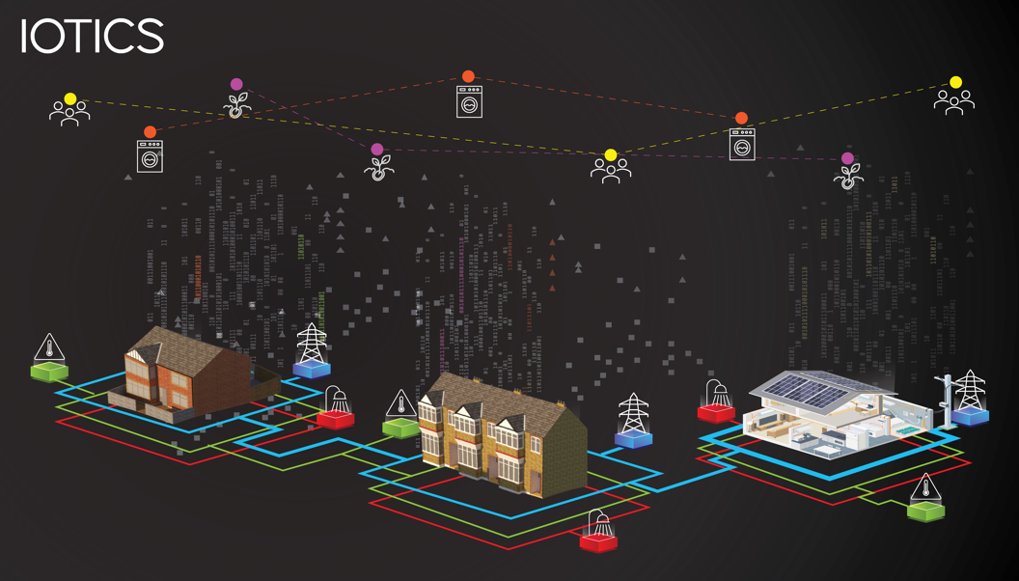
Beating heart of Futures Close – DATA!
A digital version of Futures Close
Data streams and archives discoverable and accessible by partners
Share sensors / insights / historical data
Access Building sensor data
Retain control on data we share, with who and when, protecting IP.
Notes:
A Virtual village on top of the physical one. A scalable and highly flexible data ecosystem. with real-time data
Data streams and Archives discoverable and accessible by your partners
Share (Publish & Consume) sensor data (building sensors, meters,) or insights and derived data (trends, alerts) while protecting IP This only works if everyone shares their data. Why wait until the end. Participate in real time.
Decide which data you share and who can access it
Connect via API or NGN Open data portal
Underpinned by Market leaders in making data accessible and discoverable

Slide 16
Anchor programme – Cross vector heating analysis
Support from the Heating and Hot Water Industry Council (HHIC) to work with Vaillant Group, Groupe Atlantic, Worcester Bosch and Baxi.
We aim to utilise Future’s Close to install, commission, test and monitor a series of heating systems within the following properties on Futures Close.
Partner | Property
Vaillant Group | 1900s Terraces x3
Groupe Atlantic | 1970s Flats
Worcester Bosch | 1990s Detached / 1950s Bungalow
Baxi | 1930s Semi-Detached x2
A series of test regimes will be conducted over a 2-year period commencing with Natural Gas Combi’s / System Boilers.
Post benchmarking, introduce modulating controls, different heating systems and re-evaluate

Slide 17
Our North Star…
Futures Close - Creates:
A unique national net zero research and development asset
a thriving research and development ecosystem.
an environment to test, fail, refine before roll out on real homes.
an open engagement space to improve understanding of the net zero transition.
long-term partnerships with industry, academia and wider community.
Futures Close - Generates:
Open data and intelligence to inform future decarbonisation of UK housing stock.

Slide 18
Thank you Enquiries: futuresclose@northerngas.co.uk
Questions and discussion

