Slide 1
Local Area Energy Planning at a District Level
Femi Omoniyi

Slide 2
Introduction
The West Yorkshire Combined Authority declared a climate emergency in 2019, supported by our five local authority partners, establishing a target to be a net zero carbon region by 2038
1
A key requirement to achieving our emission targets is to change how our energy system currently operates and what it does in the future.
2
Local Area Energy Planning (LAEP) is a pioneering planning approach which addresses the whole energy system, to deliver an evidence-base for change and set-out a plan for implementation.
3
The Climate and Environment Action Plan includes a committed action for LAEPs to be developed in West Yorkshire with at least one completed in 2024.
4
To inform, shape and enable the transition to a net zero carbon energy system
5

Slide 3
Current status
LAEP IN CALDERDALE
Currently in delivery
£70,000 hub funding through local capacity support
LAEP’s in other Districts in West Yorkshire
Currently in development

Slide 4
Local Area Energy Plans (LAEPs)
Lara Blake, Policy Officer NEYNZH Summit, 12 October 2023

Slide 5
West Yorkshire LAEPs
Combined Authority procuring centrally for West Yorkshire
Economies of scale; cross-boundary planning
4 LAEPs for other LAs
Incorporate - and align with - Calderdale’s LAEP
15-month contract starting in January 2024
Additional Funding for Deployment/Delivery
Investment/finance incl. business plan
Network governance
Advantages of Phased Approach to LAEP Rollout
Incorporate Calderdale learnings
Stronger Steering Group built on experience
Faster understanding of LAEP methodology
Facilitates pre-contract planning

Slide 6
Ongoing Work and Pre-contract Planning
Refresh of WYCA Carbon Emissions Reduction Pathways (CERPs)
Builds on original 2019 CERPs
Complete Pathway: set targets, develop evidence base
Action Plan: pipeline of investable projects
Interventions identified at regional level disaggregated for each LA (LAEP focus)
Interim report available early-2024
Hydrogen Use Case Study
Hydrogen deployment in different sectors in West Yorkshire
Evidence-based policy position
Scope: transport, domestic heating, industry
Initial findings available early-2024
Governance and Data
Preparatory meetings with LAs and key stakeholders to plan LAEP scope, governance
Aim to ensure datasets and NDAs in place prior to contract start

Slide 7
Proposed Local Authority Input
Project Governance
Participate in central Steering Group (planning and energy expertise)
Manage internal LA Stakeholder Group (housing, energy, transport, etc)
Manage LA Stakeholder Engagement Group
Stakeholder Engagement
Manage direct communications with stakeholders: know your audience
GDPR: invite stakeholders to events: Stakeholder Engagement Group, workshops, etc
Data Management
Coordinate collection of datasets within each LA

Slide 8
Thank you for your attention
Any questions on LAEPs to
lara.blake@westyorks-ca.gov.uk

Slide 9
Calderdale Local Area Energy Plan
Notes:
Our Local Area Energy Plan (LAEP) will offer us a clearer insight into our current energy landscape and help us to understand the next steps of local energy decarbonisation across our Borough.

Slide 10
Climate Emergency – Calderdale Local Context
Declared a Climate Emergency in 2019
Net Zero by 2038, with significant progress by 2030
Calderdale Emission Reduction Pathway
Published in 2021 (Element Energy)
Builds on the WYCA CERP but specific to Calderdale and our local characteristics
Sets out a road map to achieve Net Zero in Calderdale
Calderdale Climate Action Plan 2023-2026
Led by Calderdale Climate Action Partnership
Notes:
- Locally in Calderdale we declared a climate emergency in 2019, with targets to achieve net zero by 2038.
- We have published our own Calderdale specific Emission Reduction Pathway in 2021 (produced by consultant Element Energy), which is a daughter study to the WYCA Carbon Emission Reduction Pathway
And we have recently finalised our 3-year Calderdale Climate Action Plan 2023-2026 which aligns to our ERP study.
The Climate Action Plan is led by our Calderdale Climate Action Partnership which is a multi-agency committee that has cross-party Councillor representation plus leaders from key stakeholders in our area such as our largest social housing provider, Together Housing, organisations such as Friends of the Earth, Slow the Flow, NHS, and several others key organisations that represent our area.
Developing our LAEP is one of the actions within our Climate Action Plan and once our LAEP has been developed it is envisaged that our Climate Action Partnership will take ownership of the decisions making that comes out of LAEP to help drive action forwards.

Slide 11
LAEP - Key Drivers
Fully costed spatial plan
Show us what measures we can install, where and how much it will cost us
Provide the detail to develop strategic outline business cases
To scale up opportunities for investment and funding
Increase local stakeholder awareness
Enable and build shared understanding with our local communities
Notes:
In Calderdale we have a small population size 206,600 (ONS 2021), we are situated on the Pennines between Manchester and Leeds and 2/3rds of our Borough is rural
Number of homes 95,590
32% of homes built before 1900
45% of homes are terraced houses
69% of homes are owner occupied
Very high proportion of solid wall pre 1920’s Victorian and Grade 2 listed buildings in our Bborough.
In our ERP we have modelled our ambitions to retrofit 69,000 dwellings to EPC level C or better
Our LAEP will provide us with a:
- Fully costed spatial plan
- Show us what measures we can install, where and how much it will cost us
- Provide the detail to develop strategic outline business cases
- To scale up opportunities for investment and funding
- Increase local stakeholder awareness
- Enable and build shared understanding with our local communities
Our LAEP will help to Inform, shape and identify options, preferences and priorities for the scale of change needed and actions required

Slide 12
Project Summary
Timescale: 12 months to end of Feb 2024
Consultant: Integrated Environmental Solutions Ltd
Follows the Energy System Catapult Guidance on LAEPs
Local & national data inputs and spatial mapping to model scenarios and interventions
Cloud based Digital Twin Model with tailored dashboards - a 3D map of the entire borough and every building within it
Stakeholder Engagement running throughout
Two business cases developed for priority projects following HM Treasury Green Book guidance
Notes:
Stakeholder engagement runs throughout our project – we want to bring our communities with us on our journey to Net Zero

Slide 13
Representing the Existing Local Energy System
Low/zero carbon heat and power generation e.g., district heat, heat pumps, renewables, storage, zoning
Electricity and heat demand in buildings e.g., energy efficiency retrofit measures, fabric improvements, insulation etc.
EV charging and its expected demand incl. its impacts on the electricity distribution systems in the local area
Distribution Networks (electricity, gas and heat)
Use of distributed hydrogen where regional contexts suggest it may be an option

Slide 14
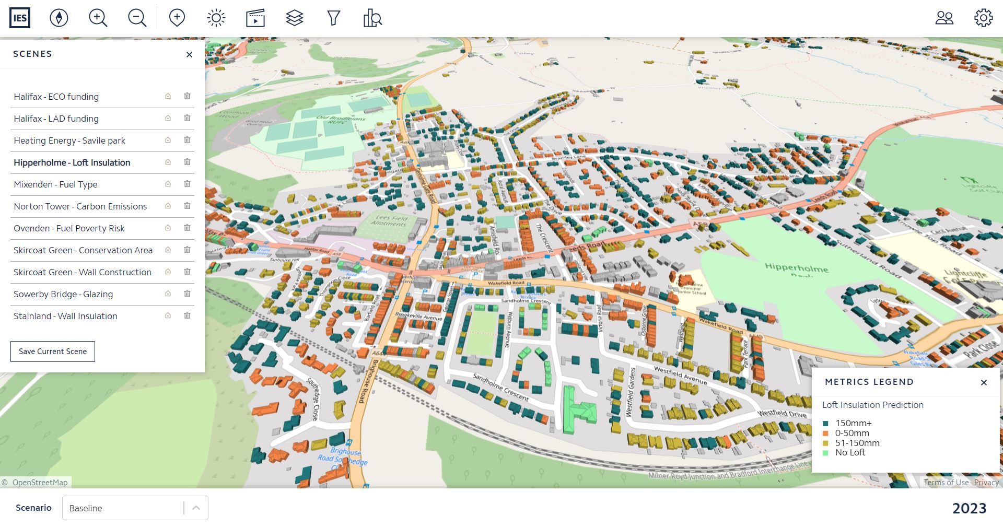
Digital twin model: domestic property loft insulation in Todmorden
Notes:
Loft Insulation in Hipperhome
Our ‘digital twin model uses a range of data to give us a best estimate of how much energy buildings are using. The model is accurate to within 5% in domestic properties and 10% in non-domestic buildings.
It gives us a household level picture of energy related metrics across the borough, from insulation levels to heating use and carbon emissions from energy. This gives us an incredible opportunity to target both funds and wider resources (both in and outside of the Council) to support decarbonisation of our buildings. As well as energy it will enable us to look at things like fuel poverty, air quality and health impacts in relation to decarbonisation.
We think that It has huge potential to inform and influence other work across the Council, and in our communities. This includes a number of active projects including Better Homes Yorkshire (insulation and boiler replacement, led by the Housing team), plans for electric vehicle charging points (in Transportation) as well as our new Innovate UK funded project looking at non tech barriers particularly with solid wall pre 1920 properties.
In future, it can be used by the Climate Action Partnership, Council departments and the wider stakeholder to support our Net Zero ambitions (subject to data sharing agreements).

Slide 15
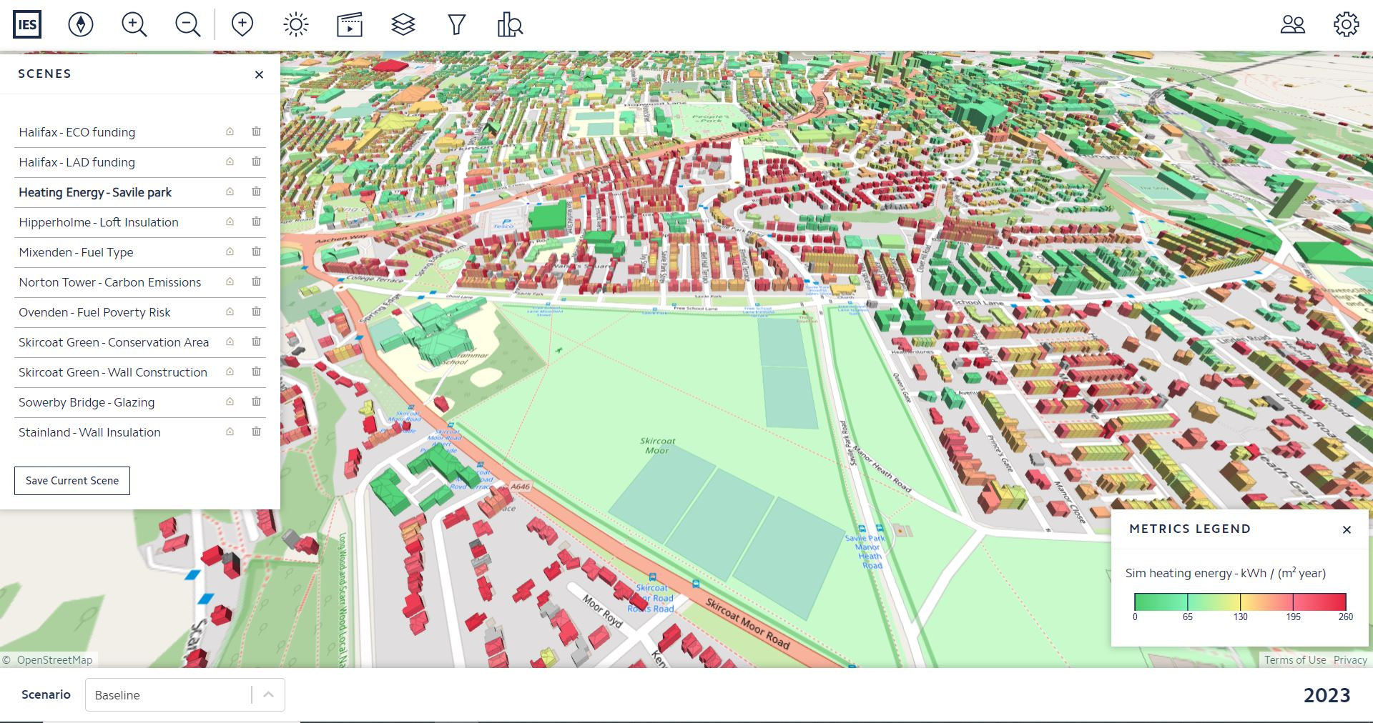
Add some more slides with pictures of the DT model
Notes:
Heating Energy in Savile Park in Halifax

Slide 16
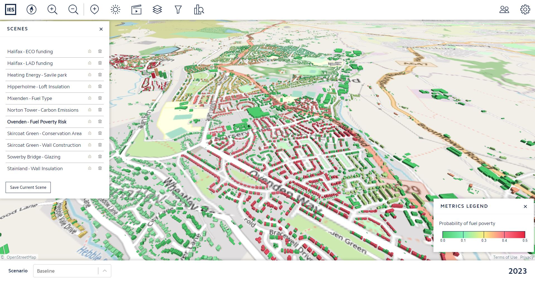
Notes:
Fuel Poverty Risk in Ovenden

Slide 17
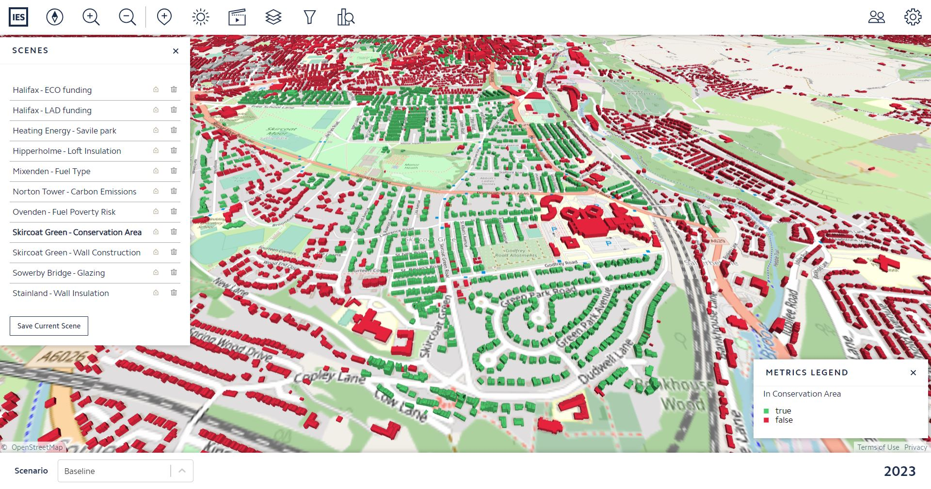
Notes:
Conservation Area in Skirtcoat Green

Slide 18
Notes:
ECO Funding

Slide 19
Business Engagement and Verifying the Model
Checks have been completed using local and regional data to verify the model
Data available for non-domestic /commercial buildings is more patchy and not so comprehensive
Difficult to identify high energy use for industrial processes in our model – modelling mainly accounts of space heating & hot water rather than process heat
1:1 meetings have been held with large energy users to check against the model and to increase confidence levels where there are uncertainties in data e.g.
Lloyds – Commercial bank with HQ in Calderdale, NHS – Calderdale and Huddersfield Trust, Calderdale Royal Hospital, Dean Clough (150 business units)
Leo Group – animal products rendering, Rosehill Polymers – plastics manufacturer, Verdant Specialty Solution – chemical manufacturer etc.
Mailer sent to over 800 businesses to complete a Building Data Template – although response was very low
Notes:
Large energy users: 121 interviews held with:
Lloyds – Commercial bank with HQ in Calderdale, NHS – Calderdale and Huddersfield Trust, Dean Clough (150 business units)
Leo Group – animal products rendering, Rosehill Polymers – plastics manufacturer, Verdant Specialty Solution – chemical manufacturer

Slide 20
Stakeholder Engagement Workshops
Domestic housing sector
Social housing organisations. tenant/landlord associations, housing officers
Public sector
Council officers, colleges, Calderdale Royal Infirmary
3rd Sector
Wide range of community organisations and Calderdale Climate Action Partnership members
Private Sector – SMEs, Chamber of Commerce and business representatives
Calderdale Councillors
Network Operators - Northern Powergrid, Northern Gas Networks, Yorkshire Water
Notes:
Wider stakeholder engagement is core part of our project to gain buy in and a shared understanding of our Local Area Energy Plan demonstrating that it has both shaped and been shaped by the perspectives of a decent range of relevant local stakeholders. Network operators (e.g., Northern Powergrid) are part of our Steering Group and other key stakeholders have been engaged from a range of sectors and will continue to be engaged with throughout our project.
Looking at barriers constraints and opportunities as well as gaining feedback on technologies. We will use this to help with the phasing of measures within our plan.

Slide 21
Fabric Retrofit
Number of individual retrofit measures installed in each scenario
Light Retrofit: cavity wall insulation, full loft Insulation, loft top-up
Deep Retrofit: double glazing upgrade from single glazing, suspended floor insulation, solid wall insulation
Notes:
So far simulations have been completed with the following interventions applied to appropriate domestic buildings:
- Light Retrofit: cavity wall insulation, full loft Insulation, loft top-up. (– look to add in room in roof insulation)
- Deep Retrofit: so measures that are more disruptive to install – including double glazing upgrade from single glazing, suspended floor insulation, solid wall insulation.
Simulations have been run to identify the number of individual retrofit measures installed in each scenario (light or deep retrofit).
The results show potential high-level projections.
If needed - In the digital twin model, each appropriate intervention / measure was applied to any domestic property that does not already have it installed
i.e., for light retrofit all uninsulated cavity walls had cavity wall insulation applied, all uninsulated lofts had full loft insulation installed and all partially insulated lofts were topped up.

Slide 22
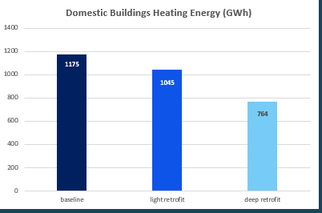
Fabric Retrofit Simulations
The results show the maximum possible reduction that could be achieved, not what likely will be
Outputs from the stakeholder engagement and techno-economic analysis will determine likely rates of uptake for each measure, which will be used in the final LAEP
Notes:
Note that it is unrealistic to assume that all homes requiring retrofit will have all applicable measures installed – so the results show the maximum possible reduction that could be achieved, not what likely will be
Outputs from the stakeholder engagement and techno-economic analysis will determine likely rates of uptake for each measure, which will be used in the final LAEP

Slide 23
Heat Decarbonisation Simulations
The model was re-simulated with all fossil fuel boilers in domestic buildings having been replaced with electric heating technologies – primarily air source heat pumps.
Notes:
Digital twin model was re-simulated with all fossil fuel boilers in domestic buildings having been replaced with electric heating technologies – primarily air source heat pumps.
ASHPs were installed on all homes other than those classed as “space constrained” (a home where the total floor area per habitable room is less than 16m²), which were modelled as having another form of electrical heating.
This was done as an initial high level simulation to get results showing the decarbonisation potential if all heat was decarbonised through electrification
the likely phasing of this is still to be assessed, taking into account grid constraints and the number of installations required per year to meet local and national targets.
GSHPs, Hydrogen boilers and bio-energy will also be considered for some areas in the LAEP depending on local grid constraints, fuel resources etc. (i.e. Hydrogen may be viable in clusters around industrial buildings with high temperature process loads).

Slide 24
Domestic Building PV Assessment
A solar PV assessment has been undertaken, to determine the maximum potential generation from rooftop PV panels on domestic properties, if all homes with south facing roofs were to install them.
Notes:
Total area of PV panels was determined from roof orientation and building geometry data from the home analytics dataset, annual electricity generation and carbon emission reductions were obtained by simulating these panels in IES’ software, using a local weather file.

Slide 25
Modelling – next steps
Heat electrification and solar assessment for non-domestic buildings
Northern Powergrid’s network data will be added to the digital twin model to see where heat electrification (as well as likely EV uptake) may cause grid constraints and require infrastructure upgrades.
Assessment of land use and restrictions to identify sites where large-scale wind or solar could be installed, with simulations undertaken to determine potential energy generation and carbon emission reductions.
Assessment of any potential sites or areas where district heating may be viable, most suitable sites will also be simulated in software.

Slide 26
Next Steps
Early-stage plans, and scoping report has been submitted to the Council for a major 302MW onshore wind farm (up to 65 wind turbines)
Includes proposal for 150MW of battery storage & £75m community benefit fund
We are working out how we might take account on that in our modelling and Plan
We will be looking to develop x2 business cases based on priority projects coming out of the LAEP to HM Treasury Green Book
Licencing / use of the LAEP Digital Twin model is something we need to work out – but it is an asset the Council will own once the project is complete that we will be able to update and use to keep track of improvement

