Slide 1


Coordinating Local Area Energy Planning Across York & North Yorkshire
Katie Privett, Energy Programme Lead
North East & Yorkshire Net Zero Hub and
York & North Yorkshire Local Enterprise Partnership
Issy Burkitt, Carbon Reduction Project Officer
City of York Council

Slide 2

Vision setting – England’s first carbon negative region
Y&NY Carbon Abatement Pathways Study
Robust, technical evidence
Y&NY’s Routemap to Carbon Negative
Co-owned plan to reach net zero by 2034 & carbon negative by 2040
Local Area Energy Plans
Provide the "where" - at a spatial level identify focus zones and key projects for the region.
Notes:
talking about how research + stakeholder buy-in = vision = detailed strategic and project development

Slide 3
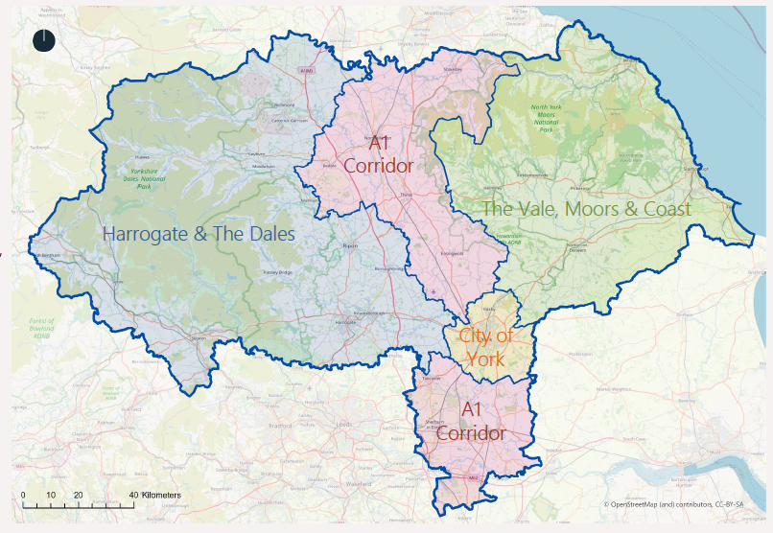

Linking LAEPs across a region
Funding
Part-funded by the UK Community Renewal Fund
CYC own reserves to complete the picture
Delivery
Data collection
Stakeholder groups
  Local Authority
  Technical
  Social
Internal assessment
Adoption
Notes:
They recognised the value for a collaborative York & North Yorkshire approach and made a clear case internally to pay for their own LAEP, using the same supplier and timeline to allow a streamlined approach and a coherent Y&NY-wide plan.
There was also significant match funding provided by the LEP, the Net Zero Hub, the Local Authorities, the National Park Authorities and Northern Powergrid and Northern Gas Networks, all of whom were involved in the project development and the LAEP steering group, driving this piece of work forward and particularly helping with the all-important data-gathering exercise that was the foundation that the LAEPs were built on.
(1m/2m55)

Slide 4


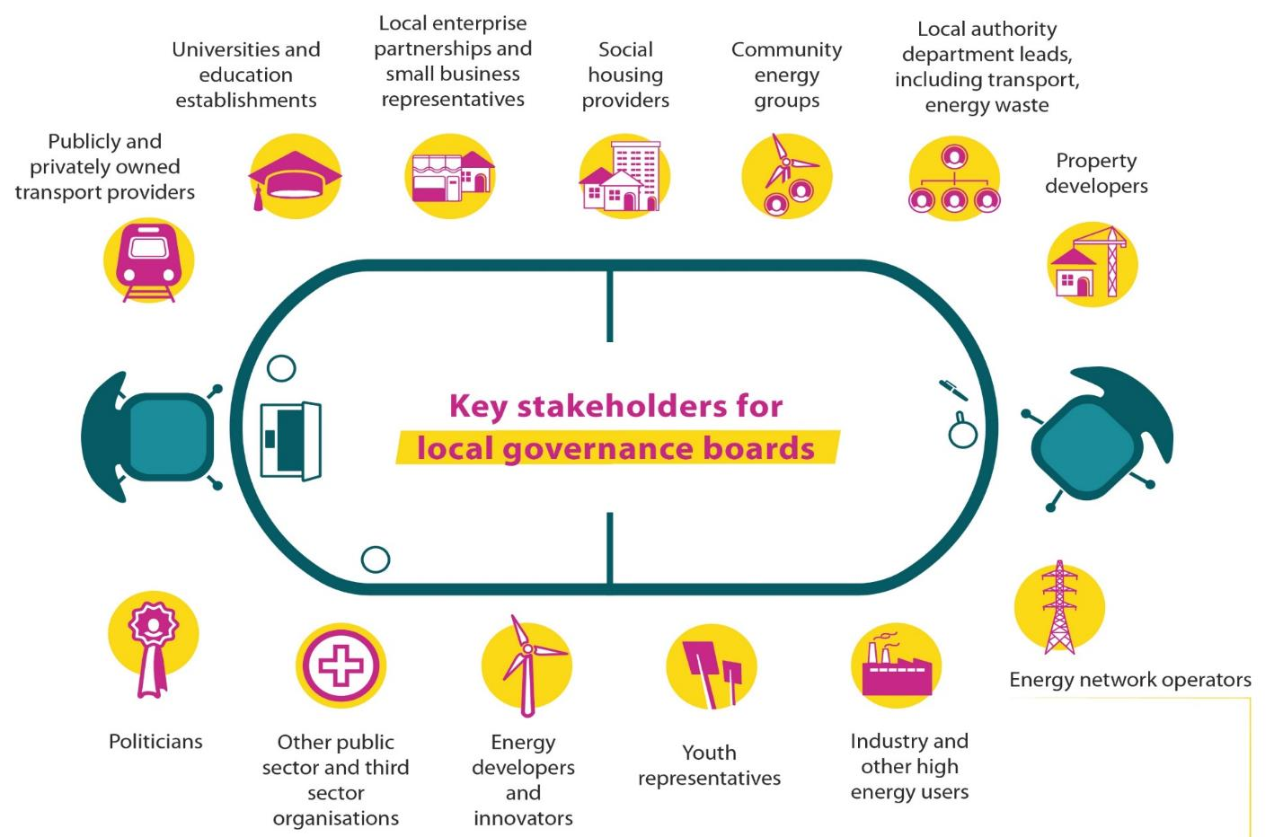









Collaboration
Y&NY LAEPs Steering Group
Notes:
They recognised the value for a collaborative York & North Yorkshire approach and made a clear case internally to pay for their own LAEP, using the same supplier and timeline to allow a streamlined approach and a coherent Y&NY-wide plan.
There was also significant match funding provided by the LEP, the Net Zero Hub, the Local Authorities, the National Park Authorities and Northern Powergrid and Northern Gas Networks, all of whom were involved in the project development and the LAEP steering group, driving this piece of work forward and particularly helping with the all-important data-gathering exercise that was the foundation that the LAEPs were built on.
(1m/2m55)

Slide 5
How were they developed?
July-August 2021:
Priming activities (workshops, data collection)
November 2021:
Bid decision and kick-off
February- March 2022:
Non-technical conditions for success, model assumptions
July 2022:
Reviewing initial model outputs
October 2022:
Reviewing initial draft documents
November 2022:
Edits, second review by SG, TAP & Peer challenge group
April 2022:
Data collection close, modelling begins
December 2022: Final document signed off
September 2022:
Peer challenge group session
February-March 2022:
Technical Advisory Panel set up and model deep-dive
October 2022: NGN’s Citizen Panel session
Notes:
Since bid submission back in June last year, the Steering group have been providing the local drive, background and context, such as ensuring a coherent link through to current and emerging strategic work like the Routemap to Carbon Negative. Steering group members have also facilitated the integration of data and expertise from across our own organisations and from key partners, to supplement our own experience as climate action leads with input from planners, public health professionals, estates operators, social housing, engineers and charitable bodies, all who have important viewpoints to integrate with the model outputs to create a plan that works for York & North Yorkshire.
By the end of November, we should have a finalised set of documents ready for internal approval prior to publication. In addition to the main PDF documents, Steering group members will have access to the datasets behind the outputs, to help them develop projects off the back of the recommendations in the report. We also intend to have an interactive map that allows anyone with an internet connection to explore the report’s results in their local area, toggling between different data layers within the report and making the information more accessible and relevant to a wider group of interested parties.
Thank you for joining us today, and I hope you enjoy seeing a snapshot of the LAEPs and how we can use them to create a greener, fairer and stronger York & North Yorkshire.
(1m30/6m)
Priming to keep momentum, use wider groups to make it better.

Slide 6
How York have used it …
Policies and Strategies
Heat Network Zoning
Transport Plan
Local Plan (SPD)
Expanding Local Skills and Supply Chain
Hackathon Event – York and North Yorkshire
Notes:
KP bridge – although plan developed regionally, local partners need to spearhead action within own governance and organisations right now – hand over to Issy who will talk about CYC.

Slide 7
…supporting project funding
Innovate UK Pathfinder Places
  Accelerating York’s Net Zero Transition (project complete)
  Phase 2 – Retrofit One-Stop-Shop (application submitted)
Net Zero Fund (applications submitted)
  Housing projects
  Large scale solar and wind projects
Local Energy Advice Demonstrator (funding awarded)
  Solid walled homes in conservation areas
  Traveller sites
Notes:
KP bridge – although plan developed regionally, local partners need to spearhead action within own governance and organisations right now – hand over to Issy who will talk about CYC.

Slide 8
Towards Implementation
Design a LAEP implementation vehicle that:
Identifies required interaction between hyper-local, local, regional
and national contributors to deliver LAEPs (including data governance)
Has robust decision making and advisory processes that consider interactions with all delivery partners
Facilitates access to finance, including most appropriate funding solutions for key strategic projects.
Work packages:
Community Engagement
Governance
Finance
Implementation Vehicle
Design
Knowledge exchange

