Slide 1
Northern Powergrid
Engaging Distribution System Operators in your Local Area Energy Plan
Lizzie Boyes
12.10.2023
Local System Planning Engineer

Slide 2
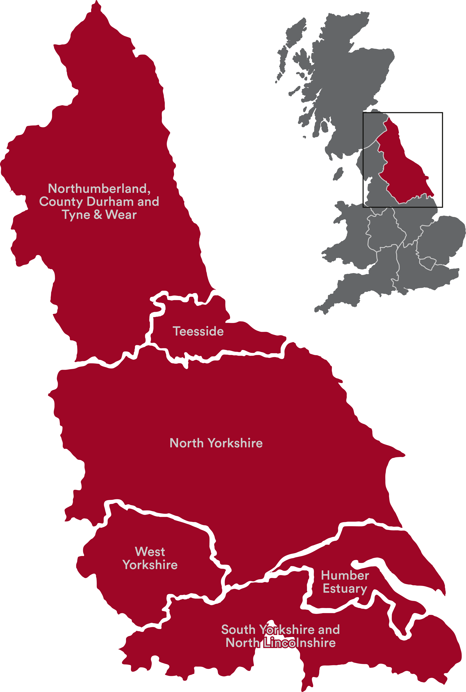
Northern Powergrid
Northern Powergrid is responsible for the electricity distribution network in the North East, Yorkshire and Northern Lincolnshire.
We move electricity from where it’s generated to homes and businesses.
We are the enabler of a net zero society.
We are a regulated utility business and therefore, we plan ahead of time in business plan cycles.
We are in the first year of our new business plan period (2023 to 2028 – Electricity Distribution 2, ED2)

Slide 3
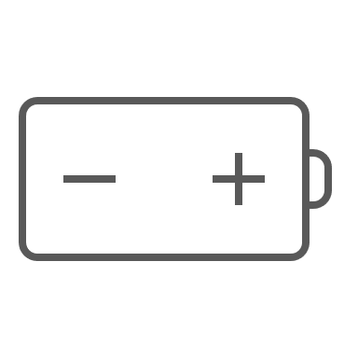
Our role in the energy system
Make it…
Move it…
Use it…
ELECTRICITY GENERATION
TRANSMISSION NETWORK
SUPPLIER
CUSTOMER HOMES AND BUSINESSES
Suppliers manage energy bills, tariffs and metering. Your energy bill is paid to your supplier.
Moves large amounts of electricity over long distances at very high voltages
Residential Customers
Industrial and Commercial Customers
Solar
DISTRIBUTION NETWORK
The distribution network takes electricity from the transmission network and smaller generators and delivers it to houses and businesses at a low voltage.
Wind
Storage
Electric Vehicle Charging
Electrified Heating
Smart Meters
Nuclear
Domestic Generation
Domestic Storage
DISTIBUTED GENERATION AND STORAGE
Northern Powergrid’s DSO business unit is responsible for managing a smarter, cleaner and more flexible energy network.
Gas
Coal
Smaller generation and storage connected directly to our network
Demand side response

Slide 4
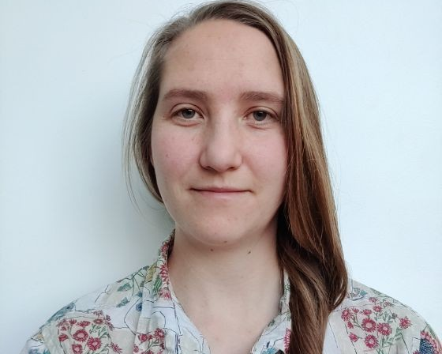
Local Area Energy Systems Team
We want to engage strategically with stakeholders to support and enable your plans
In recruitment Local Energy Systems Manager
Lizzie Boyes Local Systems Planning Engineer
Conor Edwards Local Systems Planning Engineer
Growing team in 2024
You can contact us at LAEP@northernpowergrid.com

Slide 5
Local Area Energy Systems Team
Areas for dialogue – we need to understand your plans as early as possible
Residential Decarbonisation – High volume heat pump installations
Local Area Energy Planning – Strategic ‘place based’ plans
Electric Vehicle (EV) Infrastructure Developments
Non-residential Decarbonisation
Talk to us when considering these types of projects and we’ll feed that intelligence into our network planning assumptions – informing where, when, what & how to invest

Slide 6
Northern Powergrid's Role in Local Area Energy Planning
As a network operator we are a primary stakeholder
We will support throughout the development and implementation of your LAEP by:
Providing guidance and supporting you in understanding our network
Providing network data
Participate in steering groups
Attend stakeholder engagement sessions

Slide 7
The Open Data Portal offers access to data and information about our electricity distribution network across the North East, Yorkshire and northern Lincolnshire.
The portal offers a host of interactive features for data users to access and use our data more effectively.
Notes:
DFES
Heat maps
LTDS

Slide 8
The Spatial Network Data offers spatial data and information about our electricity distribution network across the North East, Yorkshire and northern Lincolnshire.
The spatial data that is included is Extra High Voltage, High Voltage and Low Voltage cables, Sites, Link Boxes, and Feeder Pillars. The Local Area Energy Systems team can provide spatial data snipped to Local Authority boundaries.

Slide 9
The Distributed Secondary Substation (DSS) Utilisation Data offers utilisation data on local substations across the North East, Yorkshire and northern Lincolnshire.

Slide 10
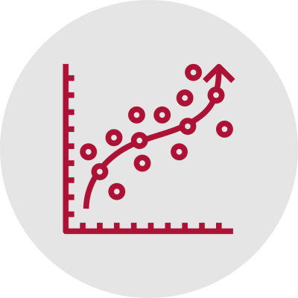
Distribution Future Energy Scenarios (DFES) Low Carbon Technology (LCT) Forecast disaggregated to the Distribution Secondary Substation (DSS).
Notes:
Heat pump and ev uptake by substation

Slide 11
Any questions?
Contact us at LAEP@northernpowergrid.com

