Slide 1
Net Zero Hub Summit
Alternative Sources of Heat
12 October 2023
Lizzie Lunn

Slide 2
Overview
North East and Devolution
Context
Benefits of heat networks
Heat Network Zoning
Sources of heat
Heat Networks and the North East
Support and the Energy Accelerator
Opportunities for the sector
Key Examples

Slide 3
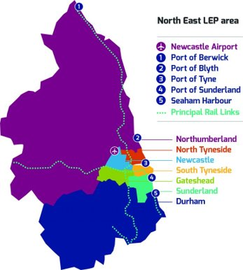
North East Devolution: North East Mayoral Combined Authority
North East has agreed devolution deal which transfers new powers and a £1.4bn investment fund over 30 years.
Result of strong cross-regional working and collaboration.
Opportunity to strengthen business, community and place collaboration and voice.
Mayor to be elected in May 2024.
Integration of the North East LEP.

Slide 4
Decarbonising Heat
The Climate Change Act commits the UK government by law to reducing greenhouse gas emissions by at least 100% of 1990 levels (net zero) by 2050.
Heating accounts for about 37% of total UK carbon emissions (17% for space heating, 4% hot water, 2% cooking and 14% industrial processes)
Keeping our homes warm costs us nearly half of our total energy spend.
Significant opportunity for job creation and other benefits, however some challenges include:
Scale / size of the challenge – only ~5% of homes currently have low carbon heating
No silver bullet for decarbonising heat
Poor energy efficiency in the UK
Lack of incentives and workforce

Slide 5
Heat Networks
In the UK today there are around 17000 heat networks connecting 500,000 customers, with 446,517 homes connected.
Can deliver warmth, cooling and security of supply to our homes and businesses.
Customers connected include domestic customers, retail, universities, hospitals, art, leisure and community buildings.
According to CCC, can provide around 18% of UK heat demand by 2050 (3% today)
Cost effective low carbon heat –reduce CO₂ by 700,000 tonnes and save 3,000GWh of gas imports a year
Utilising waste heat
Create jobs – 20-35,000 new direct jobs by 2050
Reduce consumer bills – customers on average save £100 a year compared to gas
Catalyst for growth - attract up to £60-80bn investment by 2050
Flexible stable energy system
Benefits

Slide 6
What role does a Local Authority have in the development of Heat Networks?
Source: Newcastle City Council

Slide 7
Heat Network Zoning
Heat network zoning will designate areas of England where heat networks can provide the lowest cost, low carbon heating solution.
It will enable pace and scale through:
Clear signalling
Reducing risk by
Facilitating co-ordination
Increasing revenue certainty
Developing heat network zones across the country will require billions of pounds of investment and deliver a low carbon heating revolution

Slide 8
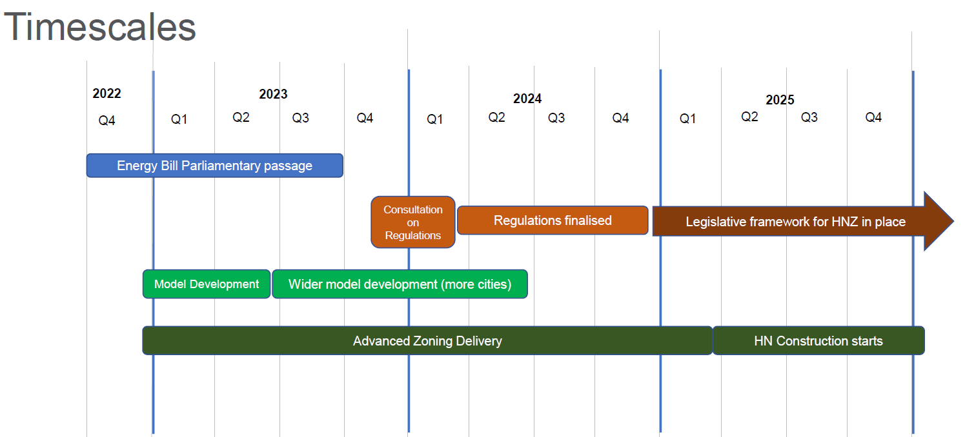
Primary Legislation
The Energy Bill is proceeding through Parliament. It will:
Provide powers to deliver zoning through regulations:
Nationwide methodology for identifying and designating zones
Creation of Zone Coordinator and Central Authority roles
Certain buildings and heat sources required to connect.
Establish the wider regulatory framework
Ofgem as regulator
Ensure fair and transparent pricing
Safeguard service standards
Enforce technical standards
Rights and powers licensing regime
Energy Ombudsman and Citizen Advice as alternative dispute resolution and consumer advocacy bodies.
Identifying Heat Network Zones
Standard methodology for identifying and designating zones.
Initial national modelling followed by local refinement
Initial pilot underway in 28 towns and cities including Newcastle and Sunderland

Slide 9
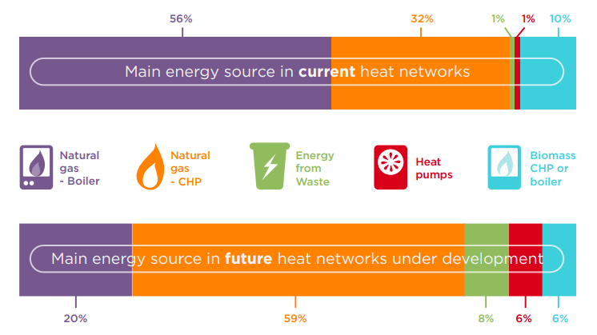
Sources of Heat
Heat networks are fuel agnostic
Examples:
Gas boilers
Combined Heat and Power plants
Waste heat (from industrial processes)
Biomass fuelled boilers
Large –scale heat pumps (water, air, or ground)
Geothermal sources
Underground transport e.g. London Underground waste heat
Waste heat from minewater
Deep geothermal
Data centres
Large-scale solar thermal (often with seasonal thermal stores).
Source: ADE, 2018: https://www.theade.co.uk/assets/docs/resources/Heat%20Networks%20in%20the%20UK_v5%20web%20single%20pages.pdf

Slide 10
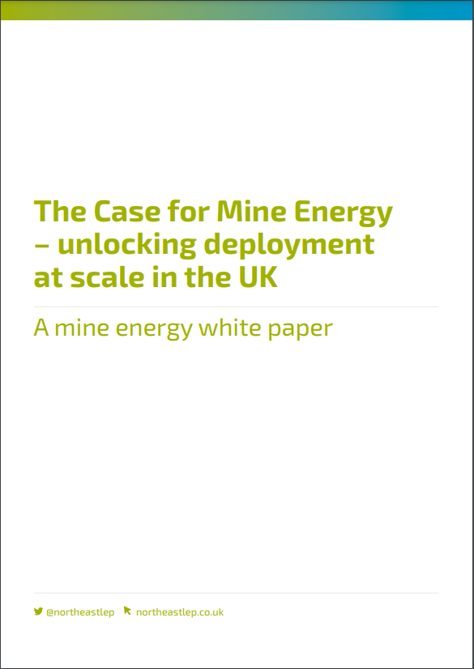
Minewater White Paper
Calls for greater support for mine energy as a key low carbon heat source in the UK.
Outlined how mine energy schemes could contribute to the government’s ‘levelling up’ agenda.
Coal Authority estimates one quarter of UK’s homes and businesses are sited on former coalfields – estimates 23,000 abandoned deep coal mines in the UK.
Coal Authority estimates that there is sufficient energy in mine water to heat all the homes on the coalfields.
42 schemes identified by the Coal Authority could generate carbon savings of 90,500 tonnes per annum, create up to 4,227 jobs and £293m GVA. An additional 9-11,000 jobs and £400-500m could be created through indirect and induced economic effects.
Benefits could be enhanced by using mines to store surplus (waste) or seasonally available (solar thermal heat sources).
Paper provides recommendations to move the sector beyond the need for public subsidy, to increase collaboration and knowledge sharing across stakeholders, and see targeted investment in research and development.

Slide 11
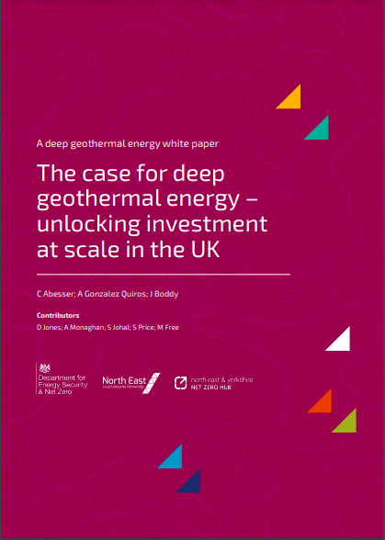
Deep Geothermal Whitepaper
Provides evidence for the acceleration, development and deployment of deep geothermal energy projects in the UK.
Outlines how deep geothermal energy can provide a low carbon source for heating, cooling and power generation.
Identifies potential opportunities and benefits that deep geothermal energy could deliver for the UK economy, local communities and government’s Net Zero commitments and energy security ambitions.
Identifies the challenges around the deployment deep geothermal energy.
Recommendations to build, scaleup and support the long-term growth of the sector, which include: reviewing financial support; signposting role of geothermal in UK net zero efforts; reviewing the legal status, regulation and licensing of geothermal energy; improved data availability and accessibility; understanding public perception of geothermal energy; and facilitating communication between stakeholder groups.
Individual deep geothermal projects in the UK could achieve total savings of 72,000 tonnes (geothermal heating project) and 700,000 tonnes (geothermal power project) of CO₂ equivalent over 30-year and 50year operational lifetime, respectively.
Has one of the lowest carbon footprints compared with other space and water heating technologies.
Economic and societal benefits, including tackling fuel poverty, job creation and opportunity to transition roles within oil and gas sector.
Next steps include creating cross hub working group, finding resource for the task force and working with National Geothermal Innovation Centre.

Slide 12
Support
Heat Networks Delivery Unit (HNDU) – provides grant funding and guidance through the early stages of project development:
Heat mapping, energy master planning, techno-economic feasibility and detailed project development.
Currently on Round 13, which closes on 31 December 2023.
Supports local authorities, registered social landlords, NHS Trusts, universities, other government departments, property developers
Green Heat Network Fund (GHNF) – capital grant support for the development of new and existing low and zero-carbon heat networks:
The commercialisation and construction of new low and zero carbon heat networks (including supply of cooling)
The retrofitting and expansion of existing heat networks.
Open to organisations in the public, private and third sectors in England.
Round 6 recently shut on 29th September
Heat Networks Efficiency Scheme (HNES) – supports performance improvements of existing district heating or communal heating projects.
Provides funding to public, private and third sector applicants in England and Wales.
For heat networks which are operating sub-optimally and resulting in poor outcomes for customers and operators.
Public Sector Decarbonisation Scheme – provides grant funding for public sector bodies to fund heat decarbonisation and energy efficiency measures
. Phase 3c has up to £230m available in 2024-2025. Expect it to open on 10th October 2023.
Public Sector Low Carbon Skills Fund – provided grants for public sector bodies to access skills and expertise to unlock heat decarbonisation on their estate.
BHIVE – Dynamic Purchasing System (DPS) for heat networks. Allows public sector heat network owners/developers in England and Wales to procure funding and funding-related services for their heat networks from a range of potential funders.
For Contracting Authorities wanting to raise funding to: finance a new heat network; finance the expansion of an existing heat network; facilitate the sale of part, or all, of an investment in a mature heat network.

Slide 13
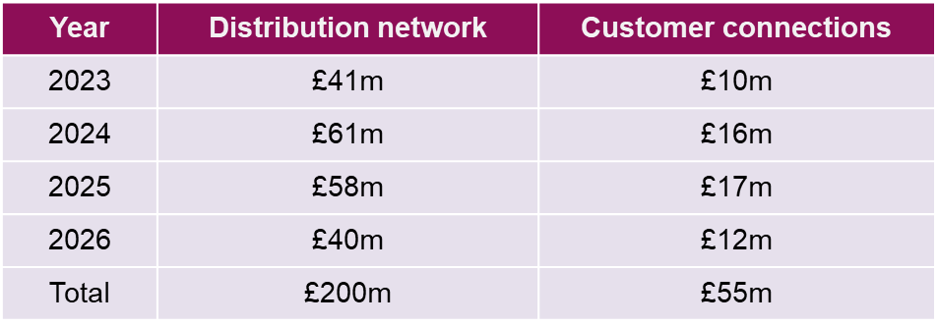
The North East Energy Accelerator
Developed to overcome market barriers and accelerate investment in low carbon projects across the North East
It was recognised that there was a lack of technical and commercial project development assistance which was a key barrier to developing low carbon projects and leveraging additional public and private sector funding. Building on existing good practise approaches such as Heat Networks Development Unit and the WYCA Energy Accelerator.
The NE EA programme has two dedicated Programme Managers to assist with project development and a Technical Capacity budget to support commercial, technical and legal consultancy projects require to get to the point of investment.
Funded by North East LEP, NTCA and the South of Tyne LAs.
£500m+ pipeline of projects ranging from techno-economic feasibility, detailed project design and with a wide range of commercialisation opportunities
Distribution network = pipework, valves, monitoring equipment etc + civils, trenching etc
Customer connections = installation and commissioning, heat exchanger / HIU, pumps, pipework etc

Slide 14
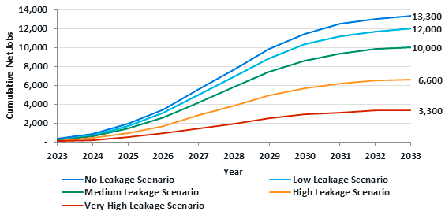
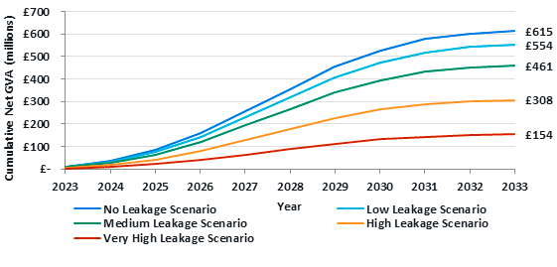
Heat networks in the North East: the opportunity
North East is home to around 9% of UK heat networks, however, adjusted for economic activity (heat capacity per £mGVA), the North East is second only to the North West and London.
In 2018, Heat Networks in North East and Tees Valley were successful on the government’s High Potential Opportunities (HPO) programme to drive direct inward investment.
Partnership working for further cluster development.
Steer study to develop a forward looking North East heat Networks Supply Chain Strategy:
Heat networks have significant and growing business base in the North East (31 businesses, 1,229 employees).
Worth £106.6m in sales in 2019/20 and grew in the three years preceding 2019 by 11.5%.

Slide 15
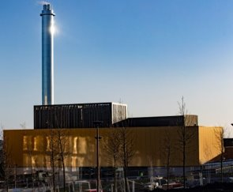
Examples : Newcastle Helix
£20m Energy centre
Provides affordable low carbon heat to businesses on the 24-acre Helix site, a landmark strategic development site for science, research and innovation as well as the nearby Victorian building Blandford House and in the future residential buildings via a network of pre-insulated underground pipes
Energy centre also provides district cooling and private wire electricity to the Helix site
732m² purpose-built energy centre
Tri-generation, Combined Heat and Power led scheme
300m³ of thermal storage, 110m³ of which is heating
Provides 10MW of heating
5MW of cooling
8MVA of power to the connected buildings on the site
30,650 thousand tonnes of carbon over lifetime
Centre received ERDF and Local Growth Deal Funding and opened in 2020.
40-year JV partnership between EQUANS and Newcastle City Council.
Opportunities to extend the original 5.2km of pipework
An incremental decarbonisation journey planned with soon to be installed Low and Zero Carbon (LZC) technology (air source heat pump, 2025)

Slide 16
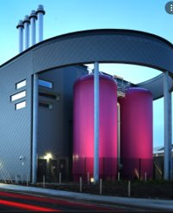
Gateshead Town Centre District Energy Scheme
£25m supplying heat and electricity via new 5km underground network of heat pipes and high voltage ‘private-wire’ electricity cables.
4MW Gas-Fired Combined Heat and Power.
Integrates heat and power generation and distribution, with energy storage, whilst providing national grid services.
Customers receive at least 5% discount compared to market energy tariffs.
Operated by Gateshead Energy Company, a public limited company wholly owned by Gateshead Council.
ERDF grant.
Completed in March 2017.
Won ADE’s Visionary Project Award.
Already being extended – 2km extension connecting 5 more buildings, 300 new build housing units, connection of Gateshead Quays and 5 high rise blocks.
6MW minewater heat pump energy centre, will supplement the network with heat from abandoned mineworking.
0.5MW of solar PV currently and plans to increase capacity.
Minewater for cooling.
Connecting EV charging points.

Slide 17
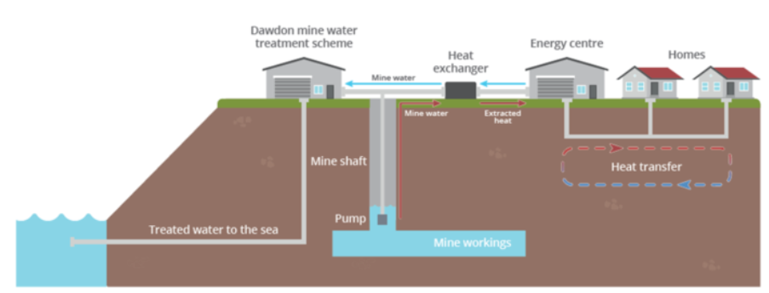
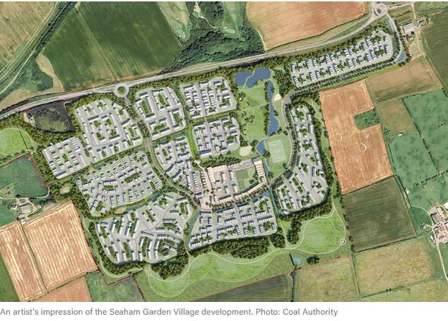
Seaham Garden Village Project: Geothermal heat shallow – Mine Energy Heat Networks
The site will provide space heating and domestic hot water for 1,500 homes, a primary school, shops, health and wellbeing hub and an innovation centre.
6MW of low carbon energy and 20kV new high voltage network

Slide 18
River heat source – River Tyne Viking Energy Network Jarrow Project
Situated on a council brownfield site on south bank of the River Tyne
Extract river water and use Water Source Heat Pump (WSHP) technology
Connect nine buildings via network of pipelines and power cables including leisure centre, residential tower blocks, business centre and Town Hall.
Situated on a former industrial site which has been disused for 12 years.
Savings of 1,000 tonnes of carbon and £500k a year.
Possible future expansion
Heat network powered by 1MW solar farm
Gas CHP back-up system
Private wire electrical network with storge battery
ERDF funding
https://youtu.be/hlzaS8lFOI0

Slide 19
Thank you for listening
Elizabeth.lunn@northoftyne-ca.gov.uk

