Slide 1
Improving the Energy Efficiency of our Homes and Buildings
Nicole Huston
Housing Retrofit Project Manager, NEY NZ Hub

Slide 2
What is retrofit?
Retrofit is the process of making changes to existing buildings so that energy consumption and emissions are reduced.

Slide 3
Why retrofit?
Increase Warmth & Comfort
Reduce Emissions
Regulatory compliance
Reduce bills
Lower consumption
Homes account for 26% of the UK's carbon emissions

Slide 4
Fabric First vs Whole House Retrofit
Fabric First is an approach to retrofitting homes that aims to reduce demand for heat and power as far as possible, through insulation and airtightness combined with adequate ventilation, before improving or decarbonising the building services or installing renewable energy systems.
Whole house retrofit is a comprehensive plan for home improvements. It’s devised with the aim of ensuring that a property operates in as energy-efficient a manner as possible, with all aspects of the building complementing each other.

Slide 5
What options are
available?
Windows & Doors
Insulation
Renewables
Heating
Lighting
Ventilation

Slide 6
What options are
available?
Windows & Doors
Insulation
Renewables
Heating
Lighting
Ventilation
Cavity wall insulation
External wall insulation (EWI
Internal wall insulation (IWI)
Loft or roof insulation
Under-floor insulation

Slide 7
What options are
available?
Windows & Doors
Insulation
Renewables
Heating
Lighting
Ventilation
Cavity wall insulation
External wall insulation (EWI
Internal wall insulation (IWI)
Loft or roof insulation
Under-floor insulation
Double or triple glazing
Energy efficient doors

Slide 8
What options are
available?
Windows & Doors
Insulation
Renewables
Heating
Lighting
Ventilation
Cavity wall insulation
External wall insulation (EWI
Internal wall insulation (IWI)
Loft or roof insulation
Under-floor insulation
Double or triple glazing
Energy efficient doors
Air source/ground source heat pumps
Solar panels (PV)
Micro wind generation
Solar water heating (solar thermal)

Slide 9
What options are
available?
Windows & Doors
Insulation
Renewables
Heating
Lighting
Ventilation
Heating controls (e.g., remotely controllable thermostats, zone controls, smart radiator valves)
• Modern Storage Heaters

Slide 10
What options are
available?
Windows & Doors
Insulation
Renewables
Heating
Lighting
Ventilation
Heating controls (e.g., remotely controllable thermostats, zone controls, smart radiator valves)
• Modern Storage Heaters
Low Energy LEDs
Mechanical ventilation with heat recovery (MVHR)
Demand controlled ventilation
Background ventilation • Natural and purge ventilation

Slide 11
Retrofit in the Region
Since 2020, over 6800 homes across the North East and Yorkshire have received retrofit measures under one or more of the following Government schemes.
LAD 1a and 1b
(2020 – 2022)
LAD 2
(2020 – 2022)
Sustainable Warmth (LAD3 and HUG1) (2021 – 2023)
Social Housing Decarbonisation Fund Wave 1 (2021 – 2023)

Slide 12
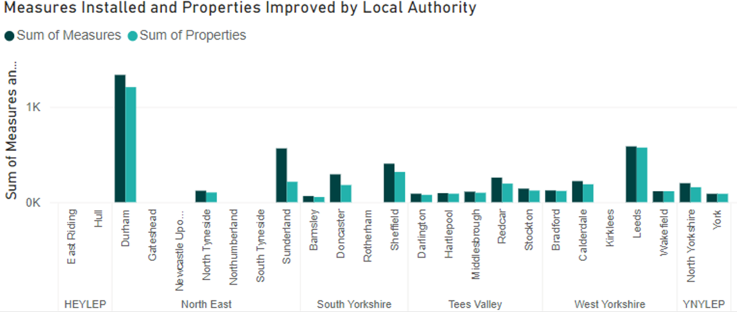
Local Authority Delivery Scheme Phase 2 (LAD2)
The NEY Net Zero Hub delivered £40m of funding on behalf of the Department for Energy Security and Net Zero (DESNZ)
The fund was offered to 31 LAs in our region - 26 were involved in LAD2 delivery, including 2 consortiums.
The funding provided 4804 measures in over 3800 homes across the region.

Slide 13
Ongoing programme delivery
SHDF2.1
(2023 – 2025)
HUG2
(2023 – 2025)
SHDF 2.2
(2024 – 2025/26)
Social Housing Decarbonisation Fund (wave 2.1)
The NEY Net Zero Hub is leading a consortium of 19 partners to deliver the £80m retrofit programme to 5,525 homes. The scheme aims to raise the EPC rating of social homes to a minimum Band C to reduce the number of people in fuel poverty and drive down CO2 emissions.
Measures include insulation, draught proofing, solar panels, heat pumps and many more.
HUG2 and SHDF 2.2
The NEY Net Zero Hub is committed to supporting eligible organisations access through funding through HUG2 and SHDF2.2 whether it’s bringing consortiums together or supporting applications

Slide 14
Local Energy Advice Demonstrator (LEAD)
The NEY Net Zero Hub is working with DESNZ and the four other Net Zero Hubs to deliver a Local Energy Advice Demonstrator programme. The programme will provide over £4million of funding to 7 different projects partners in the North -East of England running from Summer 2023 until March 2025.
The aim of the local energy advice pilots is to test various approaches to delivering in-person advice, with a particular focus on harder-to-treat properties and harder-to-reach consumer groups.
North of Tyne Combined Authority
Efficiency North
North Yorkshire Council
Groundwork Yorkshire
West Yorkshire Combined Authority
YES Energy
City of York
Council

Slide 15
North East and Yorkshire Public Estates Decarbonisation
(NEYPED)
The aim of the project was to support public sector organisations in the development of their heat decorbonisation plans, which would ultimately be used to access government funding opportunities sich as the Publisv Sector Decarbonisation Scheme
Turner & Townsend and Locogen delivered 60 heat decarbonisation plans in the North-East and Yorkshire region for Local Authorities as well as NHS Trusts and other public bodies
A package of guidance documents, toolkits and recordings have been developed which are freely available through the Net Zero Hub. These will assist organisations in rationalising future PDSC applications as well as delivery of low carbon projects

Slide 16
North East and Yorkshire Public Estates Decarbonisation
(NEYPED)
The aim of the project was to support public sector organisations in the development of their heat decorbonisation plans, which would ultimately be used to access government funding opportunities sich as the Publisv Sector Decarbonisation Scheme
Turner & Townsend and Locogen delivered 60 heat decarbonisation plans in the North-East and Yorkshire region for Local Authorities as well as NHS Trusts and other public bodies
A package of guidance documents, toolkits and recordings have been developed which are freely available through the Net Zero Hub. These will assist organisations in rationalising future PDSC applications as well as delivery of low carbon projects
NEYPED + coming soon….

Slide 17
Looking Forward
The NEY Net Zero Hub are conducting an evaluation of housing retrofit activity in the NEY region.
The evaluation will be a comprehensive analysis of complete and active housing retrofit programmes seeking to understand the lived experience of those involved in the programmes.
Overall, the evaluation seeks to understand opportunities to improve the implementation of future rollouts of similar housing retrofit programmes.
There will also be a reflection on how these findings should inform national housing retrofit policy and future programme development as well as the Hub’s retrofit support workstream.

