Slide 1
North East and Yorkshire Net Zero Hub
LAEP – The Role of Data
Spatial & Temporal Modelling (STeM)

Slide 2
How are we doing?
We are busy but are we effective?
What are the Critical Success Factors?
Short-termism
Reliant on or responding to UKGov funding
UKGov policy driven
Many routes to Net Zero, how do we choose?
NZ by any means?
Co-benefits?
What else are we trying to do?
More bang per buck!
Logical phasing
Planning for uncertainty
Notes:
Have we clearly defined the problem? Net Zero isn’t a goal in itself, it’s one of the measures of success but not the only one, how do we make the right choices and how do we seek support? No solutions, only trade-offs!

Slide 3
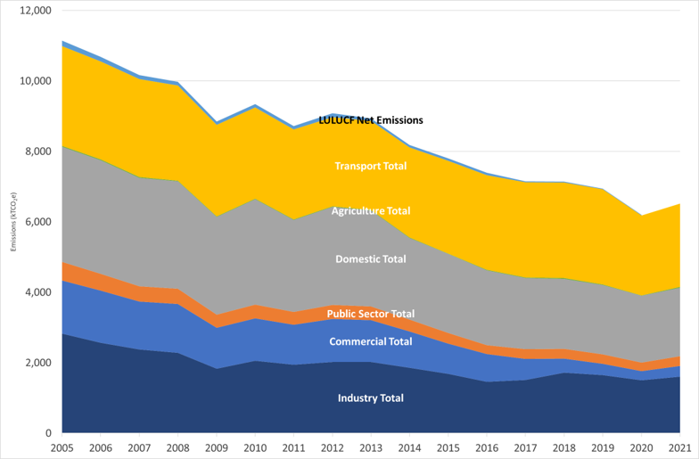
Where are we now?
We all have graphs like this…

Slide 4
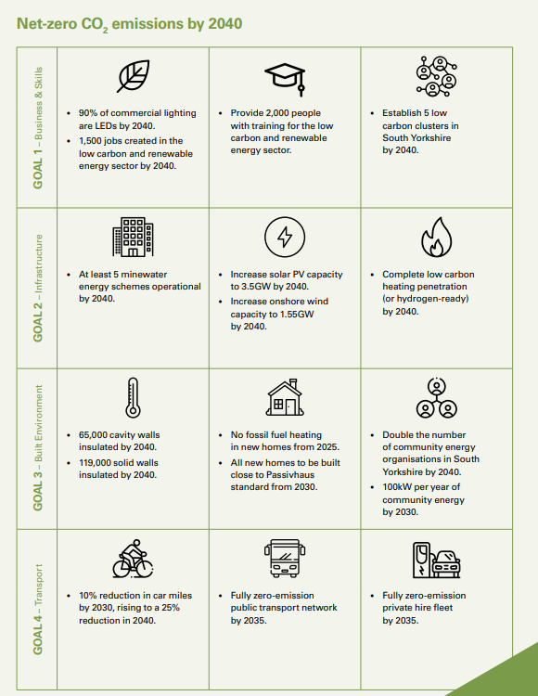
Where are we now?
…and strategies like this
How do we turn this into action?
There are many was to achieve this potentially (and not Net Zero)
How do we understand whether this is possible and how much it will cost?
How do we choose the right path?
Notes:
Lots of targets isolated from each other, it’s possible to do all of these and not achieve Net Zero or create a better future

Slide 5
What do we normally do?
Commission consultants!
Approach each target separately
Develop business cases
Get a lot of .pdf reports!
Notes:
We would commission consultants to study each target or sector

Slide 6
What do Consultants do?
DATA
PDF REPORT
‘Black Box’ Process
Consultant
Client
Notes:
Consultants create the evidence base, which they keep, they feed this into models, which they own, and we get the output, typically a pdf report, possibly some GIS layers and a couple of spreadsheets

Slide 7
What’s the problem?
Can’t make strategy juice
Complex to harmonise data from each individual study and strategy
Net Zero issues have complex interdependencies
We are not the only actor and we don’t decide the majority of the policy
Notes:
We rarely have access to the evidence base, we rarely understand or have access to the modelling, too much proprietary software, it’s impossible to harmonise the findings from a number of isolated reports into a coherent plan which accounts for the complex interdependencies, what do we do when things change?

Slide 8
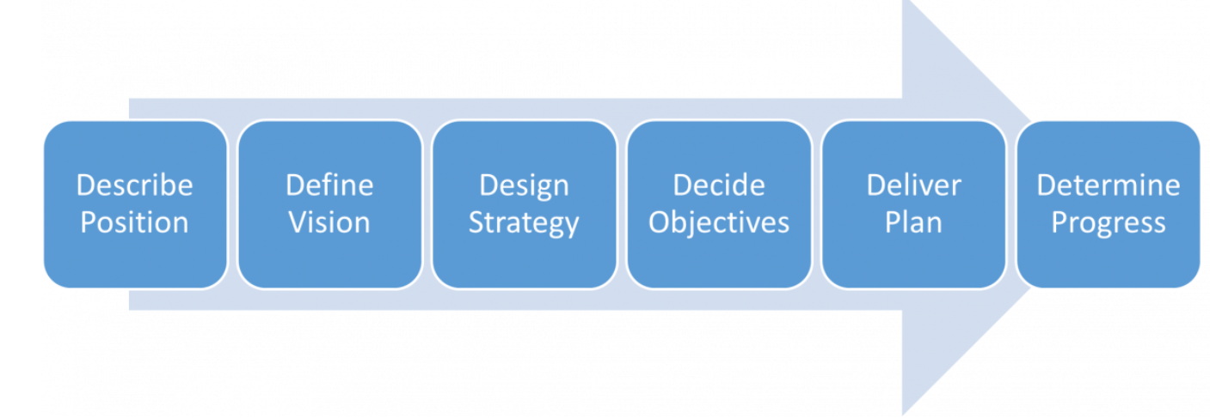
What is a Strategy?
Just a plan
We tend to approach this as linear
Strategy is not an end in itself
Could this be a dynamic process instead?
Notes:
The first point in a strategy is to understand the world right now, usually through data gathering. How do we make this a dynamic process? How do we always have a plan based on the latest data? How do we develop models which can account for interdependencies and allow for us to update them?

Slide 9
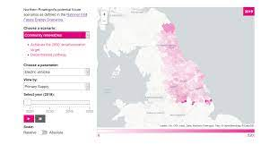
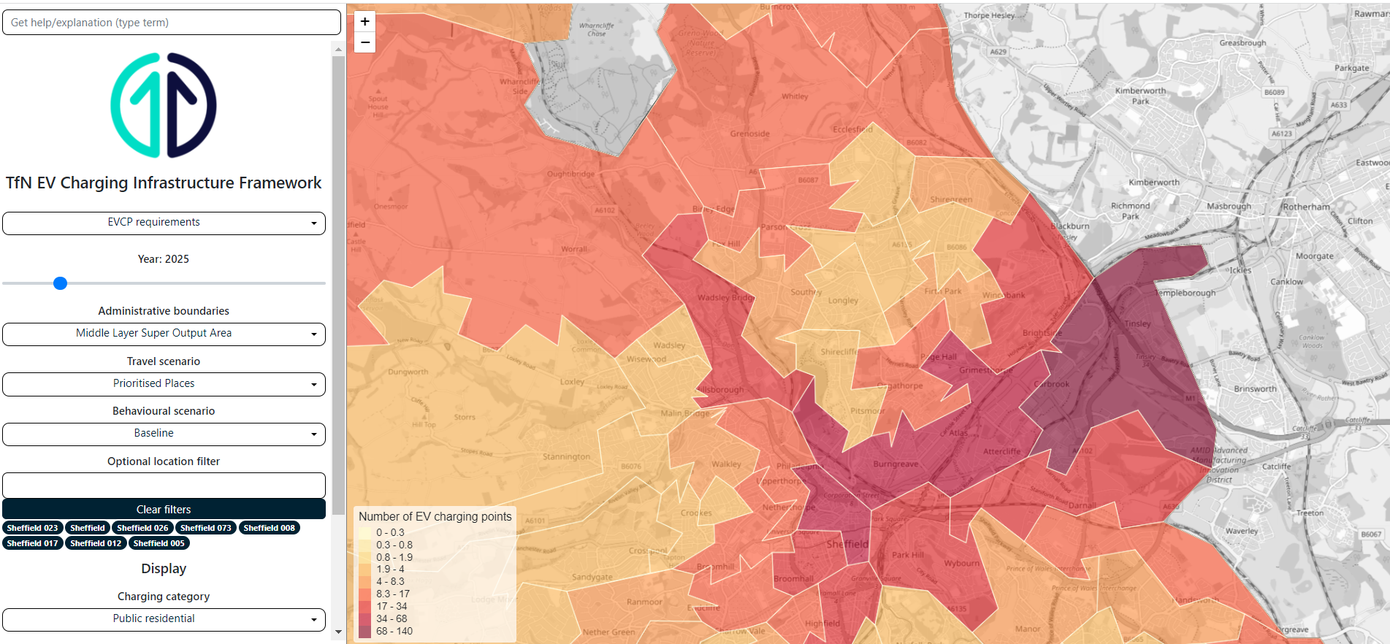
Planning for uncertainty
Notes:
There are examples of how this can be done, some of the oldest are the Future Energy Scenarios and Distribution Future Energy Scenarios but more recent sectoral examples include TFN’s EVCI tool which combine temporal models with geospatial representation and visualisation

Slide 10
Key takeaways
Spatial
Range of credible pathways explored
Pathways map to geography
Project development
Temporal
Use of data driven scenarios
Pathways can be tested
Changes can be incorporated
Adaptive
Responder as well as activist
Model can be updated and calibrated against reality
Data granularity can be improved
Linear
End goal remains the same
Policy and strategy based
Continuous improvement
Notes:
What do good examples have in common? They are spatial and temporal data based models that have geospatial representation and visualisation

Slide 11
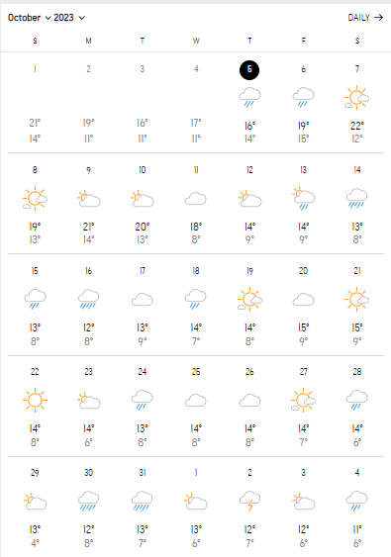
LAEP Methodology
Issue is not with the methodology itself but the process and end point
Still based in the ‘black box’ (or Magic 8 Ball) paradigm
Still based in the .pdf paradigm
Relatively slow and relatively expensive
Notes:
So where does the current LAEP methodology fit into this? Methodology itself is sound but we need to move the key parts of the process, the evidence base, modelling and visualisation, to client ownership
At the moment it’s like printing off a weather forecast for the year, it’s pretty accurate for a few weeks perhaps but then starts to get less and less reliable
What happens when something changes? You go back to the consultant to re-run the model
How do you ensure progress is still keeping you on-track to achieve net zero?

Slide 12
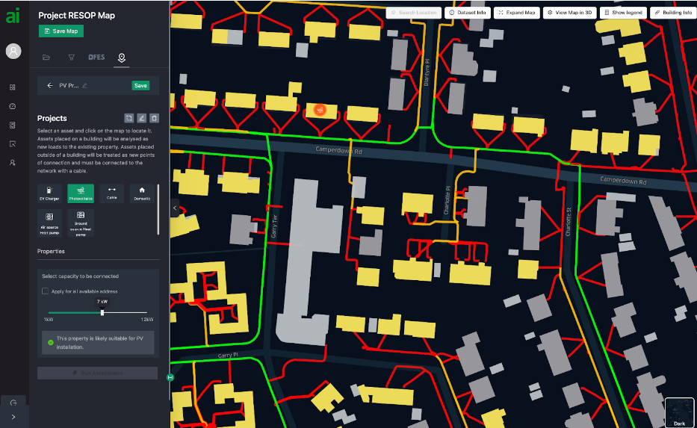
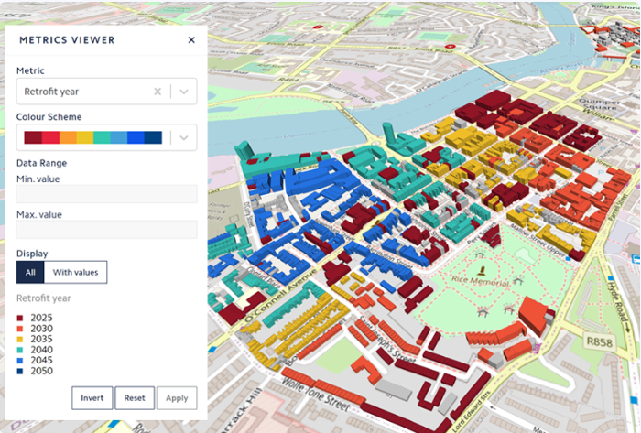
What’s the solution?
Notes:
Emerging software-as-a-service with data expertise to support to develop detailed models of cities and regions
Based in ‘digital twinning’, so creating virtual simulations of real world systems such as buildings or energy infrastructure to understand the impacts of changes
Temporal modelling not well understood currently but potential to develop using algorithms and Artificial Intelligence
Very nascent field, we need to work with suppliers to ensure we get the tools we need

Slide 13
STeM Project
Review policy background and similar examples of planning for uncertainty
Review local and combined authority preparedness and evidence of emerging need
Demonstrate case for change
Review commercial market offerings and assess against identified needs
Make recommendations on resources, training, and commercial market
Will be a .pdf!

Slide 14
Questions?
George Lee
Senior Development Manager
(Energy & Sustainability)
george.Lee@southyorkshire-ca.gov.uk

