Slide 1

Leisure Centre Guide to Installing Solar Power
Building in Net Zero

Slide 2


01
02
03
Introduction
About Solar PV
Routes to installation
Page 3
Page 5
Page 10
04
05
06
Case Studies
Next Steps
Page 18
Page 21
Page 26
Contents

Slide 3
01
Introduction
Why solar PV? Why now?

Slide 4


Introduction
Why Solar Power? Why now?
Solar power is generated using solar photovoltaics (PV) and is a source of renewable energy that can save you money on your electricity bills, protect you against future electricity price increases and reduce your carbon emissions.
Electricity bills have increased significantly, and this has placed leisure centres’ revenue budgets under significant pressure. In this guide we hear from leisure centres that are reaping rewards from solar power by saving thousands of pounds off their electricity bills. It also outlines the recommended options to deliver solar power on your leisure centre – even if you don’t have the funds to invest.
Many leisure centres have the potential to benefit from renewable energy. If you are interested in moving forward with installing solar power on your leisure centre, project development and procurement support could be available. Please refer to the Next Steps section for more information on this.
4

Slide 5
02
About Solar PV
Let’s sort the facts from the myths

Slide 6
About Solar Power
Let’s sort the facts from the myths
How does it work?
Solar power systems convert energy from the sun into electricity, even on cloudy days. This ‘free’ electricity can be used to run leisure centre equipment, appliances and lighting. Any electricity that isn’t used can be exported to the grid or stored in a battery for use when the solar power system is not generating. It’s even possible to share it with your neighbours under the right arrangement.
How much does it cost?
The cost depends on details such as the size of the system installed, roof type and building height. Recent system costs for systems between 10-50 kilowatt peak output (kWp) in size are ranging from £18k-£90k. Bigger systems are more expensive, but they generate more electricity and so can save you more in electricity bills.
Are there any grants or finance options available to help you pay for a solar power system?
There aren’t currently any dedicated capital grants for solar power, however:
Sport England can provide funding where applicable and should be contacted if interested.
Funding may be available from the Voluntary, Community, and Social Enterprise (VCSE) Energy Efficiency Scheme if eligible.
The Public Sector Decarbonisation Scheme (PSDS) may be able to fund it provided it’s integrated into a whole system decarbonisation scheme.
Third party finance options are widely available.
The Smart Export Guarantee (SEG) scheme is currently open and provides payment for any surplus electricity exported to the grid.
6

Slide 7
What are the benefits?
Reduces electricity bills by reducing the need to pay for imported electricity from the grid:
  Organisation budgets can be used elsewhere
Reduces carbon emissions by reducing your dependency on grid electricity which doesn’t always come from 100% renewable sources:
  Contribute to tackling the climate crisis (UK power stations contributed to 16% of the UK’s carbon dioxide emissions in 2022)
  Contribute to reducing air pollution and improving air quality
It is a trusted and mature technology with established supply chains
Improve site resilience if combined with battery storage (e.g., still have power in times of a power cut) and also can be integrated alongside backup diesel generators if required
If community group funded, their profits are often reinvested into local community projects
Will the installation damage my roof?
Solar panels are installed on brackets/frames and assuming a Microgeneration Certification Scheme (MCS) accredited installer is used, and the existing roof is in good condition, roof damage is very unlikely.
Will they decrease the value of the property?
Studies have shown that solar panels will increase the value of property rather than decrease.*
*The studies are targeted towards domestic properties however similar results are expected for non-domestic. An example study was performed by Solar Energy UK.
7

Slide 8
What about maintenance?
Solar panels should last 25 years or more with little loss in efficiency.
Any roofs that have an issue with birds should have a mesh included in the system design to help manage future maintenance requirements.
A maintenance inspection every 1-2 years will help to make sure the system is clean and in good working order. These inspections can be straightforward to integrate into normal maintenance activities.
The main cost will be to replace the inverter which typically lasts for 10-15 years (circa 6% of the system cost).
It’s important to monitor the generation of the system, which can be through remote monitoring installed with the power system.
Does it matter about my roof direction, pitch and type?
South, East and West facing roofs can all be used for solar power. North facing roofs are not often recommended. Unshaded roofs are best but not essential.
Solar power systems can be installed on both flat and pitched roofs. The roof construction will impact on the price to install, and a survey will be required to check that the roof condition and structure are suitable. If roof upgrade works are required it will be an additional cost.
What happens if I need more electricity than the solar power system can generate?
Leisure centres are connected to the local electricity grid so you will never be without a supply of electricity during operation. If your solar power system generates more electricity than you need, the excess can be exported into the grid. If, on the other hand, you need more electricity than your solar panels are generating, the grid can supply this. It is important to note that your system should be optimised to match your buildings electricity consumption as best as possible to limit excessive electricity exports due to the current low economic value in exporting electricity.
What’s the installation process like?
Solar power systems are typically straightforward to install in a leisure centre environment as most of the work is on the roof. With appropriate planning, typical schemes have completed within one week. Also, it is important to make sure that your solar panel supplier is made aware of any roof warranty and insurance requirements.
8

Slide 9
Do I need permission?
You will need the building owners’ permission to install a solar power system.
Solar panels on roofs are considered ‘permitted development’ and often don’t require planning permission. However, it’s best to check with your local planning office regarding prior approvals. Restrictions may apply if your building is listed or in a conservation area.
You might need permission from your local distribution network operator to install solar power – for Greater Manchester this is Electricity North West. Your solar panel supplier will typically deal with all necessary distribution network operator applications. However, Electricity North West is happy to be contacted to discuss your project prior to a supplier being appointed.
How do I go about procuring a solar power system?
Demand is currently high for solar power. Costs and quality can vary greatly so it is worth getting at least three quotes from Microgeneration Certification Scheme (MCS) accredited installers. Note, the cheapest panels do not necessarily represent the best value for money.
The Greater Manchester Combined Authority have a solar power procurement framework that may be available for leisure centres to use (subject to eligibility). It offers access to quality assured suppliers and procurement support. You might also want to consider collective purchase with other leisure centres.
Refer to the Next Steps section for more information.
Will it impact my ability to install other energy saving measures?
Solar power complements other technologies that lower carbon emissions and energy costs (such as low-carbon heating and LED lighting). It is worth planning your investment in carbon reduction as a whole building approach, even though you might wish to prioritise the installation of solar power, as other interventions may be more cost- and carbon-efficient. It is recommended that a building survey is carried out by an Energy Efficiency Advisor.
9

Slide 10
03
Routes to installation
What are the options and how do they differ?

Slide 11
Leisure Centre Delivery Route Decision Tree
Do you have surplus budget to invest in an entire power system?
Routes to installation
What are the options/models and how do they differ?
NO
YES
Self-owned and operated
Model 1 – Funded from internal budget
Third-party owned and operated
Model 3 – Funded from an energy service company
Other emerging models
Model 5 – Joint venture (funded from self and third-party)
Model 4 – Funded from a community group
Model 2 – Funded from an external loan
Model 6 – Innovative multi-party arrangements
Are you eligible for a loan?
Model 1 – Evaluate business case for allocating surplus budget to power system (zero cost energy tariff)
Do you have any surplus budget at all for some contribution into a power system?
YES
NO
Model 2 – Fund from an external loan
YES
NO
Model 5 – Consider joint venture with a third-party
Model 3, 4 or 6 – A third party owned and operated system or an innovative multi-party arrangement
11

Slide 12
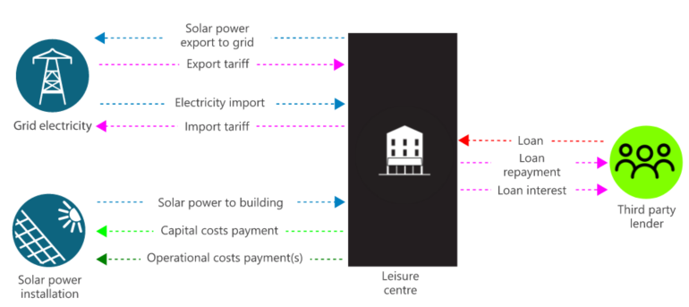
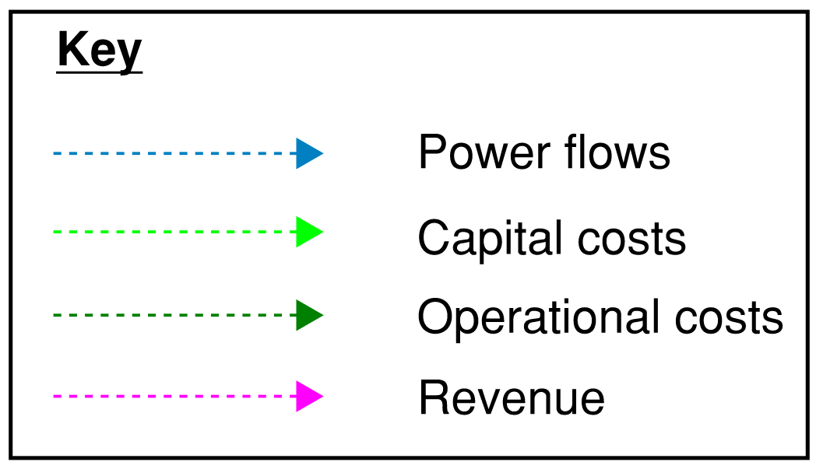
Summary:
The leisure centre procures the solar power installation from a solar panel supplier.
The leisure centre is responsible for procuring and/or managing panel maintenance and insurance.
The electricity generated offsets the leisure centre’s imported grid electricity, resulting in reduced energy bills.
Excess solar power generation that isn’t used on site can be exported to the grid. The leisure centre would receive a revenue for this from the Smart Export Guarantee (SEG). You can apply for a SEG tariff with any SEG Licensee – it does not need to be the same company as your current energy supplier.
This model avoids having to lease or licence the use of the leisure centre premises, or parts of them, to third parties as well as having to pay any interest payments on loans.
Reduce site exposure to energy price volatility due to the reduction in imported electricity.
This model will give you the cheapest solar tariff (zero cost zero cost of electricity) and negates the need for third-party arrangements.
Model 1 – Self-owned and operated:
Funded from internal budget
12

Slide 13
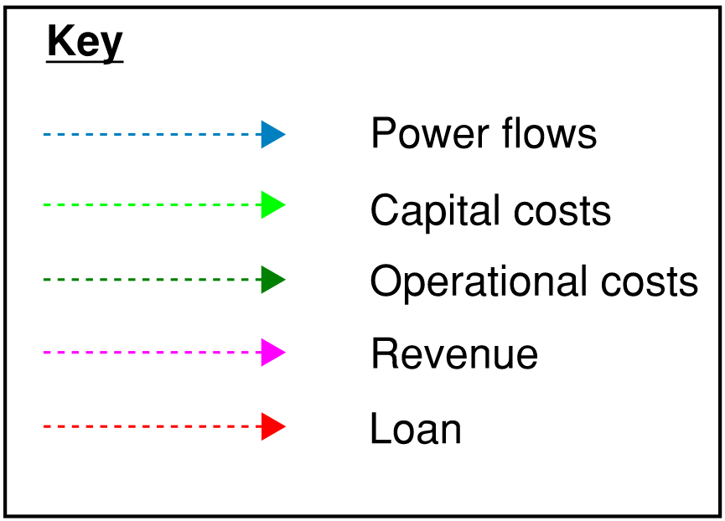
Summary:
This model is the same as the previous with the only difference being capital costs are covered by a loan.
Interest rates will likely be incurred on the loan
The leisure centre procures the solar power installation from a solar panel supplier.
The leisure centre is responsible for procuring and/or managing panel maintenance and insurance.
The electricity generated offsets the leisure centre’s imported grid electricity, resulting in reduced energy bills.
Excess solar power that isn’t used on site can be exported to the grid. The leisure centre would receive a revenue for this from the Smart Export Guarantee (SEG). You can apply for a SEG tariff with any SEG Licensee – it does not need to be the same company as your current energy supplier.
This model avoids upfront capital expenditure and may allow an offset of loan interest against tax.
Model 2 – Self-owned and operated:
Funded from external loan
13

Slide 14
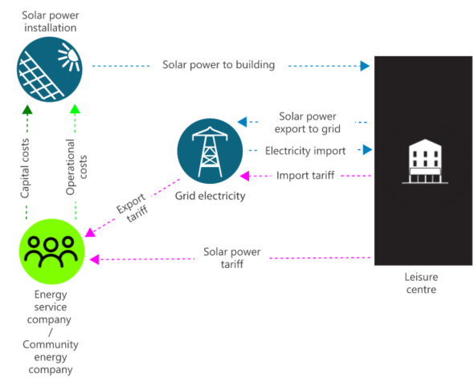
Summary:
The installation is funded by a service provider. The service provider could be an energy service company or a community energy company.
There is no initial capital expenditure by the leisure centre. The third-party owns and operates the system, and sells the electricity generated to the leisure centre at a preferential rate under a long-term power purchase agreement (typically 10 years or more).
An energy service company is a for-profit company whereas a community energy company is a not-for-profit company, meaning community group funded projects will have more favourable tariff costs. The community energy company’s power tariff will typically be ~10% lower than that of an energy service company’s.
The service provider receives any revenue from the export tariff.
Key considerations for this model are the contractual agreements (e.g. roof lease and power purchase agreements (PPA)) and compensation clauses (e.g. if the panels needed to be removed to repair the roof) that would need to be put in place to facilitate the service.
This model negates the need for capital and operational expenditure or loaned finance in return for a suitable tariff through a contractual arrangement.
Model 3/4 – Third-party owned and operated:
Funded from energy service company or community energy company
14

Slide 15
Joint venture and other bespoke multi-party arrangements
There are other emerging models that could be considered at your site(s) should the common business models not be applicable. Descriptions of two key ones are given below:
Model 5 – Joint venture: This is an arrangement between your organisation and another external partner. Both parties are going to get benefits out of the system, but they need to agree on how to divide the benefits and costs. This is usually mainly based on how much capital each party puts into the project.
Model 6 – Bespoke multi-party arrangements: This is a customised plan involving many parties (people or buildings in this case) working together to enable the solar power installation. It creates a way to share the energy fairly, even with those who might not be able to house a solar power installation themselves.
The key takeaway is that there are other beneficial arrangements that could be explored for most sites when initially it may seem impossible. There are also several specialists that can provide these offerings should they be of interest.
15

Slide 16
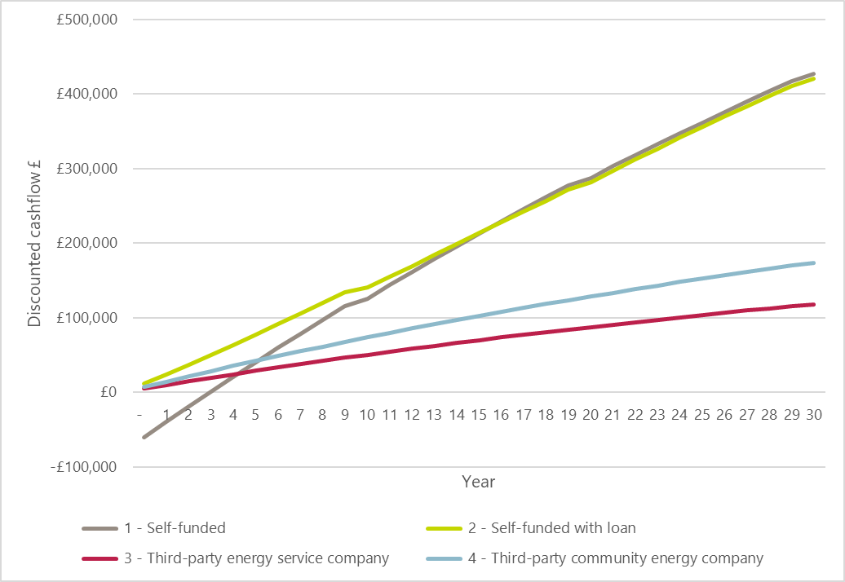
Financial Comparison
Financial performance summary
The chart opposite compares the key funding options (business models) for an example case study, Irlam and Cadishead (slide 18). The different funding sources include; self (without loan), self with loan, third-party energy service company, and third-party community energy company. These are models 1 to 4 that were previously described.
This chart shows the estimated value of the project (from the leisure centre’s perspective) for each year of the project’s expected lifetime.
The assumptions and inputs for this graph are shown in the appendix (slide 26). Note that these results/benefits are heavily dependent on grid electricity import costs.
Key observations from the chart are as follows:
The self-funded model (without loan) is negative at the start due to the large initial capital outlay and pays back the original investment within 3 years
For the self-funded models, there is a slight reduction in cashflow in years 10 and 20 due to an assumed cost for replacing the inverter
The value of the self-funded models are around 2 - 4 times that of the third-party models at the end of the project’s lifetime
The self-funded (without loan) model ends at a higher value than the self-funded with loan model because it does not have the loan interest payments
The third-party models are consistently inclining throughout due to their lack of operational and maintenance costs. Note that the community energy company model inclines at a greater rate because of the cheaper power tariff
16

Slide 17
04
Case Studies
Where has solar power been implemented locally?

Slide 18
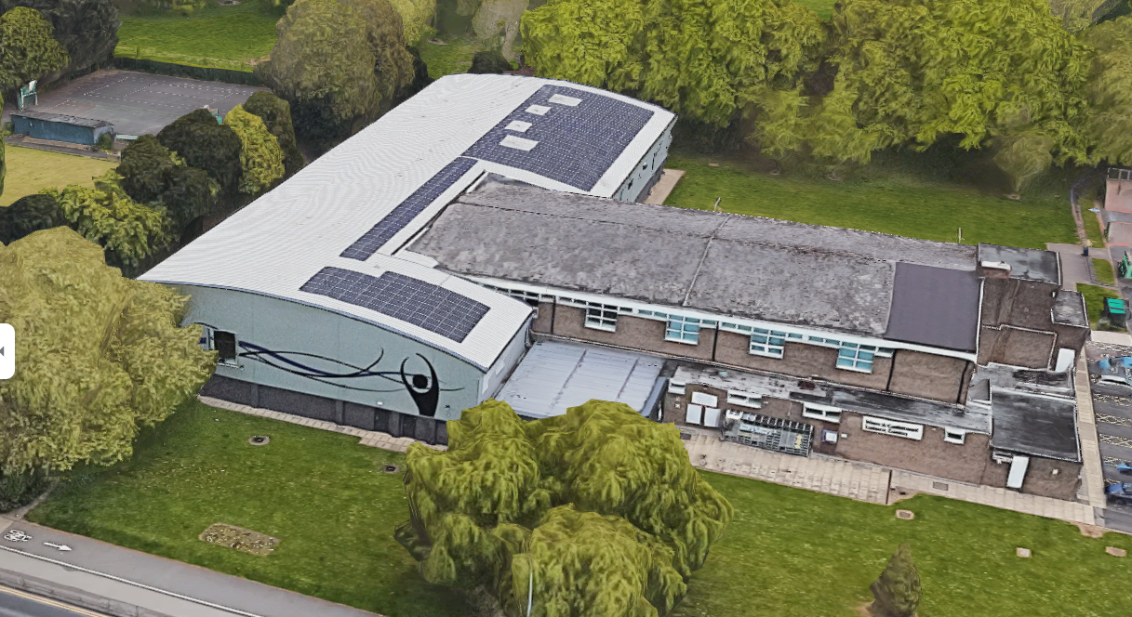
Irlam and Cadishead Leisure Centre
Case Study: Irlam
Solar power was installed on a curved roof
System was commissioned in March 2022 (over 1 year since the time of writing)
£46,000 energy bill savings to date (in ~1.5 years)
Grant funded via PSDS 1 (public sector decarbonisation scheme)
System will save ~100 tonnes CO₂e* emissions
A planning application was required via the Local Planning Authority as the system is over 50kWp – this was considered a relatively straightforward process
Members and senior managers were supportive of the installation
No operational costs to date other than (an optional) remote data monitoring platform for £200/year
No unexpected maintenance issues have arisen
Tips/advice for others:
  Make sure the assessments have taken place on building suitability, electricity supply, structural surveys including the roof condition to ensure no issues arise further down the line
Size: 260 panels (98.8kWp)
Cost to install: £85k
“Approximately 20% of the site’s electricity consumption is now generated on site, helping to achieve the council’s 2038 carbon neutral target and the resultant financial saving was a welcome relief in the current challenging economic climate.”
Majid Maqbool – Energy Manager, Salford Council
*Based on an average UK Government GHG conversion factors for UK electricity plus transmission and distribution for 2022-2052 and assuming a 30-year system lifetime
18

Slide 19
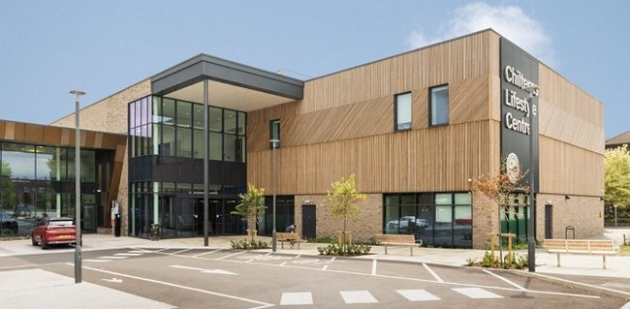
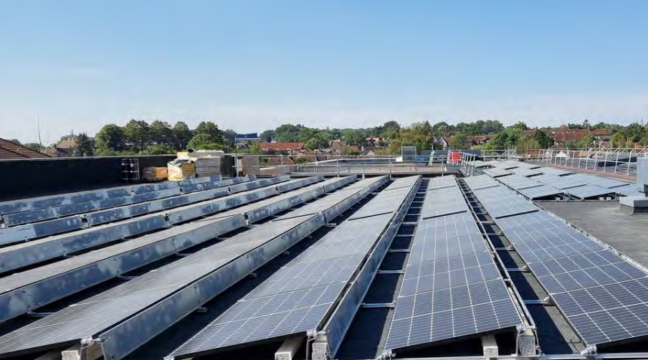
Chilterns Lifestyle Centre
Case Study: Buckinghamshire
Solar panels were installed on flat roofs
System was commissioned in December 2021 (2 years since the time of writing)
Grant received via Salix (PSDS) for £345k for the solar panel system and a water source heat pump
The whole system (including the heat pump) could save up 180 tonnes CO₂e emissions compared to gas boilers
Size: 450 panels (~157kWp)
Estimated cost to install: ~£190k
“We are absolutely over the moon to receive this funding from BEIS which will allow us to provide zero carbon heat to the Chilterns Lifestyle Centre.”
Councillor Clive Harriss – Cabinet Member for Sports and Leisure
References: https://buckinghamshire.moderngov.co.uk/documents/s19798/Report%20for%20Salix%20Grant%20Chiltern%20Lifestyle%20Centre%20Solar%20power%20System.pdf
https://wendovernews.co.uk/news/new-grant-to-boost-chilterns-lifestyle-centres-green-credentials/
19

Slide 20
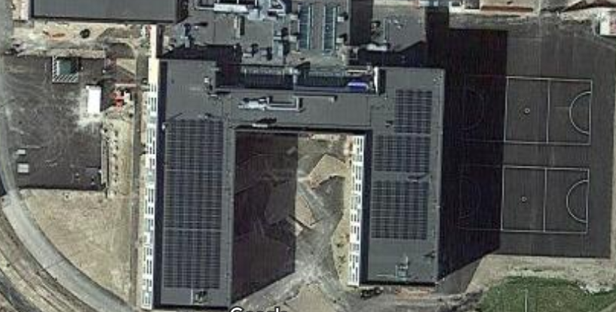
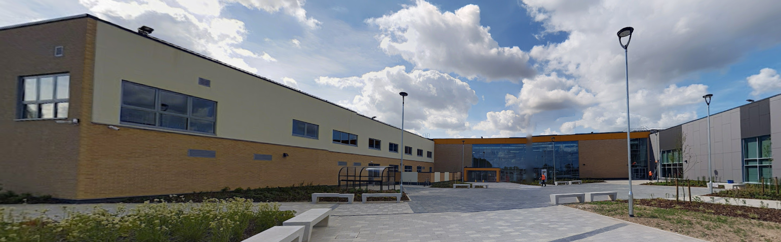
Mildenhall Hub
Case Study: Suffolk
Solar power was installed on flat roofs
System was commissioned in 2021 (2 years since the time of writing)
Paid for by a partnership of organisations and funding bodies
Saved over £40,000 worth of electricity and saved 140 tonnes CO₂e in 2022
Installed alongside a ground source heat pump and battery storage
Installed a management system to utilise onsite EV chargers during times of excess soar power generation
Size: 741 panels (~259kWp)
Estimated cost to install: ~£310k
“…The Hub itself, as well as bringing together services for Mildenhall and beyond, will of course be more energy efficient than the buildings that it will replace. By incorporating and investing in these environmental technologies we are further reducing the environmental impact of the Hub. It will also save the Hub partners money on their running costs which will make services more resilient to some of the challenges that we may all face over the years ahead”
Councillor John Griffiths – Leader of West Suffolk Council
References:
https://www.westsuffolk.gov.uk/news/pr230316ws01.cfm
https://www.acleisure.com/the-green-energy-helping-power-mildenhall-hub/
20

Slide 21
04
Next steps
You’re interested. What next?

Slide 22

Next steps
You’re interested. What next?
If you are interested in installing solar PV on your Leisure Centre, please contact the NW Net Zero Hub to find out more. Contact details are provided in the Appendix.
If you don’t already have a plan in place, project development and procurement support could be available from the NW Ner Zero Hub. There might also be an option to join up with other Leisure Centres in your locality to purchase the solar PV.
Understand your building ownership and discuss with your landlord (if applicable) the possibility of installing solar power and any financial implications that may occur as a result.
Ensure you understand the important details and requirements of any funding that is potentially available to you. Sport England should be able to assist you with most funding queries. Please see their website with more information HERE.
Find an (ideally local) MCS certified contractor and ask them if they have experience with projects of a similar scale to yours.
Aim to receive a minimum of three quotes for comparison before commissioning a contractor.
See the NW Net Zero Hub PPA Guide.
Refer to Net Zero Go for resources on PV Business Case, Planning and implementation along with case study information.

Slide 23

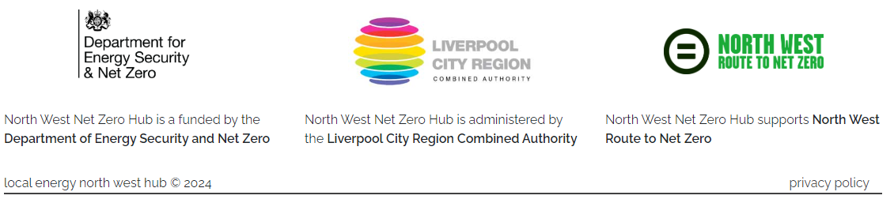
Contact
Contact the North West Net Zero Hub:
Email
NWNZHub@liverpoolcityregion-ca.gov.uk
Linkedin
www.linkedin.com/company/north-west-net-zero-hub/
Our address
No.1 Mann Island
Liverpool
L3 1BP
Directions to office: Travelling to Mann Island

Slide 24
05
Appendix
Financial assumptions and modelling

Slide 25
Other Opportunities
Other ways in addition to rooftop solar power that can improve your carbon emissions and reduce your energy bills
Solar power carports: a sustainable alternative if rooftop space is limited and on-site energy demands are large.
Adjacent ground-mounted solar power arrays: a sustainable alternative if rooftop space is limited and on-site energy demands are large.
EV charging: combine solar power projects with EV charging to improve solar power payback periods and reduce site associated emissions further (by reducing transport emissions).
Heat pumps: combine solar power projects with heat pumps to reduce solar power export and decrease site associated emissions further (by reducing emissions from gas boilers).
Energy usage reduction: performing energy reduction measures is important and should ideally be done before installing solar panels for optimal effectiveness. Example measures to reduce energy costs and environmental impact include ensuring boiler controls are set correctly, improving insulation, changing to LED lightbulbs, and adding reflective solar film on windows. Furthermore, the feasibility of installing a microfiltration system could be explored (which typically consumes less energy than traditional filters).
24

Slide 26
Financial Modelling Inputs*
Technical Data |  | Source(s)
Size of solar power array | 98.8 kWp | Questionnaire from leisure centre case study
Estimated electricity generated by the solar power system in the first year | 85 MWh/yr
Annual loss in efficiency of the solar panels from wear and tear and shading | 0.5% | IRENA
Percentage of solar power generation used on site | 90% | Questionnaire from leisure centre case study
Percentage of solar power generation exported to the grid | 10%
Project lifespan | 30 years | Professional experience and many manufacturer's warranty durations
Start year | 2024 | Assumption
Financial data |  | Source(s)
Project Capital Cost | £85,000 | Questionnaire from leisure centre case study
Cost of replacement inverter (modelled as every 10 years) | £12,251 | £124/kWp – from professional experience
Operational expenditure (annual) | £24 /kWp | Assumption based on professional experience
Business Rates | £400 /yr
Tariff – Grid imported electricity | 29p/kWh
Tariff – Solar power exported to the grid | 5.5p/kWh | Conservative existing tariff price
Tariff – PPA with ESCo (i.e. the preferential rate at which the solar electricity is sold to the leisure centre) | 23.2p/kWh | 20% lower than grid import tariff
Tariff – PPA with community energy group (i.e. the preferential rate at which the solar electricity is sold to the leisure centre) | 20.3p/kWh | 30% lower than grid import tariff
Change in electricity prices (percent per annum) | Applied 4.7% year-on-year inflation | Assumption based on professional experience
Cost of borrowing (interest paid on loan) | 5.5% | Agreed with GMCA
Discount rate | 6%
Loan length (years) | 20 | Assumption based on professional experience
*numbers are only provided as an example and not to be used for a financial appraisal
25

Slide 27
Routes to installation
Financial comparison
All tested models indicate a valid business case for solar power installation in leisure centres. This position is supported by the case studies presented in this guide. However, the most suitable model will be determined by the circumstances of the leisure centre, the options available to them and key assumptions in the financial model, including cost of borrowing and future change in energy prices.
26

Slide 28
Glossary of Terms
Distribution Network Operator (DNO) is a company licensed to distribute electricity in the UK.
Electricity North West (ENWL) is the electricity distribution network operator for North West of England.
Energy Services Company (ESCo) is a company that offers energy services including implementing renewable energy schemes. They can also finance or arrange financing for the operation and their remuneration is linked to the energy savings achieved.
Power Purchase Agreement (PPA) is a long-term renewable energy contract between the client and the Energy Services Company.
Payback period refers to the length of time it takes to recover the cost of an investment, in this case achieved through observed energy savings.
Public Sector Decarbonisation Scheme (PSDS) provides grants for public sector bodies to fund heat decarbonisation and energy efficiency measures.

Slide 29



This guide has been pulled together under the guidance and support of several organisations.
Technical content:
> Buro Happold
Case study content:
>Irlam and Cadishead Leisure Centre
>Chilterns Lifestyle Centre
>Mildenhall Hub
Content oversight and guidance:
>Greater Manchester Combined Authority
>GM Active
Funding support:
> North West Net Zero Hub supports the publication of this guide with funding from the Department for Energy & Net Zero (DESNZ)
With thanks to…

