Slide 1

School’s Guide to Solar PV
Building in Net Zero

Slide 2


01
02
03
Introduction
About Solar PV
Routes to installation
Page 3
Page 5
Page 10
04
05
06
Next Steps
Financial assumptions and modelling: Appendix
Page 18
Page 21
Page 26
Contents

Slide 3
01
Introduction
Why solar PV? Why now?

Slide 4
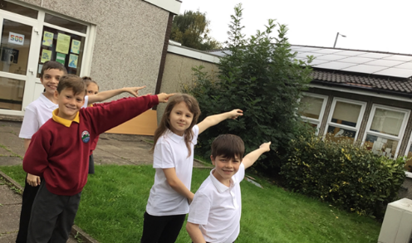

Introduction
Why Solar PV? Why now?
Solar PV is a source of renewable energy that can save you money on your electricity bills, protect you against future electricity price increases and reduce your carbon emissions. Solar PV can also be a valuable curriculum aide, bringing STEM and climate change action to life.
The cost-of-living crisis has seen electricity bills increase significantly and this has placed school revenue budgets under significant pressure. In this guide we hear from schools that are reaping rewards from solar PV by saving thousands of pounds off their electricity bills. It also outlines Local Authority recommended options to deliver solar PV on your school – even if you don’t have the funds to invest.
Every school has the potential to benefit from renewable energy. If you are interested in moving forward with installing solar PV on your school, project development and procurement support could be available from the NW Net Zero Hub. Please contact the Hub or your Local Authority in the first instance to find out more.
Pupils at Gorse Hall Primary pointing at their 40kWp solar PV system, installed in 2022
“Having solar panels installed at our school has not only meant we save money on our fuel bills but it is also cleaner for our environment. Mitigating climate change has to be our priority and opportunities like these cannot be missed.”
Gorse Hall Primary, Tameside, Manchester

Slide 5
02
> How does it work?
> What are the benefits?
> How much does it cost?
> Are there any grants available to help you pay for a solar PV system?
> What about maintenance?
> Does it matter about my roof direction, pitch and type?
> What happens if I need more electricity than the solar PV can generate?
> What is the installation process like?
> Do I need permission?
> How do I go about procuring a solar PV system?
> Will it impact on my ability to install other energy saving measures?
> What if our school becomes an academy in the future?
About Solar PV
Let’s sort the facts from the myths

Slide 6
About Solar PV
Let’s sort the facts from the myths
How does it work?
Solar PV systems convert energy from the sun into electricity, even on cold and cloudy days. This ‘free’ electricity can be used to run school equipment, appliances and lighting. Any electricity that isn’t used can be exported to the grid or stored in a battery for use when the solar PV is not generating.
What are the benefits?
Solar PV can help to reduce electricity bills and carbon emissions. It can also provide a valuable educational resource to bring STEM topics to life and to engage student environmental groups. Taking these benefits into consideration, the business, moral and education case for installing solar PV on schools is very compelling.
How much does it cost?
The cost depends on details such as the size of the system installed, roof type and building height. Recent primary school schemes of between 20-60 kilowatt peak output (kWp) in size have been installed for costs ranging from £25k-£100k, and secondary school schemes of between 100-200 kWp in size for costs ranging from £140k-£330k. Bigger systems are more expensive, but they generate more electricity and so can save you more in electricity bills.
Are there any grants available to help you pay for a solar PV system?
There aren’t currently any dedicated capital grants for solar PV. However, current energy prices have improved the business case as demonstrated by the case studies. The Smart Export Guarantee (SEG) scheme is currently open and provides payment for any surplus electricity exported to the grid.
“Prior to installation, A-level students developed an Excel model to predict annual generation. Now, GCSE and A-level students use the panels to predict electricity and carbon savings.
Our student environmental group also use the solar panels and other low-carbon projects to estimate benefits and monitor impact.”
Parrs Wood High, Manchester

Slide 7

“I am not aware of any maintenance costs for any of the solar PV installations on SCC roofs that have been in for a number of years. The only cost will be to replace the inverter once in the panels lifetime (after approximately ten years or so).”
Energy Manager, Salford City Council
What about maintenance?
Solar PV systems need little maintenance and should last 25 years or more with little loss in efficiency. Any roofs that have an issue with pigeons should have a mesh included in the system design. A maintenance inspection every 1-2 years will help to make sure the system is clean and in good working order. The main cost will be to replace the inverter which typically lasts for 10-15 years (circa 6% of the system cost). It’s important to monitor the generation of the system, which can be through remote monitoring installed with the PV system.
Does it matter about my roof direction, pitch and type?
South, East and West facing roofs can all be used for solar PV. North facing roofs are not recommended. Unshaded roofs are best but not essential.
Solar PV can be installed on both flat and pitched roofs. The roof construction will impact on the price to install, and a survey will be required to check that the roof condition and structure are suitable. If roof upgrade works are required it will be an additional cost.
What happens if I need more electricity than the solar PV system can generate?
Schools are connected to the local electricity grid so you will never be without a supply of electricity. If your solar panel system generates more electricity than you need, the excess can be exported into the grid. If, on the other hand, you need more electricity than your solar panels are generating, the grid can supply this.
What’s the installation process like?
Solar PV systems are typically straightforward to install in a school environment as most of the work is on the roof. With appropriate planning, recent schemes have completed within one week during term-time. Make sure that your solar PV supplier is made aware of any roof warranty and insurance requirements.
“We are currently installing a solar PV system at the same time as re-roofing the building, during term-time. This involves regular meetings between the school Business Manager, site manager, and the installer to agree processes in advance, such as the routes and times of access, segregation of work area, delivery times, signage and safeguarding.”
Parrs Wood High, Manchester

Slide 8
Do I need permission?
If your school is owned by the Local Authority (LA) you will need their permission to install solar PV.
Solar PV panels on roofs are considered ‘permitted development’ and often don’t require planning permission. However, it’s best to check with your local planning office regarding prior approvals. Restrictions may apply if your building is listed or in a conservation area.
You might need permission from your local Distribution Network Operator (DNO) to install solar PV – for the North West this is either Electricity North West (ENWL) or Scottish Power Networks (SPEN). Your solar PV supplier will typically deal with all necessary DNO applications. However, the DNO is happy to be contacted to discuss your project prior to a solar PV supplier being appointed.
How do I go about procuring a solar PV system?
Demand is currently high for solar PV. Costs and quality can vary greatly so it is worth getting at least three quotes from Microgeneration Certification Scheme (MCS) accredited installers. Note, the cheapest panels do not necessarily represent the best value for money.
The Greater Manchester Combined Authority have a solar PV procurement framework that is available for schools to use. It offers access to quality assured suppliers and procurement support. You might also want to consider collective purchase with other schools. Solar for Schools is another route that can be useful but advice can be obtained from the NW Net Zero Hub.
Will it impact my ability to install other energy saving measures?
Solar PV complements other technologies that lower carbon emissions and energy costs (such as low-carbon heating and LED lighting). It is worth planning your investment in carbon reduction as a whole building approach, even though you might wish to fast-track the installation of solar PV.
What if our school becomes an Academy in the future?
A solar PV system is just another asset that in the process of creating an Academy needs to be accounted for. There may be additional fees associated with the transfer of contractual obligations, but this should not be prohibitively expensive. Parrs Wood High School is an example of a school becoming an academy but the ownership of the PV system being retained by the investor (in this case Manchester City Council).
“The installations were coordinated well by the PV contractor and undertaken in around a week during school holidays. We have an electronic display on site that tells us how much we are generating.”
Alderbrook Primary School, Salford
Parrs Wood High School installed solar PV in 2015, funded by Manchester City Council (MCC) who own the panels. In 2016 they became an Academy. According to the school:
“The arrangement with MCC just rolled over – no real changes were made, and we continue to benefit from the solar panels.”
Parrs Wood High, Manchester

Slide 9

Gorse Hall Primary School, Tameside, Manchester.
Case Study: Direct purchase
£8.9k estimated saving in electricity bill in the first year, based on a grid electricity price of 29p/kWh
Size: 50 kWp
Cost to install: £43k
“Having solar panels installed at our school has not only meant we save money on our fuel bills, it is also cleaner for our environment. Mitigating climate change has to be our priority and opportunities like these cannot be missed.”
Gorse Hall Primary School
Investment could pay back in under six years if funded from capital reserves and allowing for maintenance costs
Solar PV was installed on a mixture of pitched and flat roofs
System will save 8.4 tonnes CO2/yr*
Installation was funded by PSDS Phase 1 grant
*Based on UK Government 2022 GHG conversion factors for UK electricity plus transmission and distribution

Slide 10
03
Routes to installation
What are the options and how do they differ?

Slide 11
School’s Delivery Route Decision Tree
Do you have surplus budget to invest in a PV system?
Routes to installation
What are the options and how do they differ?
Greater Manchester (GM) school representatives have identified two preferred routes to installing solar PV on schools:
Model 1 - Direct purchase
The school procures, owns, operates and maintains the solar PV system either through school surplus budget or a loan.
Model 2 - Leasing Arrangement
A third party funds, owns and operates the solar PV system. The school has no initial capital outlay and will receive a reduced rate on the electricity generated by the solar PV.
In the financial performance summary on pages 13 and 17, Gorse Hall Primary School’s solar PV scheme is used as an example to demonstrate and compare the financial outcomes of the two models.
NO
YES
Are you eligible for a loan?
Model 1 Option A - Fund from school’s surplus budget. Remember to gain consent from your LA.
Do you want to maximise savings in the short term and are you able to enter into long-term (10 yr. +) roof lease and power purchase agreements?
YES
NO
Model 1 Option B - Fund with a loan. Please contact your LA to discuss further before proceeding. Consider the value in increasing the repayment term to maximise short term revenue benefit.
YES
NO
Model 2 Option B – Leasing arrangement with a power purchase agreement or early repayment transfer of asset. Please contact your LA to discuss further before proceeding.
Model 2 Option A – Leasing arrangement with early repayment and transfer of asset. Agreements will still be required but for a shorter term. Please contact your LA to discuss further before proceeding.

Slide 12




In this model:
The school procures the solar PV installation from a Solar PV Supplier. The school is then responsible for the arranging maintenance and insuring the panels.
The electricity generated by the solar PV offsets the school’s imported grid electricity. The school benefits from a reduced energy bill from its Utility Supplier.
Any excess solar PV electricity that the school doesn’t use (e.g. on sunny days, weekends and summer holidays) can be exported to the grid. The school could receive a revenue for this from the Smart Export Guarantee (SEG). You can apply for a SEG tariff with any SEG Licensee – it does not need to be the same company as your current energy supplier.
The school avoids having to lease or licence the use of school premises, or parts of them, to third parties.
There are different ways to secure the finance to purchase the solar PV system: from school’s own surplus budget, from borrowing or securing finance through fund raising. These options are presented on the following page and can be discussed in more detail with your Local Authority.
Model 1: Direct purchase
Overview
Utility Supplier
When the school requires more electricity than the solar PV can provide, the school will take the extra electricity from the grid (as it currently does now).
When the solar PV generates more electricity than is required by the school, the excess electricity is exported to the grid. Or alternatively it could be stored in a battery on site for use later.
School
PV
The Solar PV supplier will install the solar PV system on the school’s roof. They will test and commission the system to make sure that it is fit for purpose.
The school pays the utility supplier for any electricity that it takes from the grid.
The school might receive an income (SEG) for any solar PV generation that it feeds into the grid.
Solar PV Suppliers
Legend:
Energy Streams
Financial Streams:
solid - one-off
dashed - monthly
Plant/ Material Streams
The school purchases the PV installation directly from an MCS approved solar PV supplier. This capital outlay might be funded through reserves or a loan.

Slide 13
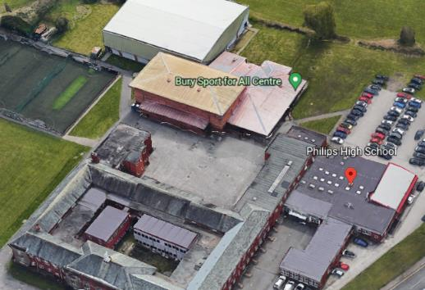
Philips High School, Bury
Case Study: Direct Purchase
100% of electricity generated is expected to be consumed by the school
£5.5k estimated saving in electricity bill in the first year (based on a grid electricity tariff of 31.5p/kWh)
Size: 30 kWp
Cost to install: £25k
“We have already reduced the financial impact of electricity for the school by installing LED lights, sensors etc. and so we discussed solar PV as an option to help with the increasing electricity unit price. We presented the option to Governors, with a 5-6 year payback, and the Governors supported the project.”
Philips High School
Investment could pay back in under six years
Solar PV was installed on a flat roof
System will save 5 tonnes CO2/yr*
Paid for from school funds
*Based on UK Government 2022 GHG conversion factors for UK electricity plus transmission and distribution

Slide 14
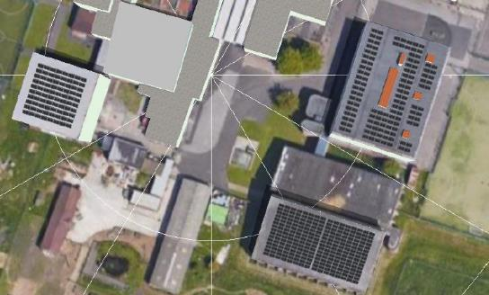
Ladybridge High School, Bolton
Case Study: Direct Purchase
£35k projected saving in electricity bill in the first year (based on a grid electricity tariff of 34p/kWh)
Size: 187 kWp
Cost to install: £213k
“We had panels installed on 3 different roofs. We helped select the best locations for scaffolding which minimised disruption. The majority of the work was outside the building so very little impact on the pupils. Any internal work can be planned to negate any impact on the pupils. Invest adequate time in the planning - it will pay dividends.”
Ladybridge High School
Investment could pay back in under eight years if funded from capital reserves and allowing for maintenance costs
Solar PV was installed on pitched and flat roofs
System will save 30 tonnes CO2/yr*
Installation was funded by PSDS 1 grant
*Based on UK Government 2022 GHG conversion factors for UK electricity plus transmission and distribution

Slide 15
Model 2: Leasing Arrangement
In this model:
The PV installation is funded by a Service Provider acting as an Energy Services Company (ESCo). The Service Provider could be a solar PV Supplier or a community energy group, for example.
There is no initial capital outlay by the school. The ESCo owns and operates the PV, and sells the electricity generated to the school at a preferential rate under a long-term Power Purchase Agreement (PPA) (typically 10 years or more).
A variant of this model is to use the electricity savings generated by the solar PV system to return the ESCo investment more quickly, then transfer the ownership of the asset to the school so that the school then realise the full benefit from the system over its remaining lifetime.
Key considerations for this model are the contractual agreements (e.g. roof lease and power purchase agreements) and compensation clauses (e.g. if the panels needed to be removed to repair the roof) that would need to be put in place to facilitate the service. These would need to be agreed with your Local Authority before proceeding.
Overview
If the system exports electricity to the grid, any revenue generated is typically retained by the service provider.
Utility Supplier
When the school requires more electricity than the solar PV can provide, the school will take the extra electricity from the grid (as it currently does now).
When the solar PV generates more electricity than is required by the school, the excess electricity is exported to the grid.
School
PV
The school appoints a service provider to install, own, operate and maintain the PV installation.
The school pays the utility supplier for any electricity that it takes from the grid.
ESCO Service Provider
The service provider funds the solar PV system. The school purchases the solar PV electricity from the Service Provider at a preferential rate. There might be an option for the Service Provider to transfer the solar PV asset to the school once they have recouped their return on investment.
Legend:
Energy Streams
Financial Streams:
solid - one-off
dashed - monthly
Plant/ Material Streams

Slide 16
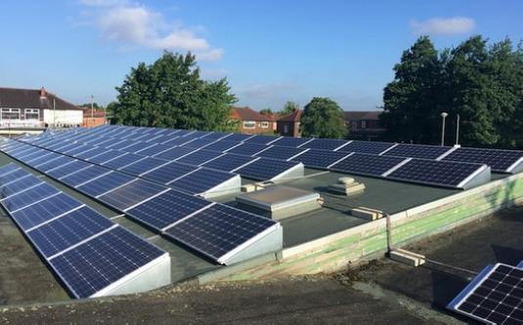
Fiddlers Lane Primary School, Salford
Case Study: Leasing Arrangement
25% saving in electricity from the grid
£3.5k estimated annual saving in electricity bill for 2022 based on a grid electricity price of 40p/kWh and a preferential rate on the solar electricity
Size: 30 kWp
No capital outlay to the school
“When we embarked on our journey with Greater Manchester Community Renewables (GMCR), who would have thought it would be so life changing for us? We’ve improved our ethical practice and embedded this into our strategy. The vision of a more sustainable world starts with our children and we have the privilege of passing on to them that there is hope for our future and future generations.”
Fiddlers Lane Primary School
Solar PV was installed on flat roofs
System will save 5 tonnes CO2/yr*
Installation was funded by Greater Manchester Community Renewables. Electricity is provided at a discounted rate to the school.
*Based on UK Government 2022 GHG conversion factors for UK electricity plus transmission and distribution

Slide 17
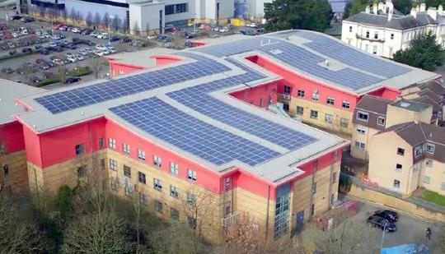
Parrs Wood High School, Manchester
Case Study: Leasing Arrangement
25% saving in electricity from the grid
£15.8k saving in electricity bill per year based on a grid electricity price of 25p/kWh and a preferential rate on the solar electricity
Size: 250 kWp
No capital outlay to the school
Parrs Wood High School installed solar PV in 2015, funded by Manchester City Council who own the panels. In 2016 they became an Academy. According to the school:
“the arrangement with MCC just rolled over – no real changes were made, and we continue to benefit from the solar panels.”
Parrs Wood High School
Solar PV was installed on a sloped roof
System will save 40 tonnes CO2/yr*
Installation was funded by Manchester City Council under the Manchester Green Initiative. The system is owned by the council. The council has a power purchase agreement with the school to provide them with electricity at a discounted rate.
*Based on UK Government 2022 GHG conversion factors for UK electricity plus transmission and distribution

Slide 18
04
Next steps
You’re interested. What next?

Slide 19

Next steps
You’re interested. What next?
If you are interested in installing solar PV on your school, please contact the NW Net Zero Hub to find out more. Contact details are provided in the Appendix.
If you don’t already have a plan in place, project development and procurement support could be available from the NW Ner Zero Hub. There might also be an option to join up with other schools in your locality to purchase the solar PV.
Solar for Schools is another national programme that can help with the options for your school. The Greater Manchester Combined Authority have a solar PV procurement framework that is available for schools to use.
See the NW Net Zero Hub PPA Guide.
Refer to Net Zero Go for resources on PV Business Case, Planning and implementation along with case study information.

Slide 20
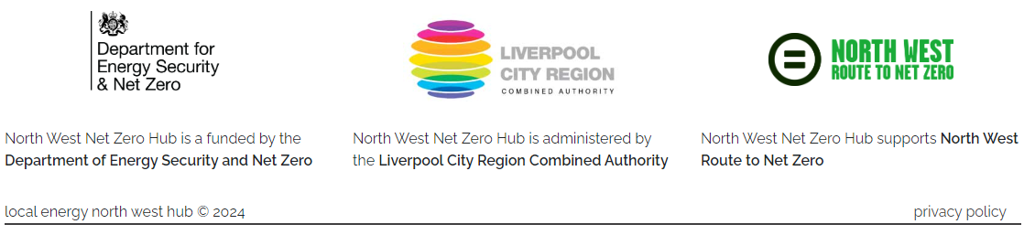
Contact
Contact the North West Net Zero Hub:
Email
NWNZHub@liverpoolcityregion-ca.gov.uk
Linkedin
www.linkedin.com/company/north-west-net-zero-hub/
Our address
No.1 Mann Island
Liverpool
L3 1BP
Directions to office: Travelling to Mann Island

Slide 21
05
Appendix
Financial assumptions and modelling

Slide 22
Financial Modelling Assumptions
For the Gorse Hall Primary School case study featured on slides 13, 17 and 18
Technical Data
Size of solar PV array (kWp) | 50.3 kWp
Estimated electricity generated by the solar PV in the first year (kWh/year) | 39,913 kWh
Annual loss in efficiency of the solar PV panels from wear and tear and shading | 0.4%
Percentage of solar PV electricity generation used on site | 72%
Percentage of solar PV electricity generation exported to the grid | 28%
Project lifespan (years) | 25 years
Financial data
Project Capital Cost | £43,124
Annual allowance for maintenance checks and cleaning (£/yr) | £620
Cost of replacement inverter (modelled as every 10 years) | £ 2,500
Insurance (£/yr) | £178
Business Rates (£/yr) | £1,126
Tariff – Grid imported electricity (p/kWh) | 42p/kWh
Tariff – solar PV electricity exported to the grid (p/kWh) | 5.5p/kWh
Tariff – PPA with ESCo under Model 2 Option b (i.e. the preferential rate at which the solar electricity is sold to the school) | 29p/kWh
Inflation | 0%
Escalation rate on electricity prices (percent per annum) | 0%
Cost of borrowing for school (interest paid on loan) – based on latest PWLB rates | 4.41%
Cost of borrowing for ESCo (interest paid on loan) - based on supply chain feedback | 4%

Slide 23
Annual cost saving to the school:
Model 1a vs. Model 1b
Model 1: Direct Purchase
Financial performance summary
GM LA representatives have identified two preferred options for direct purchase (self-funding) solar PV on schools:
  Model 1 Option a – funded from school’s surplus budget
  Model 1 Option b – funded from borrowing (assuming a 6% interest rate)
The charts opposite provide a comparison of these options for the Gorse Hall Primary School case study (see the Appendix for the assumptions). The top chart shows the estimated net annual cost savings over the 25 year project lifetime. The cost savings are the reduction in electricity spend less maintenance and other costs. The bottom chart shows the cumulative of these net annual cost savings over the same period.
In Model 1 Option a the school incurs the full capital outlay in Year 0 and cost savings are generated from Year 1 onwards. In Model 1 Option b the loan is repaid using the savings in electricity spend. Once repaid, the cost savings received by the school are the same as Model 1 Option a. The slight reduction in savings in years 10 and 20 is due to an assumed cost for replacing the inverter.
Funding the project through capital reserves (Model 1 Option a) provides greater financial benefit over the lifetime of the project as it does not incur a cost of finance. An option to extend the loan repayment term for Model 1 Option b would increase the savings received in the early years, but it will cost the school more in loan repayments over the project lifetime.
Year
Cumulative annual cost saving to the school
Model 1a vs. Model 1b
Year

Slide 24
Annual cost saving to the school
Model 2a vs. Model 2b
Model 2: Leasing Arrangement
Financial performance summary
GM LA representatives have identified two preferred options for third party (ESCo) funding of solar PV on schools:
Model 2 Option A – The ESCo funds the project and retains the benefit of all cost savings until their investment is repaid. At this point the full benefit of the system transfers to the school, notionally through the transfer of the asset.
Model 2 Option B – The ESCo funds the project and owns the PV for the lifetime of the system. The school purchases the electricity generated by the solar PV from the ESCo at a preferential rate for the 25 year project lifetime.
The charts opposite provide a comparison of these options for the Gorse Hall Primary School case study (see the Appendix for the assumptions). The top chart shows the estimated net annual cost savings over the 25 year project lifetime. The cost savings for both models are the reduction in electricity spend. For Model 2 Option A there is less maintenance and other costs that are incurred upon asset transfer. The bottom chart shows the cumulative of these net annual cost savings over the same period. The slight reduction in savings in years 10 and 20 is due to an assumed cost for replacing the inverter.
In both options the schools cashflow remains positive. In Model 2 Option A, the school realises no financial benefit until the transfer of ownership, but sees a greater benefit over the longer term. In Model 2 Option B the school sees an immediate benefit, but the cumulative benefit is less over the lifetime of the asset.
Year
Cumulative annual cost saving to the school
Model 2a vs. Model 2b
Year

Slide 25
Annual cost saving to the school – all models
Routes to installation
Financial comparison
All tested models indicate a valid business case for solar PV installation in schools. This position is supported by the case studies presented in this guide. However, the actual benefit will be determined by the circumstances of the school, the options available to them and key assumptions in the financial model, including cost of borrowing and escalation rates on energy prices.
The charts opposite provide a comparison of the two models. The top chart shows the estimated net annual cost savings in years 1, 5 and 15 (taking maintenance and other costs into consideration). Please note that inflation on energy prices has not been factored into the analysis and so the observed reduction is due to a modelled loss in efficiency of the solar PV system.
The option for a school to deliver the scheme directly through school’s surplus budget (Model 1 Option A) provides the most favourable outcome for immediate cost savings and lifetime financial benefit, but requires an initial capital outlay. If capital funding isn’t possible, then a school could consider self funding through a loan (Model 1 Option B) or entering into an ESCo arrangement (models 2a & 2b).
Of the ESCo arrangements, a ‘repay and transfer’ option (Model 2 Option A) is shown to provide the best returns over the life of the project, but provides no cost benefit to the school in the short term, unlike Model 2 Option B.
There are added legal considerations associated with Model 2 which will need to be agreed with your Local Authority prior to progressing.
Cumulative annual cost saving to the school – all models
Year

Slide 26
Glossary of Terms
Distribution Network Operator (DNO) is a company licensed to distribute electricity in the UK.
Electricity North West (ENWL) is the electricity distribution network operator for North West of England.
Energy Services Company (ESCo) is a company that offers energy services including implementing renewable energy schemes. They can also finance or arrange financing for the operation and their remuneration is linked to the energy savings achieved.
Power Purchase Agreement (PPA) is a long-term renewable energy contract between the client and the Energy Services Company.
Payback period refers to the length of time it takes to recover the cost of an investment, in this case achieved through observed energy savings.

Slide 27


This guide has been pulled together under the guidance and support of several organisations.
Technical content:
> Anthesis Ltd
Case study content:
> Parrs Wood Academy
> Alderbrook Primary School
> Gorse Hall Primary School
> Ladybridge High School
> Philips High School
> Fiddlers Lane Primary School
> Greater Manchester Community Renewables
Content oversight and guidance:
> Bury Council
> Bolton Council
> Manchester City Council
> Salford City Council
> Stockport Council
> Tameside Council
> Trafford Council
> Turner & Townsend
Funding support:
> North West Net Zero Hub
With thanks to…

