Slide 1
Household Energy Use Survey
South Yorkshire Sustainability Centre

Slide 2
Energy Use Survey
Selected Results
South Yorkshire Sustainability Centre
Dr Jayne Carrick

Slide 3
Why study consumption habits?
Domestic energy use represents between 29% (Doncaster) and 39% (Sheffield) of total energy use in South Yorkshire
SYMCA’s Energy Strategy (2022): “improve the energy efficiency and sustainability of our built environment, and encourage communities to be part of the transition”
Income is one of the strongest and most consistent drivers of energy use; energy use increases with income

Slide 4
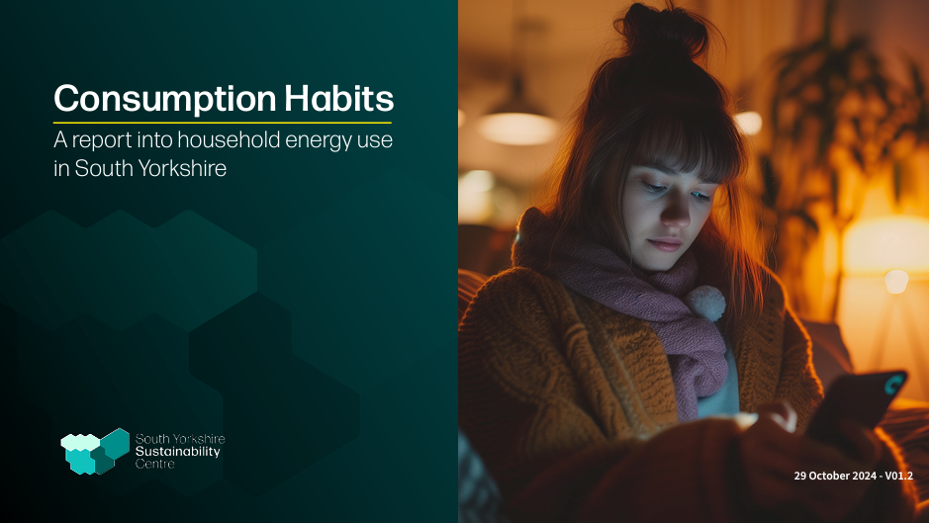
Energy Use Survey
622 residents of South Yorkshire, representative of the region in terms of age, gender and location
Administered by IPSOS
Fieldwork ran for around 3 weeks in January - February 2024
Notes:
We conducted a survey of household energy use across the region in January this year.
It is important to stress this focused on energy used to heat and power homes, and not transport and consumption of goods. But it does give us some interesting insights on the attitudes of people in this region to consumption

Slide 5
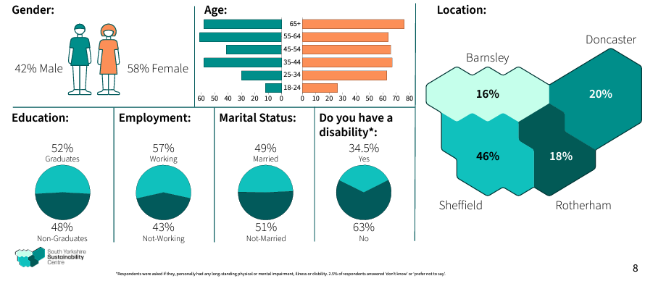
The survey was completed by a diverse group in terms of key demographics, income, and attitude to climate change

Slide 6
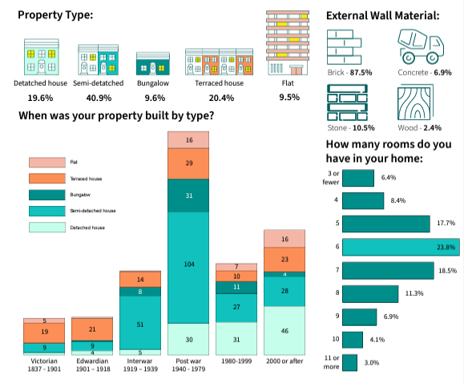

Slide 7
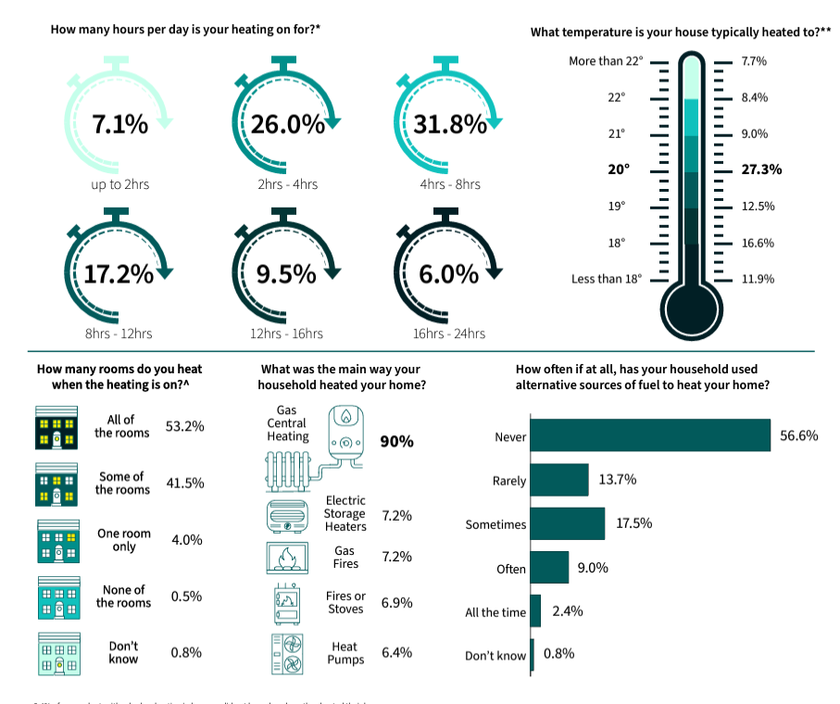

Slide 8
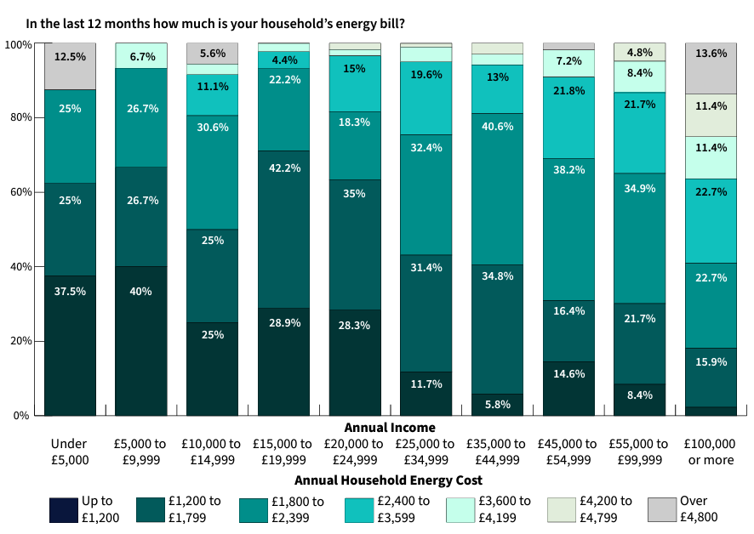
As expected, reported energy use, as measured by spending on energy bills, increases with income.

Slide 9
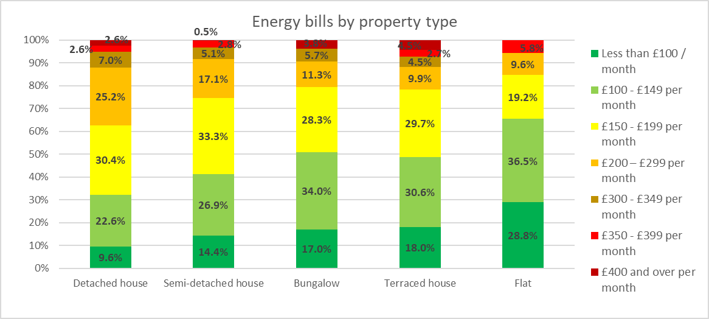
Energy use and property type
Notes:
There is a statistically significant relationship between property type and energy use - the bigger the property, the more they spend on energy.
There is no relationship between tenure and amount people spend on energy

Slide 10
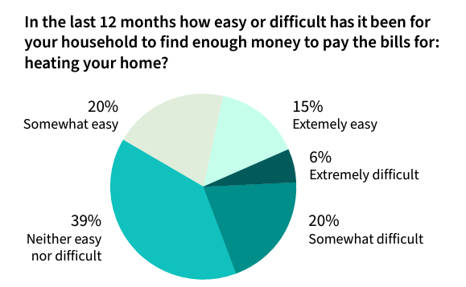
A quarter of respondents said they found it extremely or somewhat difficult to pay their utility bills.
Those on lower incomes, those with a disability and those who do not own their home are more likely to find it difficult to find enough money to heat their home.

Slide 11
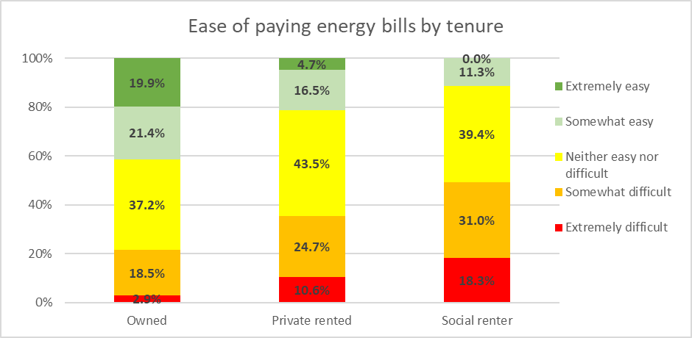
Nearly half of those is social rented accommodation said they found it somewhat or extremely difficult to pay their energy bills, compared to around 20% of those who own their home.
Notes:
There is a statistically significant relationship between tenure and how easy people find paying their energy bills
Nearly half of those is social rented accommodation said they found it somewhat or extremely difficult to pay their energy bills, compared to around 20% of those who own their home.

Slide 12
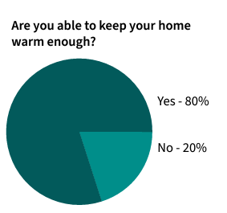
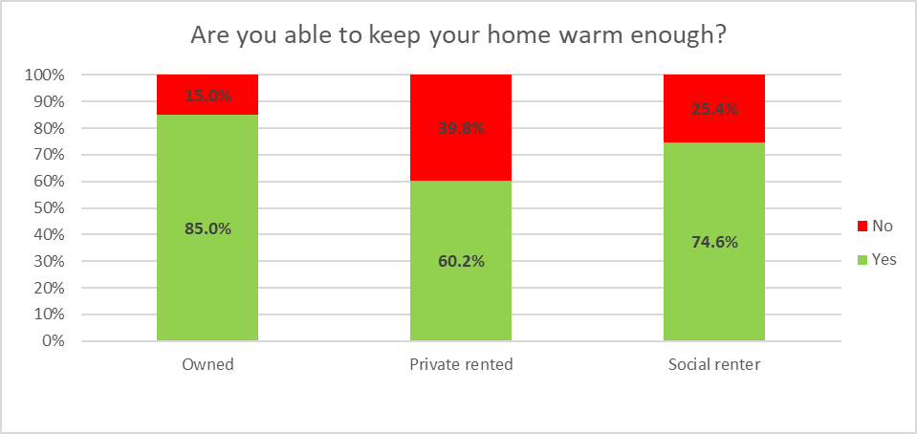
Are you able to keep your home warm enough?

Slide 13
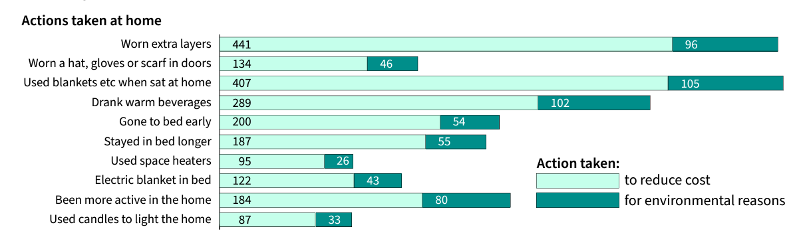
High awareness of energy consumption: 76% of respondents report that they often think about ways to save energy at home
Most respondents engaged in some energy saving behaviour, such as wearing extra layers with most saying they did so to reduce the cost of energy

Slide 14
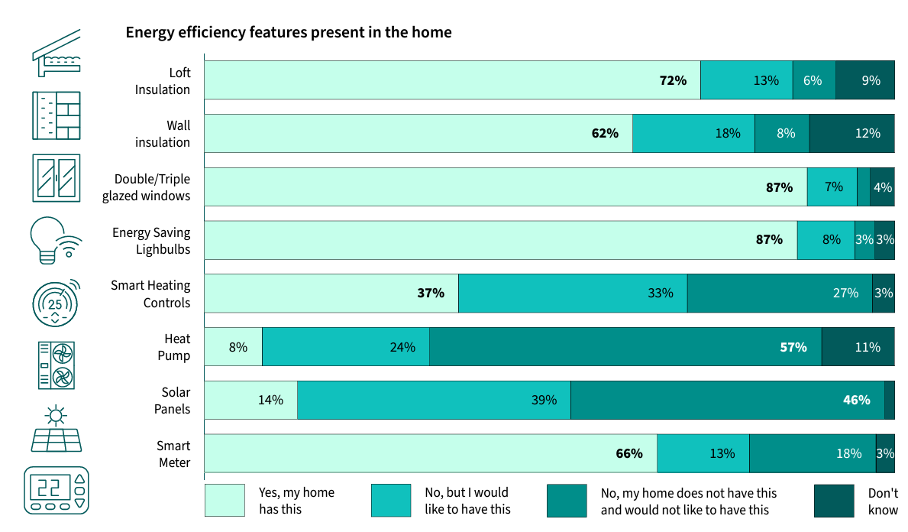

Slide 15
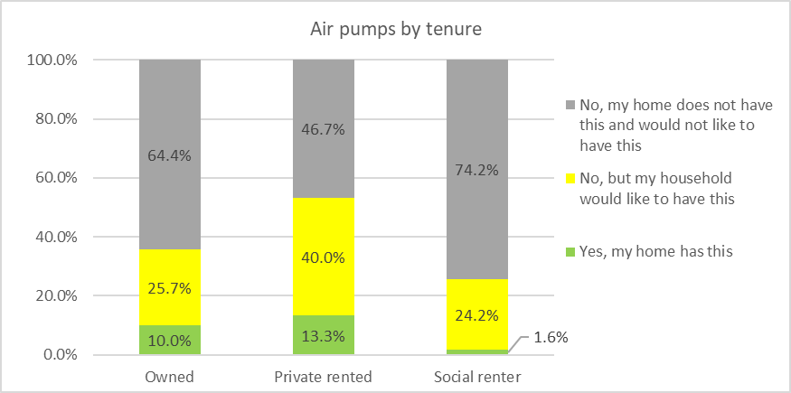
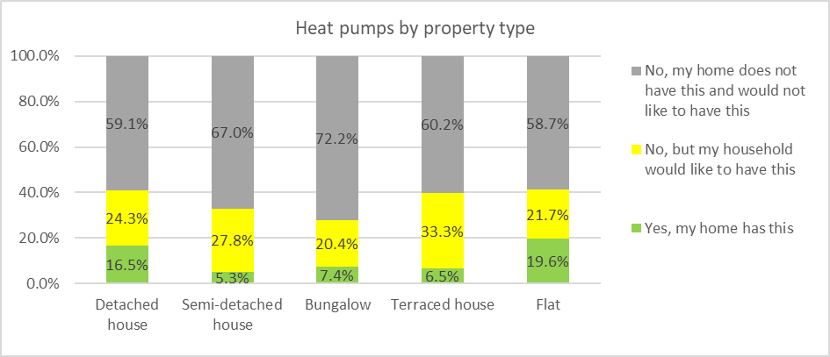
Not wanting a heat pump increases with age and decreases with income

Slide 16
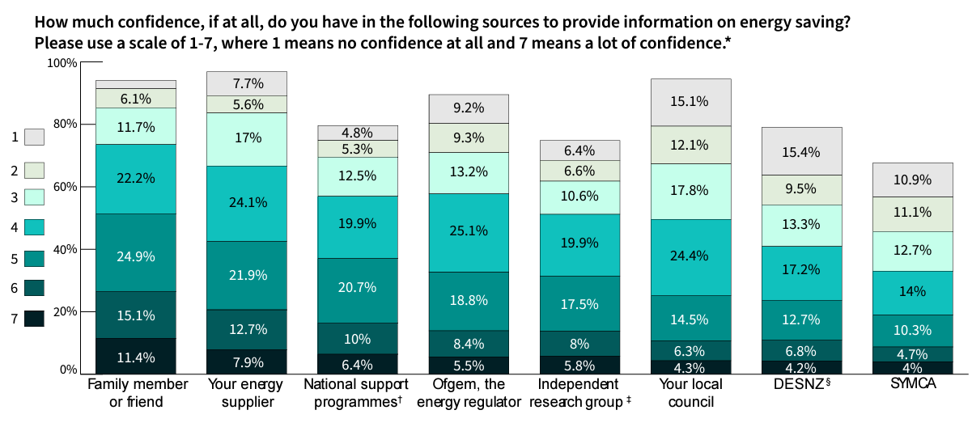
Social networks were identified as key sources of information on energy use. Family and friends were rated as the source respondents had most confidence in to provide them with information on energy

Slide 17
What’s next?
We are keen for these survey results to be used widely for the benefit of research and knowledge development. We have already shared the data with colleagues working on:
the roll out of heat networks in Sheffield;
mapping public and active travel infrastructure with areas of deprivation in Sheffield; and
models to inform retrofit planning across the region
If you are working on a project that you think could benefit from our survey data, please get in touch with the South Yorkshire Sustainability Centre (sysustainabilitycentre@sheffield.ac.uk) or Jayne Carrick (j.carrick@sheffield.ac.uk) to discuss your ideas.

