Slide 1
Community Building Decarbonisation in the North East and Yorkshire
Abbie Raynes – North East and Yorkshire Net Zero Hub

Slide 2
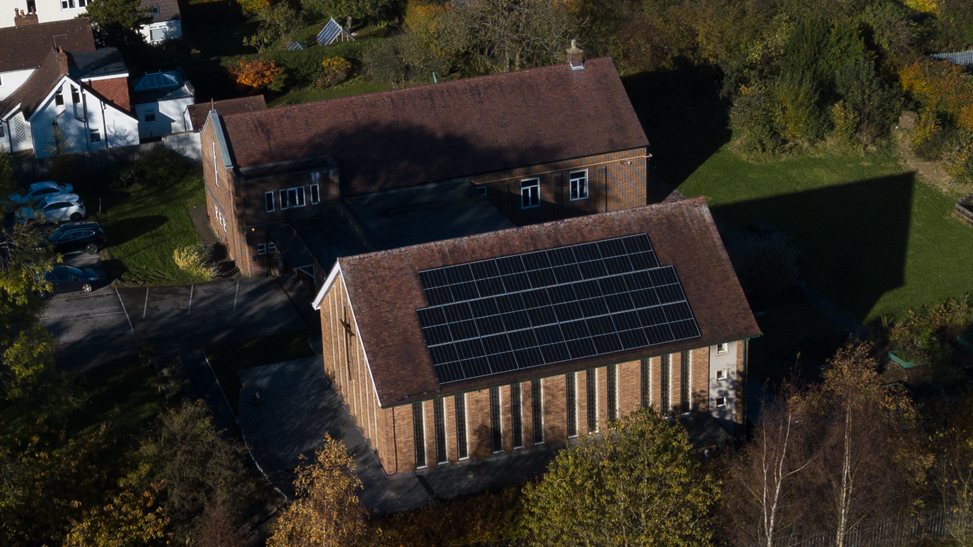
What is Community Energy?
Community energy is the delivery of community-led renewable energy projects including energy demand reduction and energy supply projects.
Community energy is about people and communities taking control over their energy future, by understanding, generating, and saving energy in their communities, as well as working together across regions and nationally.
Projects are often community owned or developed in partnership with commercial or public sector organisations.

Slide 3
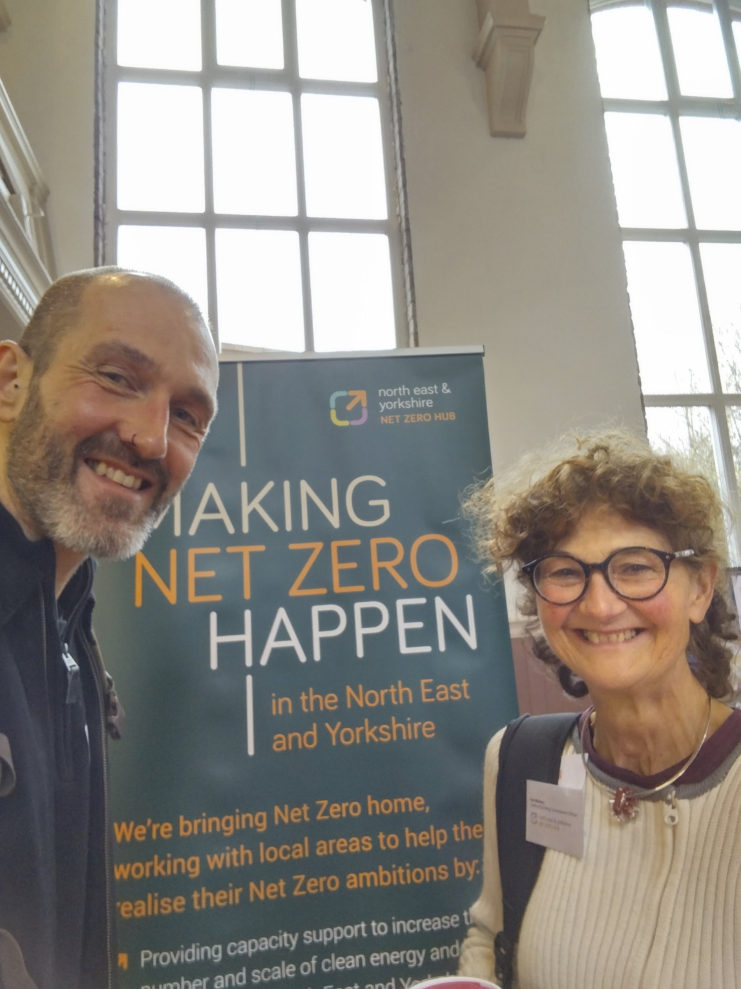
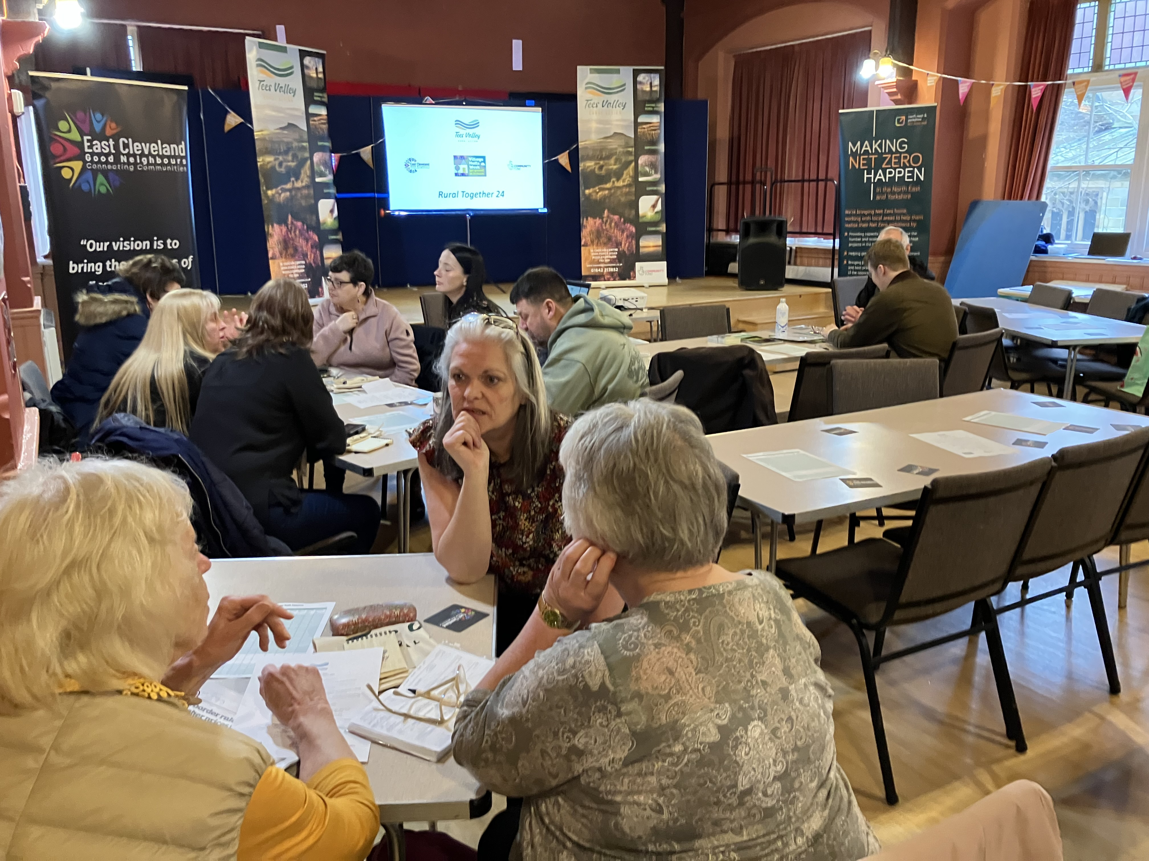
Why is Community Energy Important?
Supports in the move towards renewable and clean energy generation and use.
Reduces reliance on the grid.
Profits for local people.
Can help to tackle rural fuel poverty.
Builds community resilience.
Empowerment and unity for local communities.
Reduction in carbon emissions.
Job creation.
Development of innovative technologies.
Can protect the local landscape.
Notes:
Specifically – Community buildings often offer social services such as warm hubs, family groups, social groups for elderly people, etc, so it’s important that these buildings remain open and are warm inside.

Slide 4
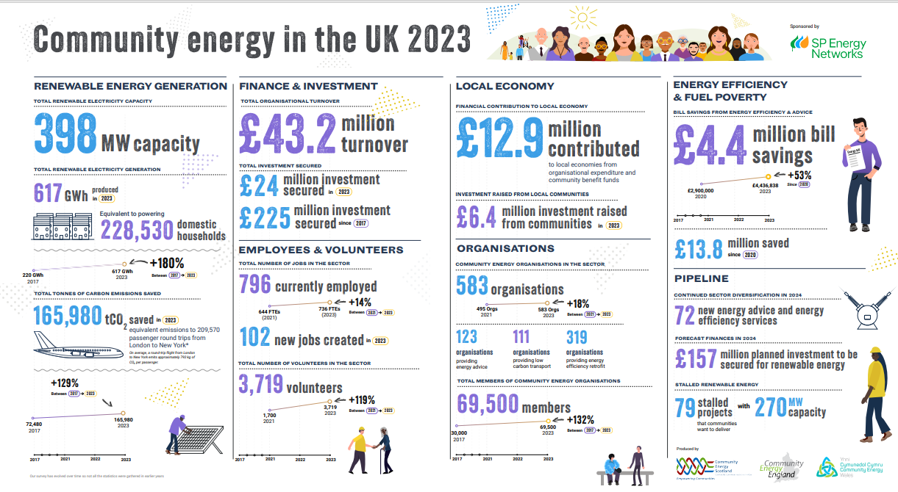
CEE State of the Sector Report 2023

Slide 5
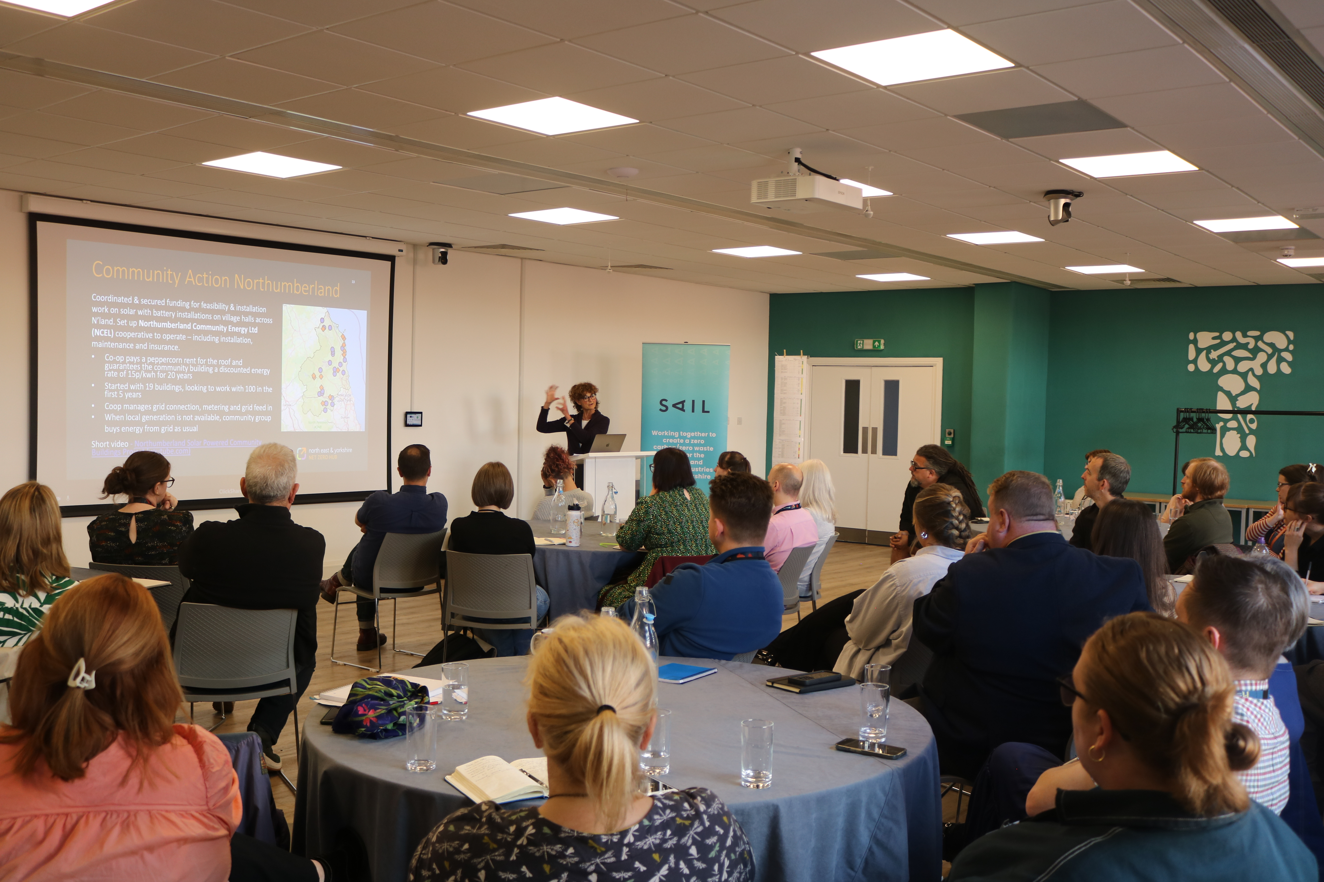
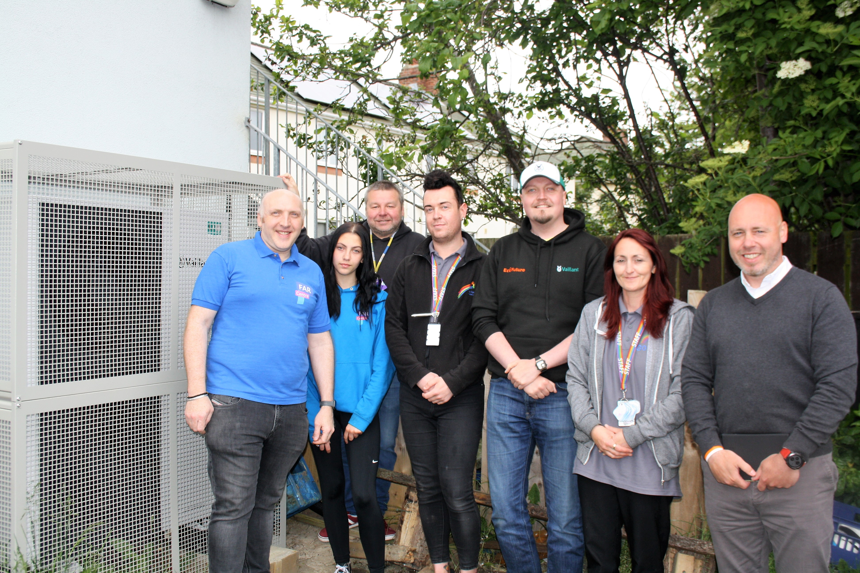
How has the Hub Supported the Decarbonisation of Community Buildings?
Funding
  Energy Project Enabling Fund (Development and Delivery)
  School Solar Enabling Fund (Delivery)
  Rural Community Energy Fund (Development)
  Community Energy Fund (Development)
Upskilling/Capacity Building
  Carbon Literacy Training
  Workshops
  Steering Group for shared knowledge and best practice
Opportunities
  Subsidised Energy Audits
  Signposting and support

Slide 6
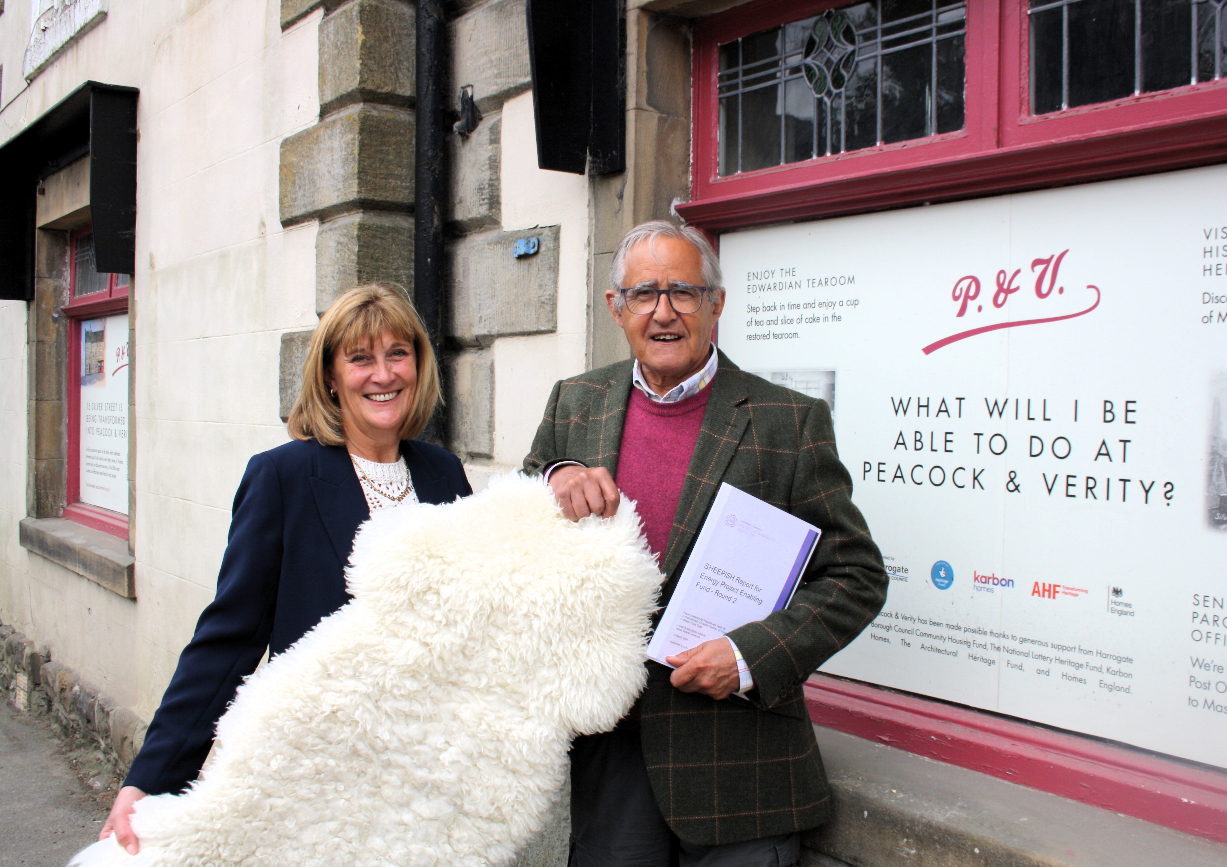
P&V Sheepish – Fabric First
Delivered by Peacock and Verity
Development project exploring the feasibility of using sheep wool as building insulation.
The project also aims to get wool insulation used across the country, with their building acting as a test site where contractors and builders can learn how to install sheep’s wool insulation.
Awarded £39,000
Expected to save 250 tonnes of carbon from their test site alone.

Slide 7
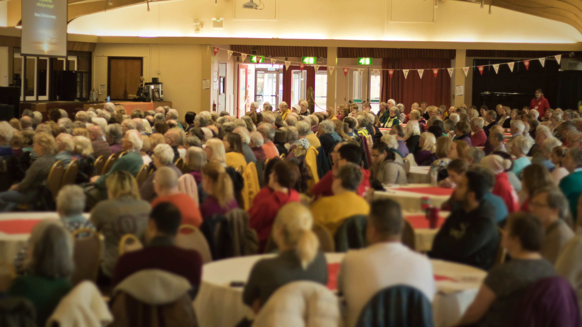
Pathways to Net Zero - Development
Delivered by the Yorkshire North and East District of the Methodist Church
Awarded £50,000
Five churches having a ‘Pathway to Net Zero’ designed, specified and costed, and now, subject to planning approvals, are investment ready.
Explored the possibility of solar, battery storage, ASHP, and fabric measures.
46t CO2e savings projected per annum – subject to planning approvals and implementation.

Slide 8
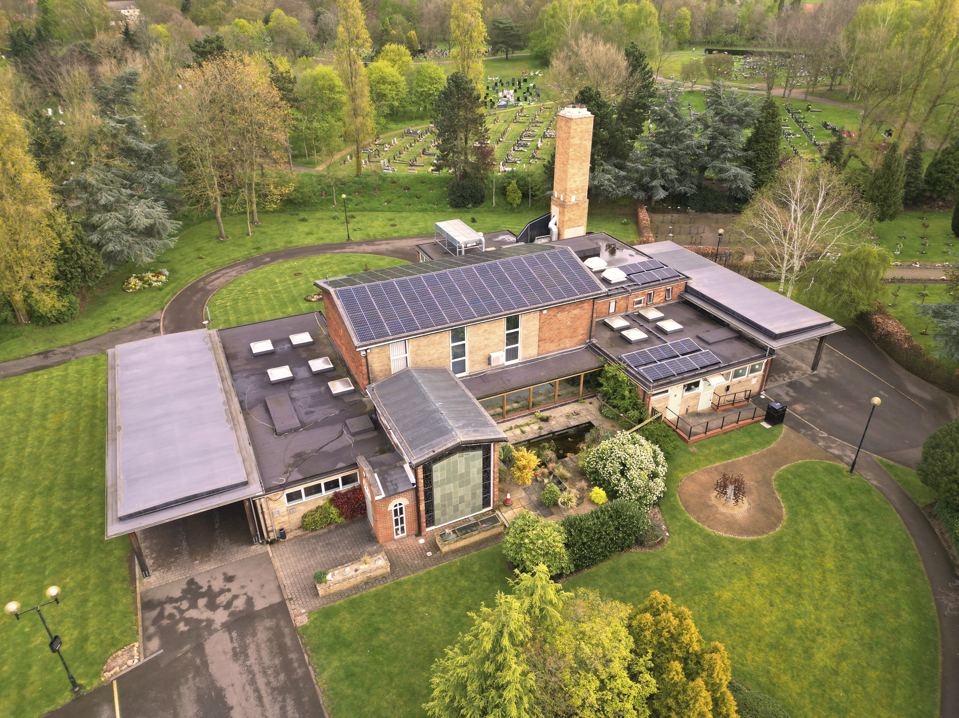
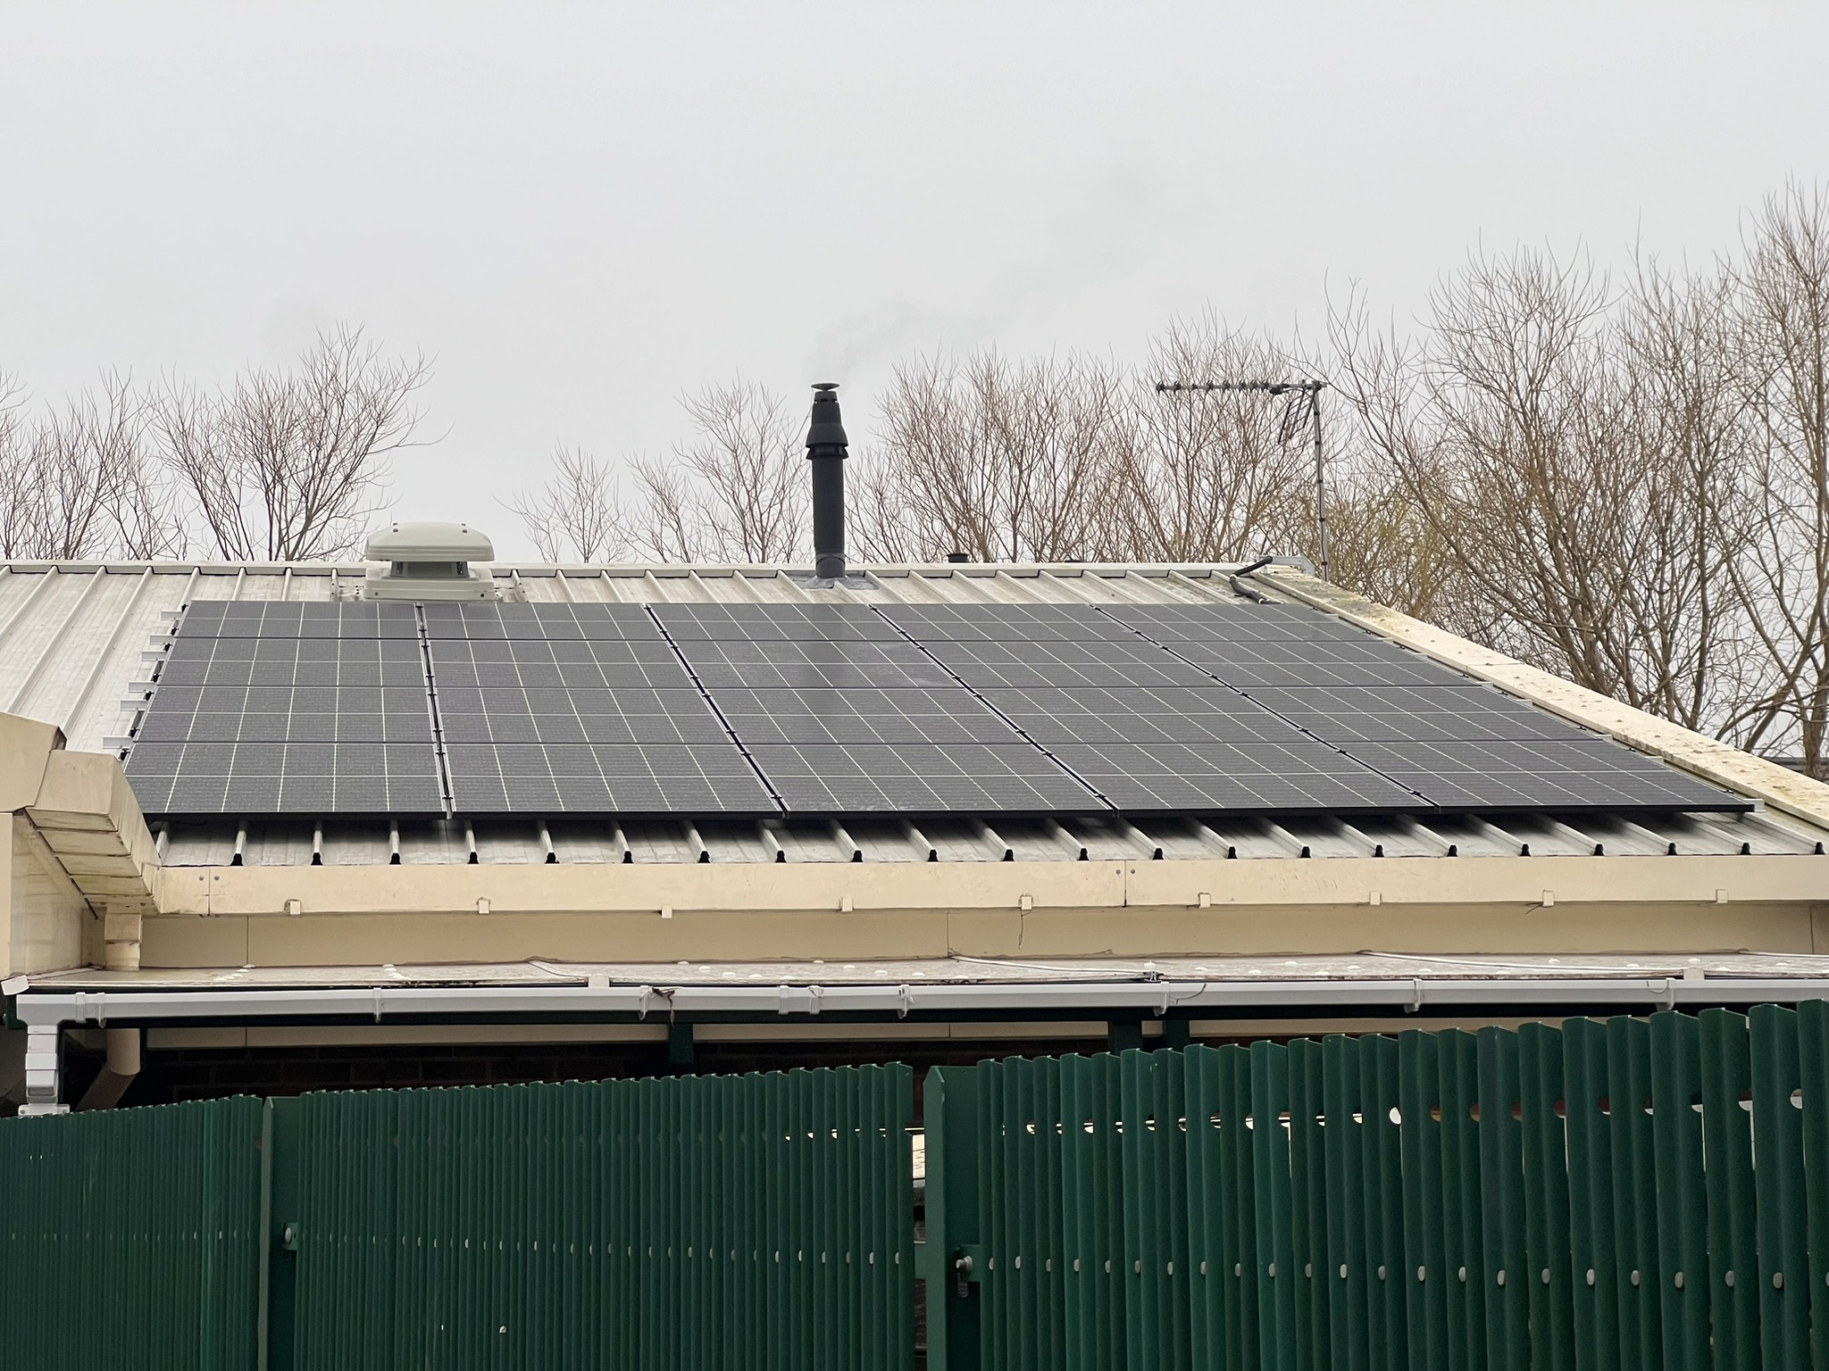
Decarbonising Doncaster - Delivery
Delivered by City of Doncaster Council
Local Authority led project, aiming to decarbonise their community buildings.
Solar panels installed on local crematorium and community hub.
Awarded £54,801
Expected to save 10.2 tonnes of carbon per annum across both sites.

Slide 9
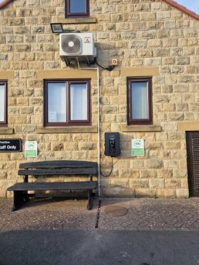
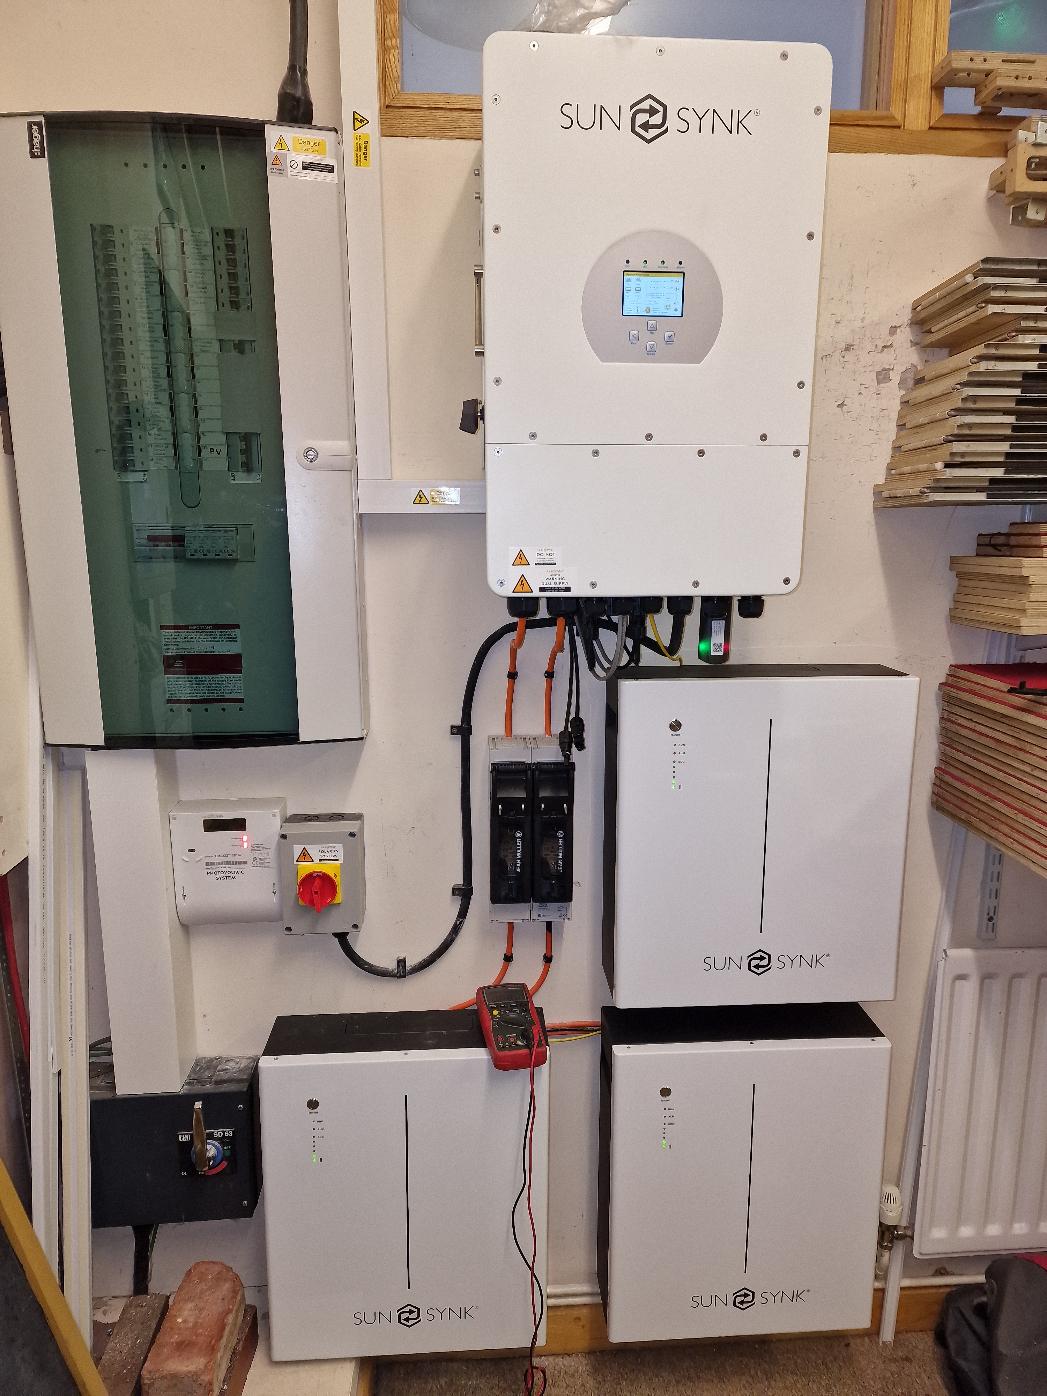
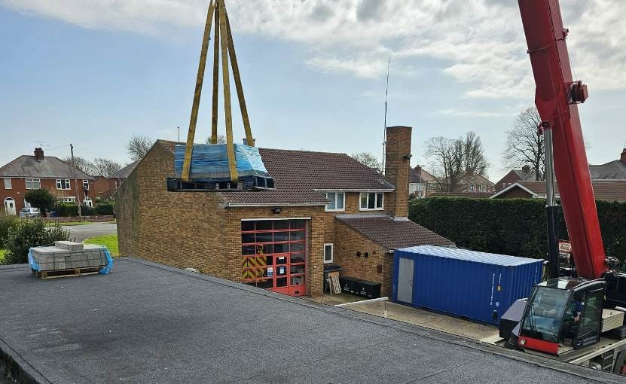
Where can you start?
Capacity Building:
  Video Case Studies
  Community Energy Surgeries
  Community Energy Workshops
Community Energy England
  10 step starter guide
  Members Forum
Speaking to other Groups
Contact your Local Authority
Net Zero Go – for LAs

Slide 10
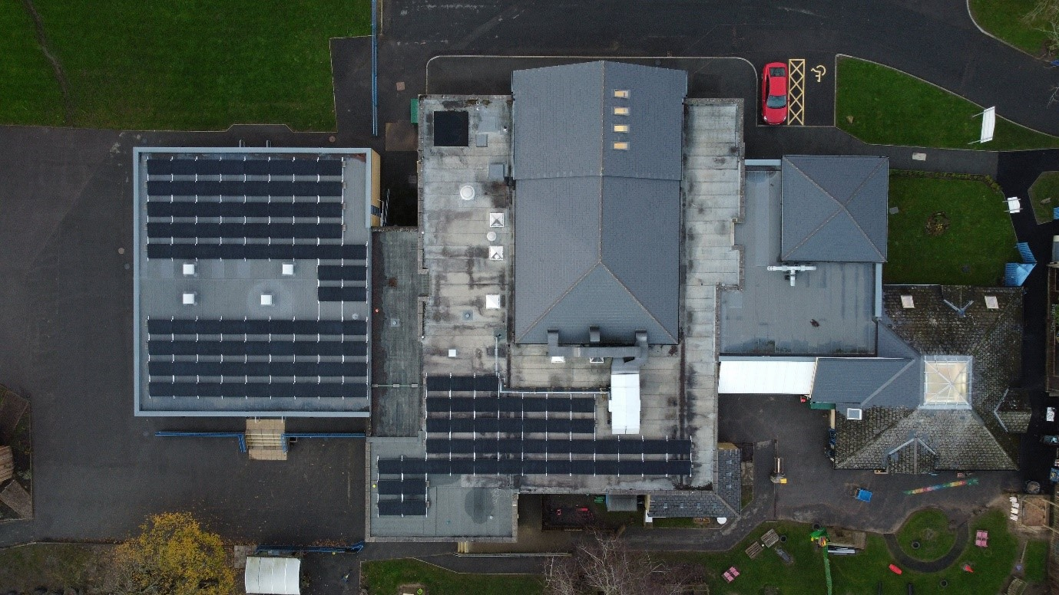
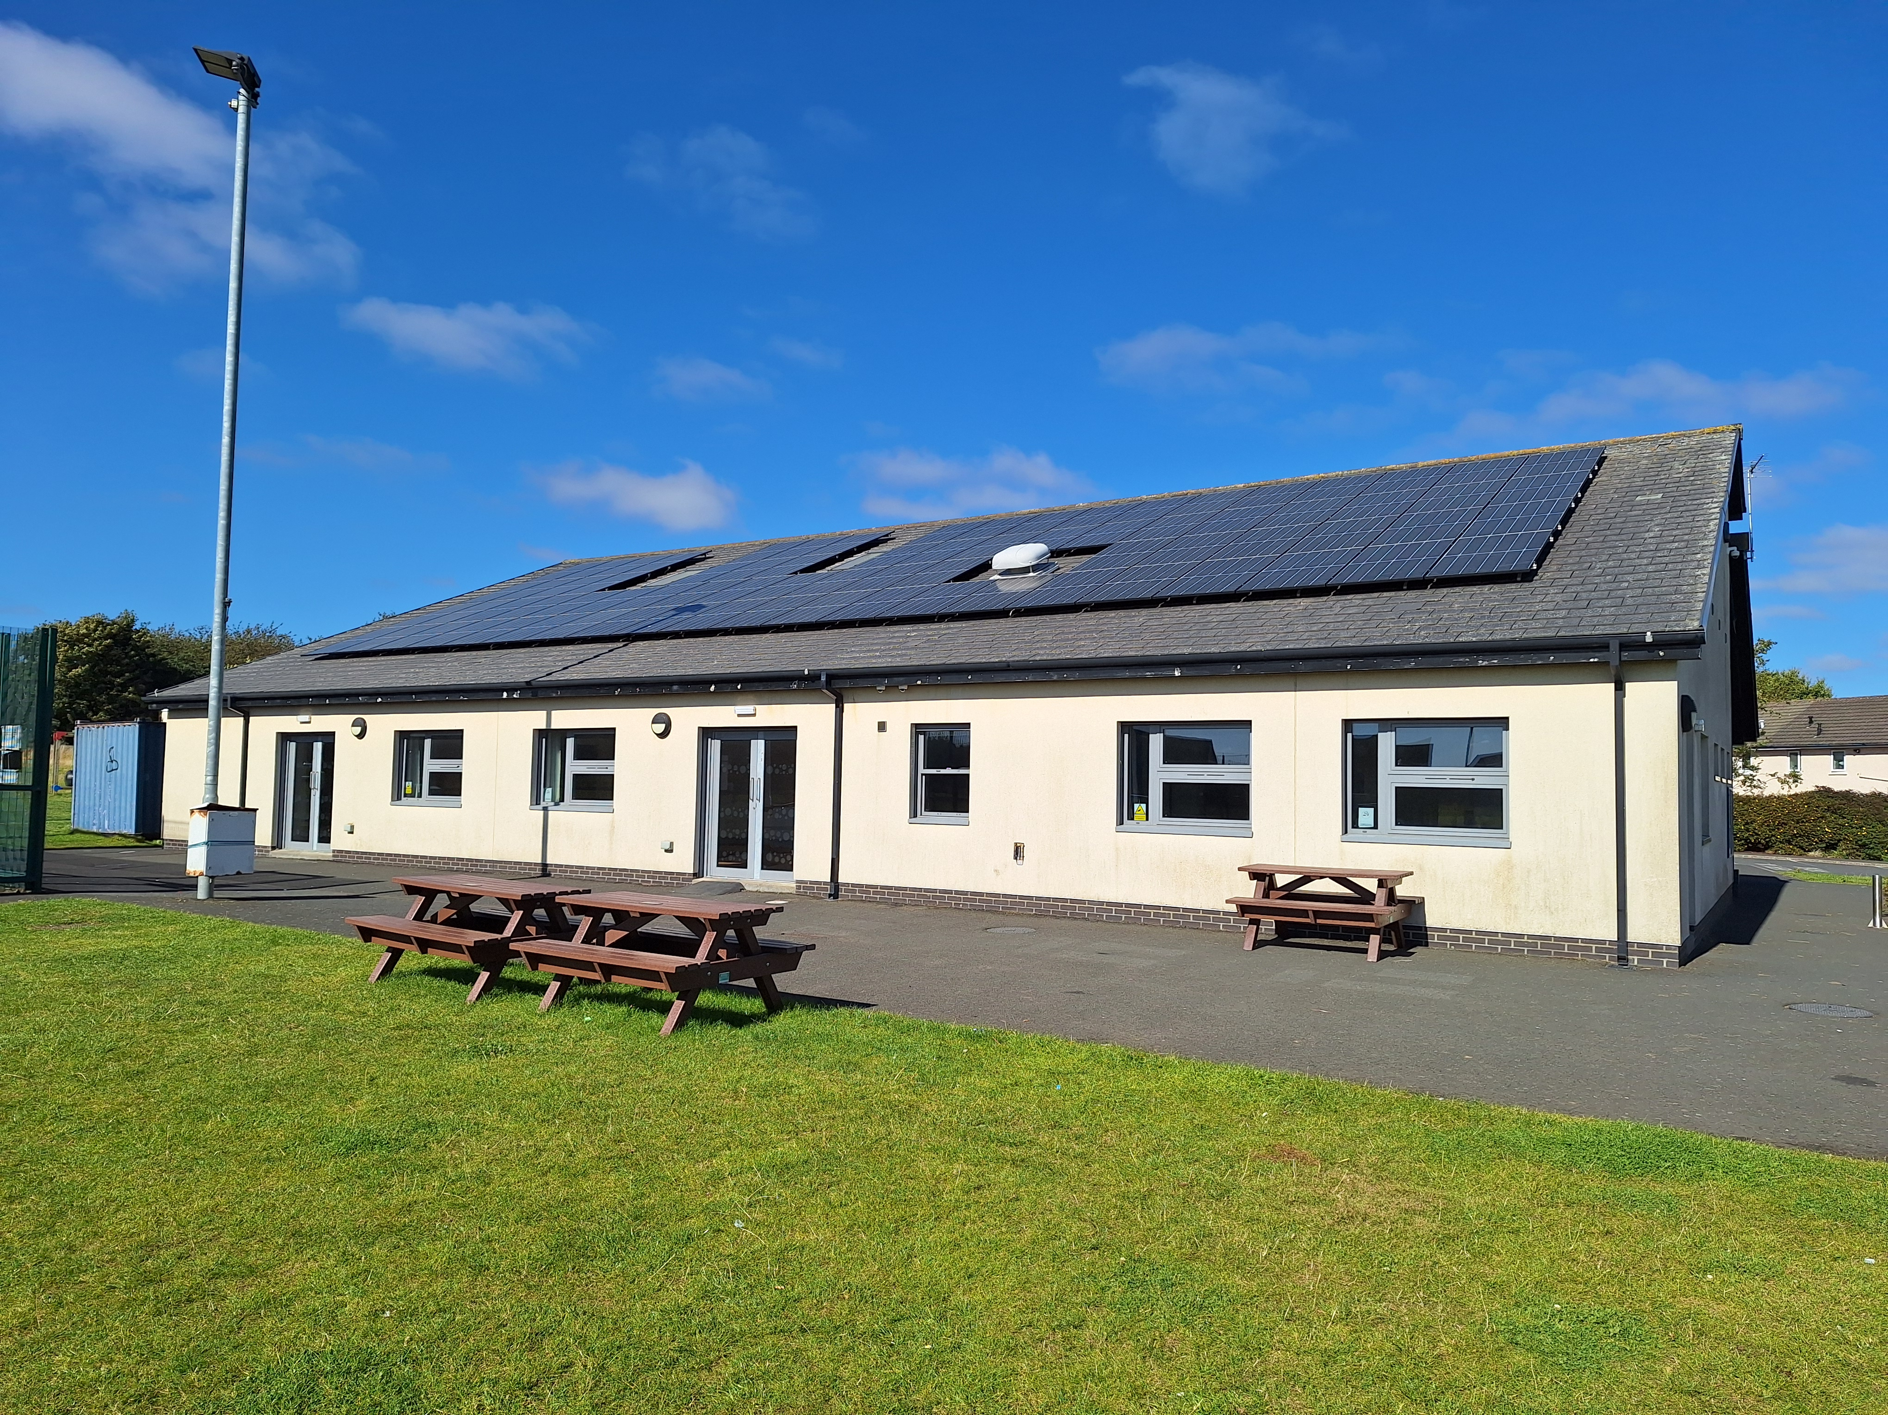
Energy Project Enabling Fund Round 3
NOW OPEN FOR APPLICATIONS
Capital grants of between £30,000 and £245,000.
All successful projects must be completed, by the end of September 2025.
match funding of a minimum of 50% of the overall project value, with at least 20% of this coming from commercial investment
Please read the guidance document in full before you apply. If you have any questions, please don’t hesitate to contact us at enquiries@NEYnetzerohub.com.
Please submit completed applications and supporting documents to enquiries@NEYnetzerohub.com by midnight on 8th December 2024.

Slide 11

Community Energy Team
Abbie Raynes
Net Zero Hub Project Manager and Community Energy Lead
Sue Manson
Community Energy Development Officer
Emma Dowson
Project Officer for Community Energy
All enquiries sent to the inbox will be passed on to one of the Community Energy Team who will respond ASAP.

Slide 12
Regional Support
Lizzie Lunn - (North Of Tyne)
Elizabeth.Lunn@northoftyne-ca.gov.uk
George Lee (South Yorkshire) ​
george.lee@southyorkshire-ca.gov.uk
Karen Rossell (York and North Yorkshire)
Karen.Rossell@yorknorthyorks-ca.gov.uk
Harry Baross (Hull and East Riding)
h.baross@heylep.com
Femi Omoniyi (West Yorkshire) Oluwafemi.Omoniyi@westyorks-ca.gov.uk
We are currently recruiting for our Tees Valley based Project Manager
Please contact enquiries@NEYnetzerohub.com
If you’re within the TV region

Slide 13
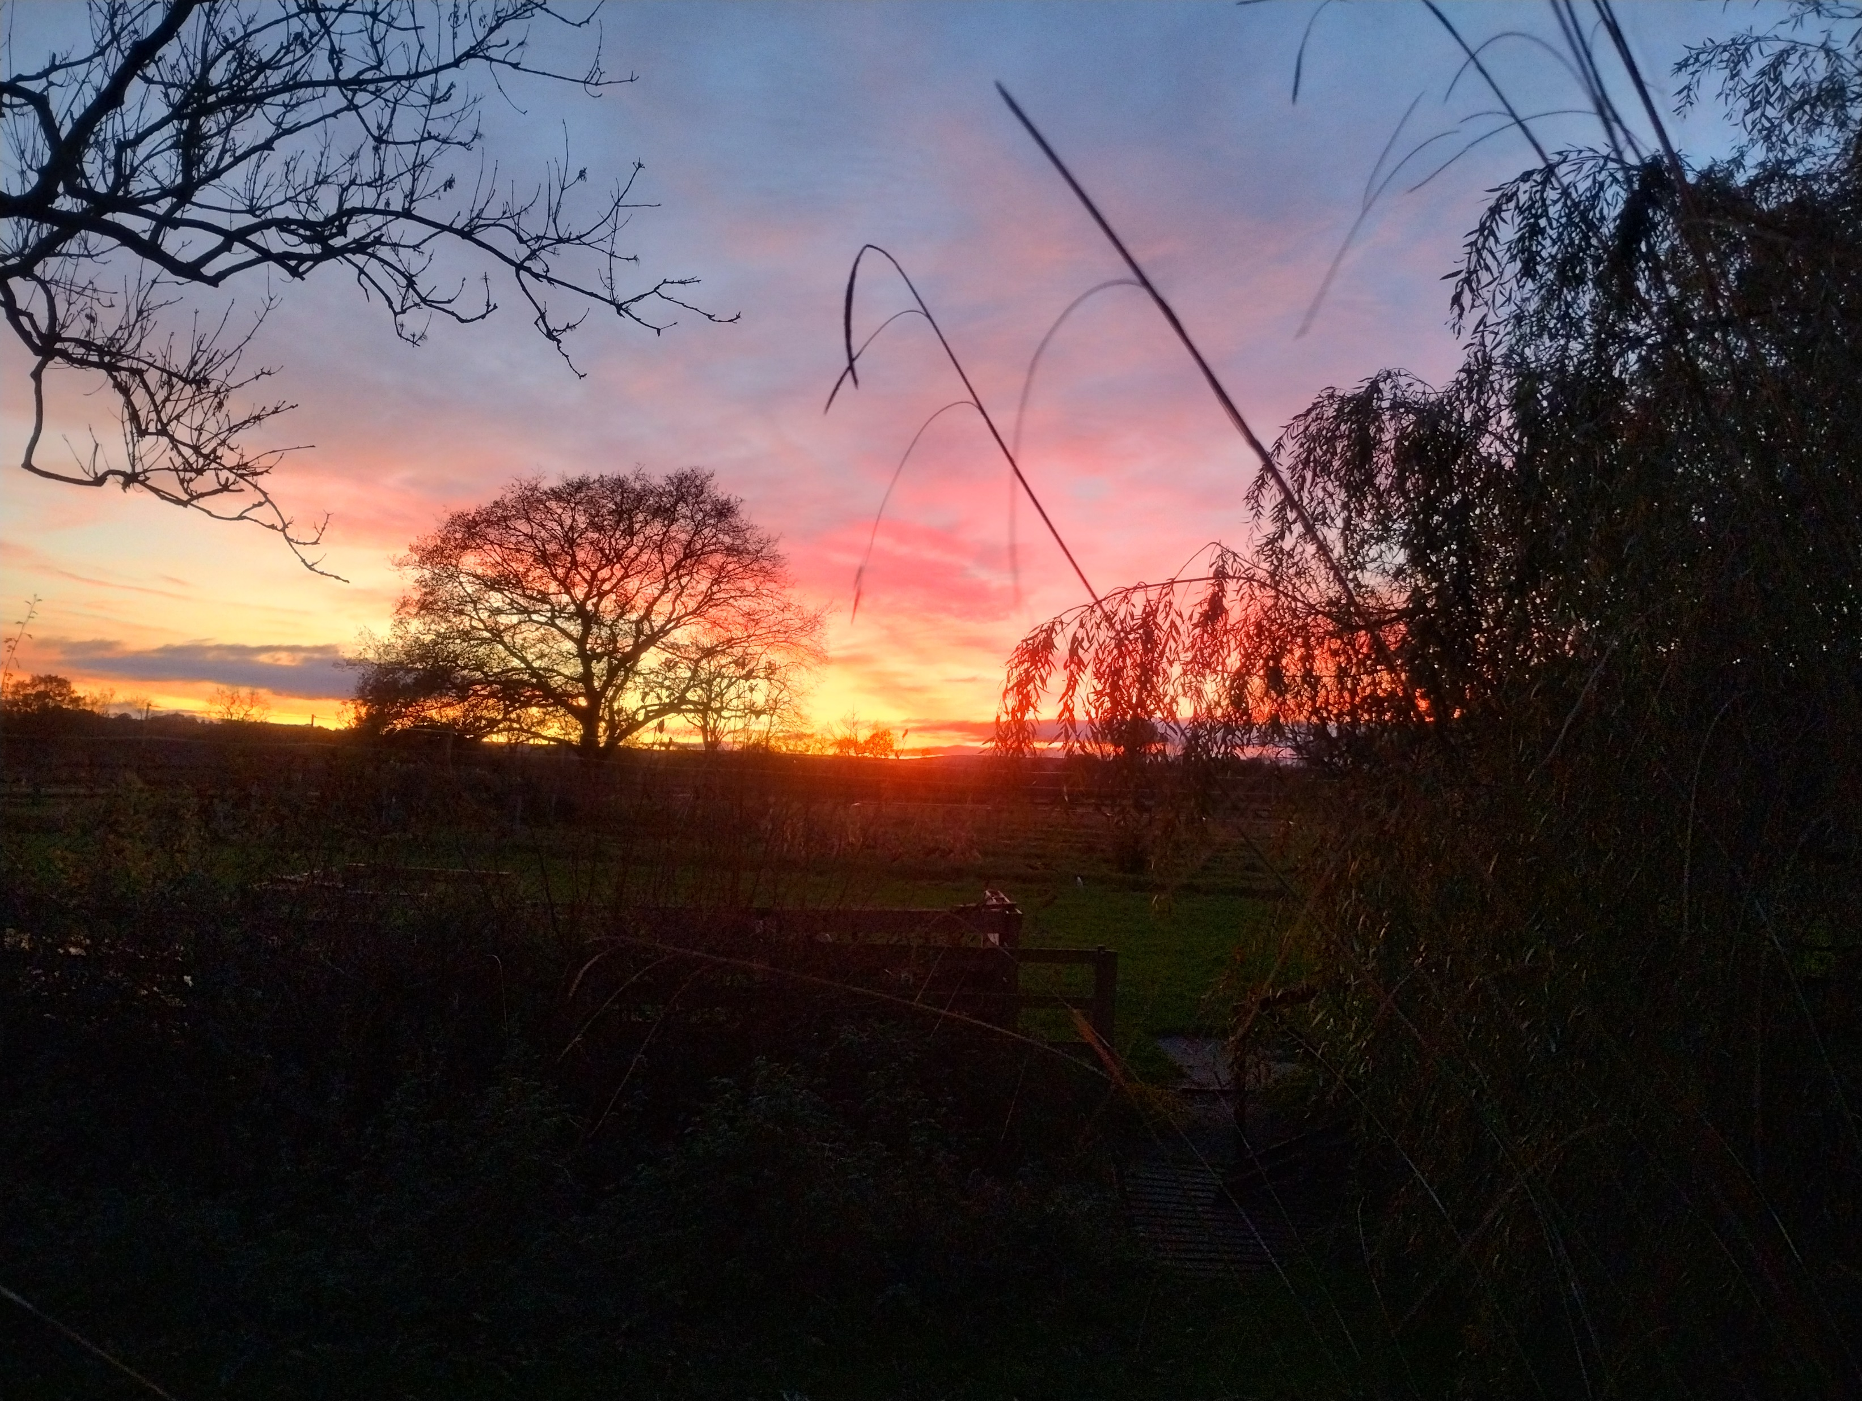

NEY Net Zero Hub Summit 2024
Delivering & Financing Building Decarbonisation

Slide 14
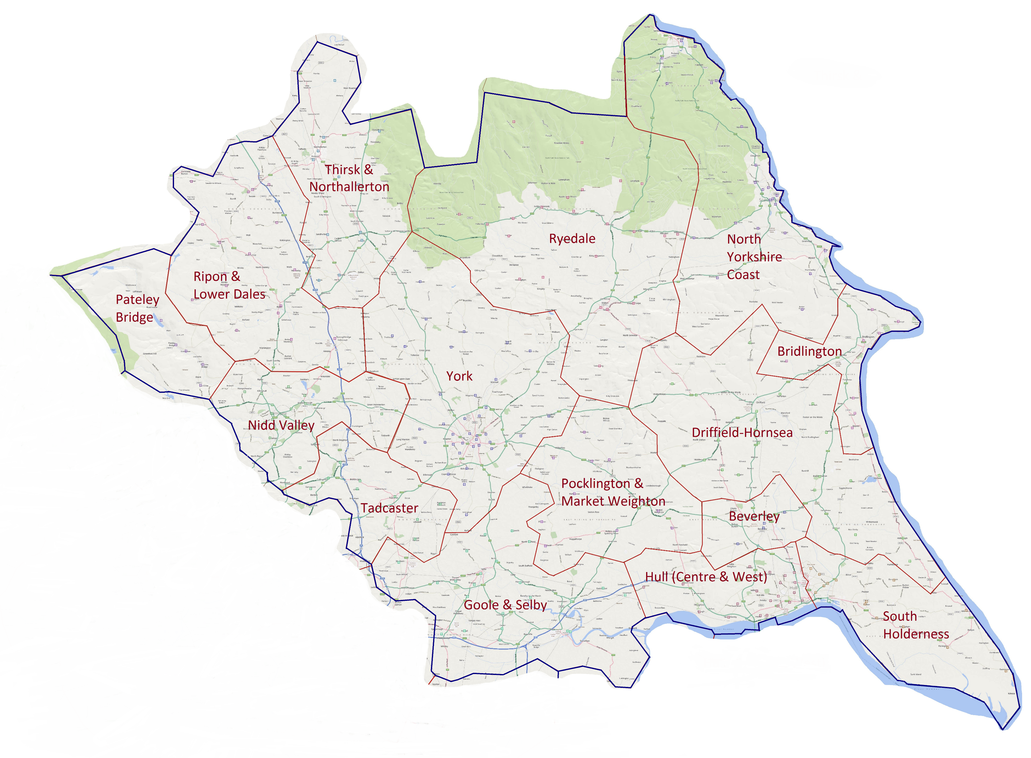
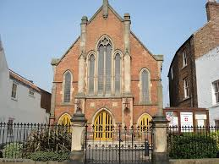


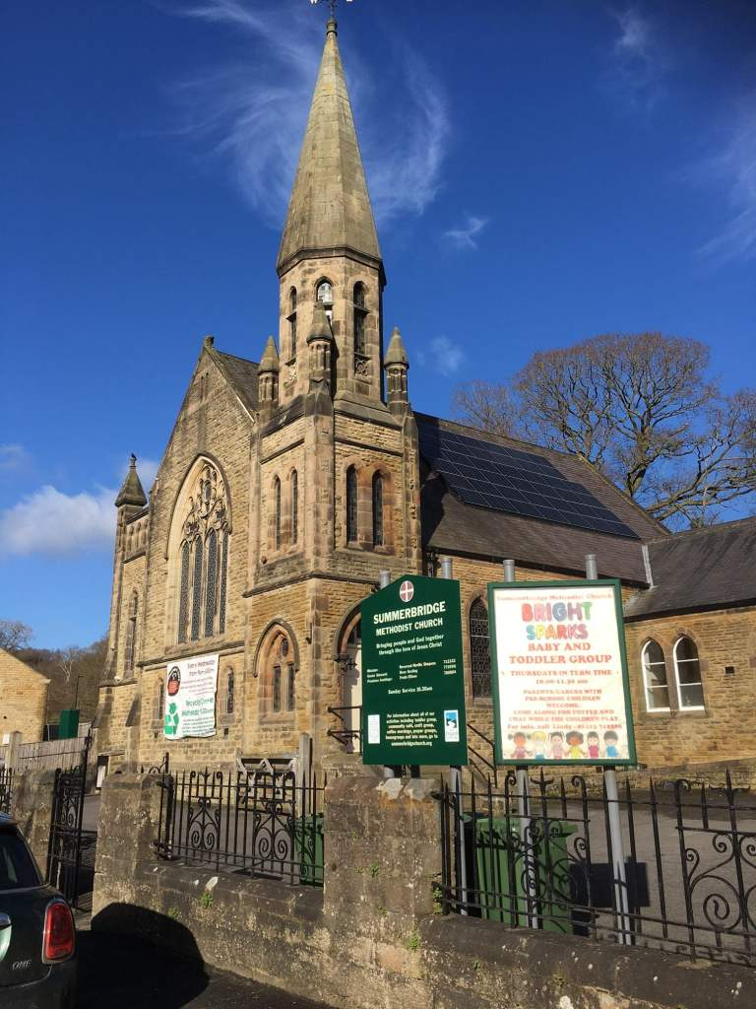
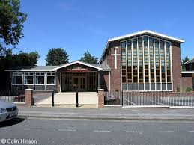
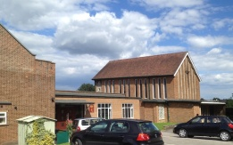
Summerbridge
6.029 MWh
Significant Net Zero Project
Net Zero Near You
Northallerton
8.174 MWh
Woodlands
9.202 MWh
Willerby
4.835 MWh
North and East Yorkshire
Methodist District

Slide 15



Managing Funding and
Delivery Capacity
Group Projects
Project Management
Funding Enabler

